Slide 1
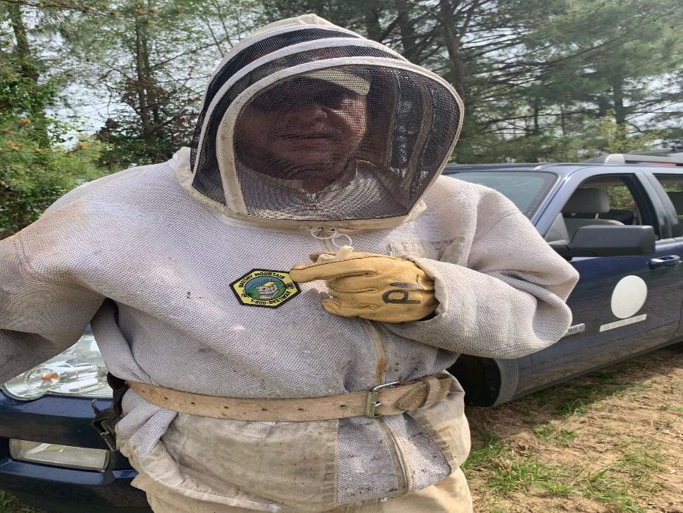
Paul – The Bee Keeper
While Paul was living at Western State Hospital, he met a couple, Valerie and Kent Williams. Valerie and Kent would come in and played music at the hospital. Once he moved out and into a staff residence, they stayed in touch and Paul started spending several weekends at a time at their home. Finally, the director of the staff residence shared with Kent and Valeria that it was getting harder and harder for Paul to come back to staffed residence. After each visit, Paul would become very upset. The director acknowledged that Kent and Valeria were spending money when Paul would come to stay and asked, if they would like to get paid for some of their expenses. Kent and Valerie already felt a connection with Paul, but they had no idea this was an option. The move to Valeria and Kent’s occurred almost 17 years ago and that’s when Paul’s good life really began.

Slide 2
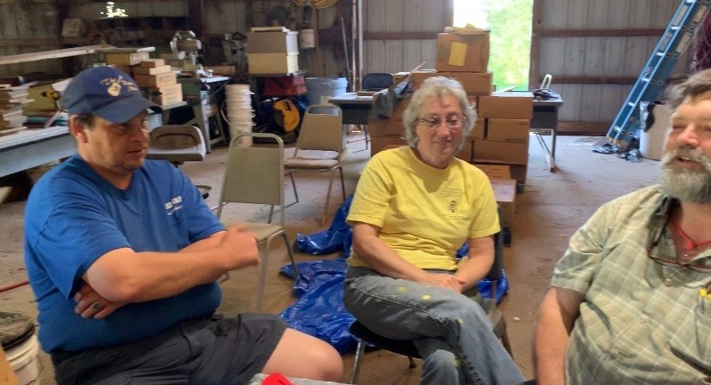
Paul
Paul started going with them to bee conferences
all over the world. Finally, curiosity got the best
of Paul and wanted to learn the process. Paul
now has hives of his own.
Valerie and Kent helped Paul reconnect
with his father and his father ended up
moving closer to Paul. As they spent time
together, Paul was able to reconnect with
his extended family. He now sees them on a
regular basis. Unfortunately, Paul’s father
passed a few years ago, but he is grateful for the time he had with him.

Slide 3
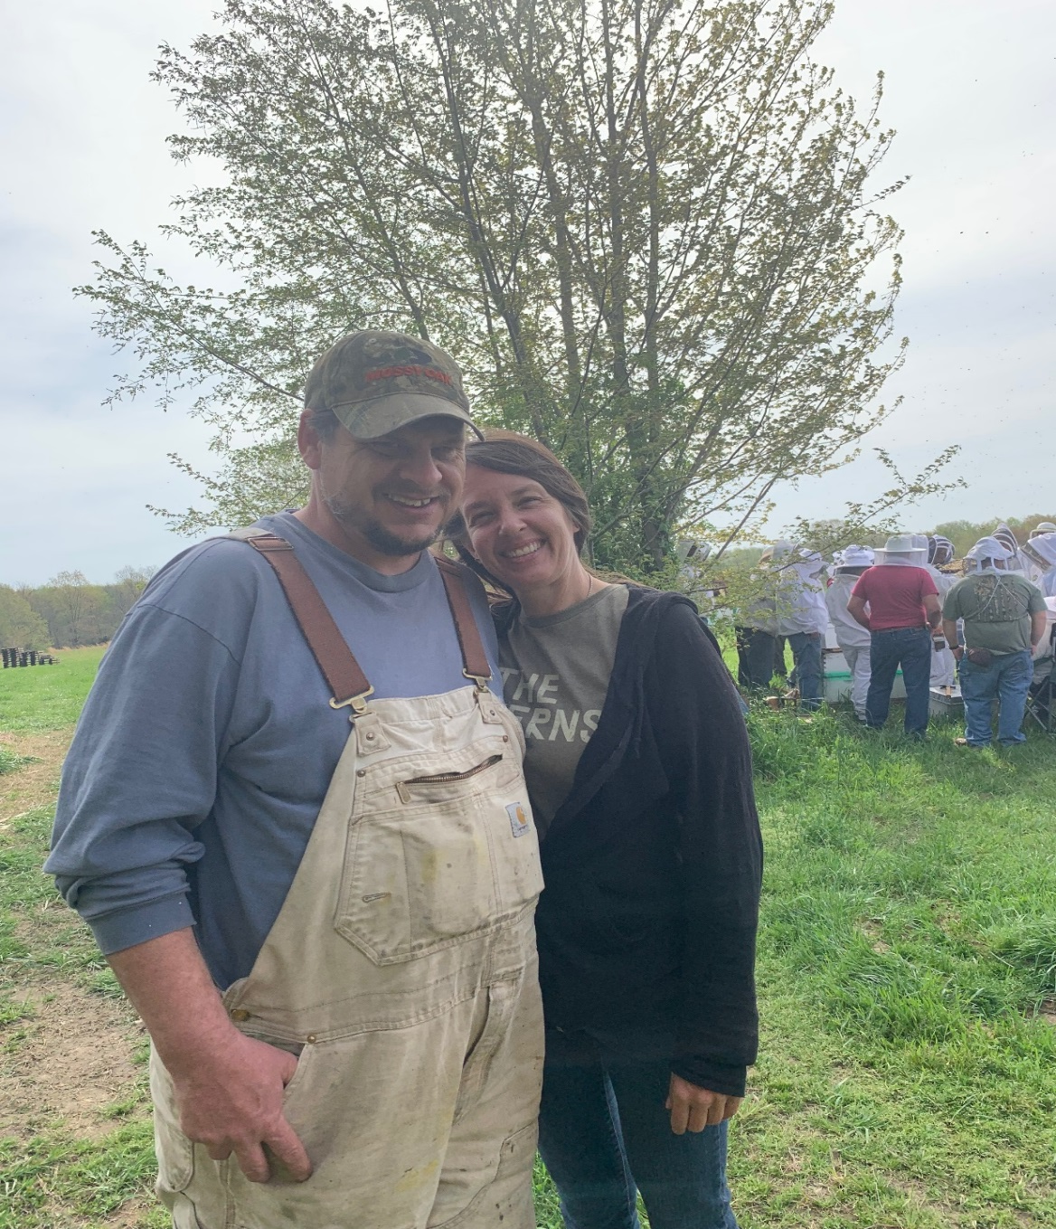
Paul
Paul has friends in many states that he stays
in touch with… some on a weekly basis.
Recently, Paul’s cell phone was out of
commission and as a result, Kent’s
phone was ringing off the hook with
people wondering, if Paul was okay.
Paul also has a neighbor, Tony, that he
helps out a lot with his animals.
Tony bought Paul his sheep and Paul will
take care of it and sell the babies.

Slide 4
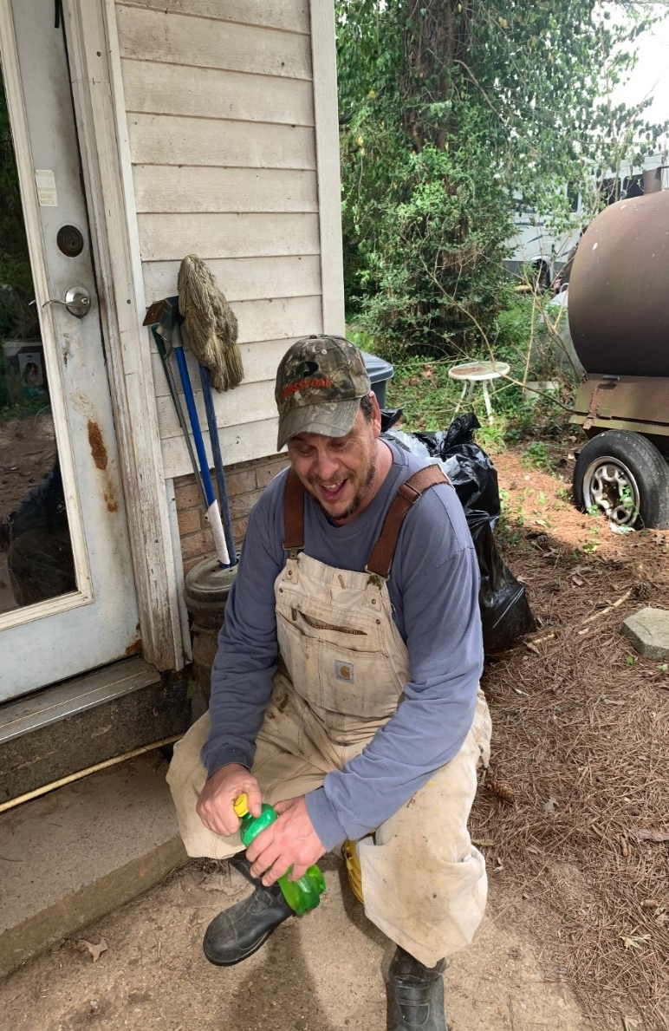
Paul joined a bowling league that Kent was a member of
several years ago, but with the beekeeping business getting
so busy, Kent had to drop out. Paul is actively involved in the
beekeeping business but still continues to bowl every Monday night.
Paul is a member of Calvary Methodist Church and is involved with
Chrysalis, Walk to Emmaus, and Kairos (prison ministry)

Slide 5
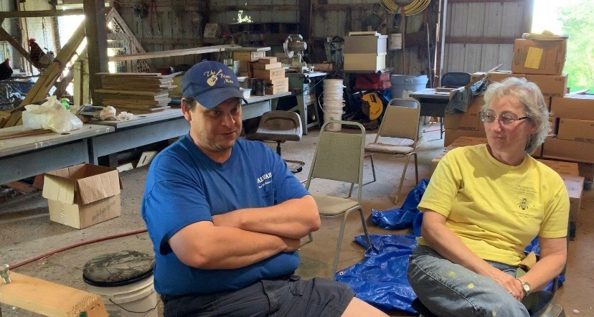
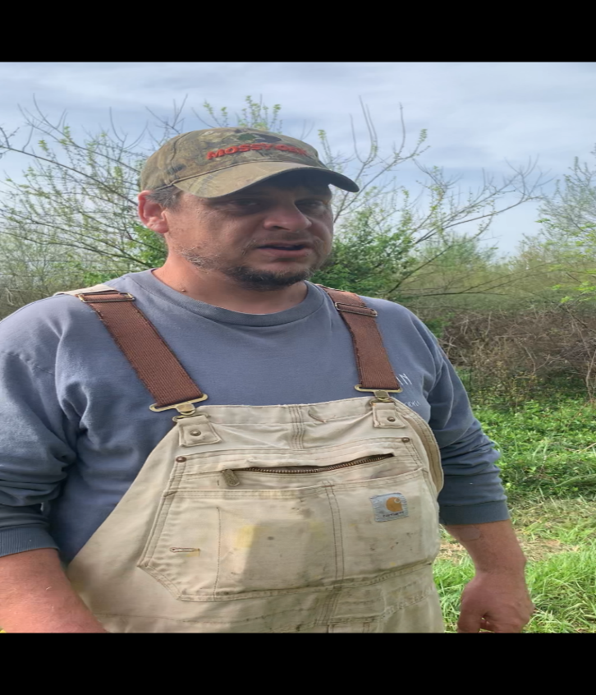
Paul was diagnosed with Stage 4 colon cancer 2 years ago. Paul shared with
tears in his eyes, how grateful he was for Valerie and Kent taking care of him.
The Williams said they never thought anything other than he was part of their
family and that’s what you do! The scans that Paul has gotten so far have been clear!
Now, Paul receives Adult Foster Care (AFC) services from Cumberland River Homes and case management from Superior Case Management.

Slide 6
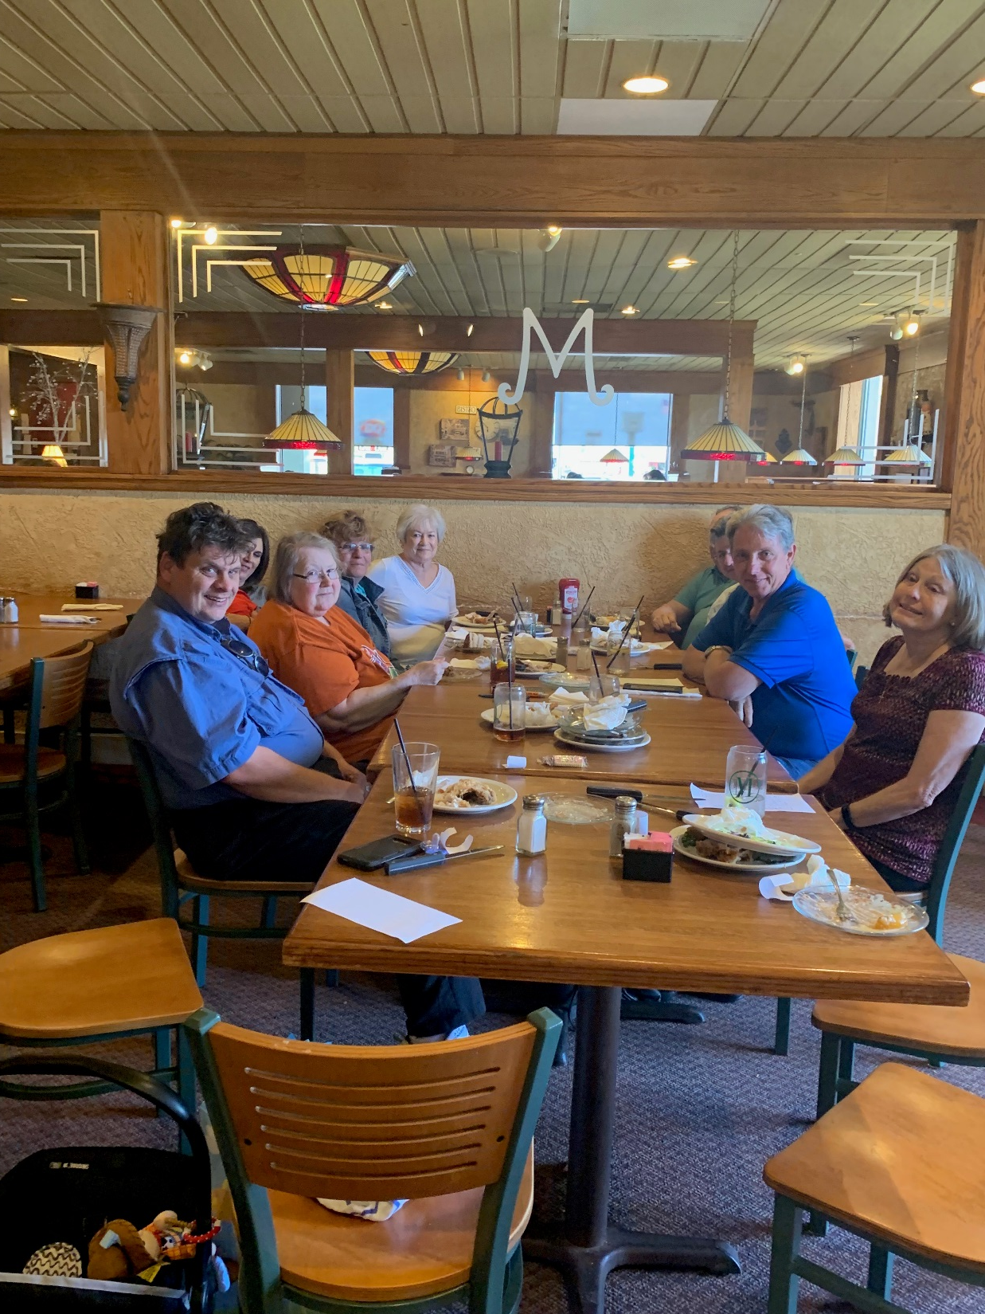
Paul recently reconnected with some of his staff from 20 years ago. He was so excited to show how far he had come and what all he is involved in
Notes:
Think Spot
Paul’s life evidences the move from a Service Life to a Community Life. His life also exemplifies the five valued life experiences – sharing ordinary places, belonging, choice, contribution and valued social roles. What do you see as the major reasons why he is now able to live such a good life?

