Slide 1

Trauma- and development-informed approach to NAS and DCBS services
W. David Lohr, MD, DFAPA, DFAACAP
Professor, Division of Child Psychiatry and Pediatric Psychology
Department of Pediatrics
University of Louisville School of Medicine
Medical Director DCBS, Kentucky CHFS

Slide 2
Disclosures
I have received grant funding from State-University Partnership (CHFS DMS, Norton Healthcare)

Slide 3
Objectives
1. Participants will identify key principles of NAS and drug exposure in children
2. Participants will understand the role of ACES and how trauma-informed practices can provide best practices of care
3. Participants will identify services available through DCBS for families affected by substance use disorder and their children.

Slide 4
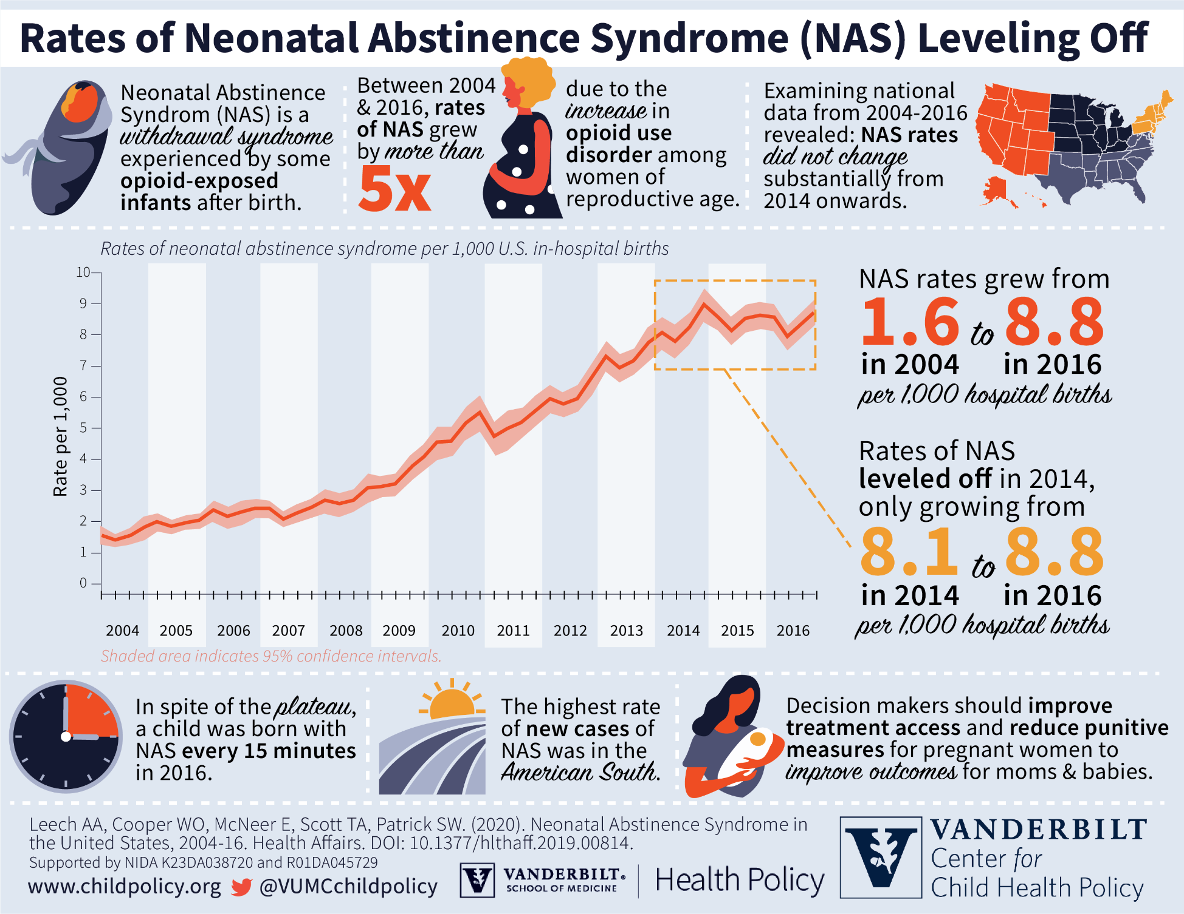
NOWS and NAS

Slide 5
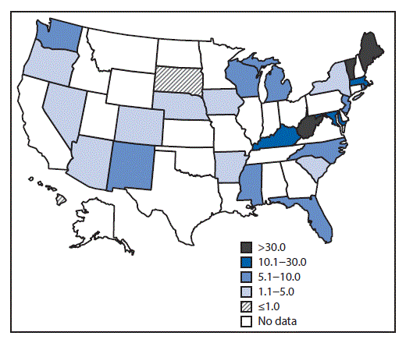
Incidence of NAS – 28 states, 1999 - 2013
https://www.cdc.gov/mmwr/volumes/65/wr/mm6531a2.htm

Slide 6
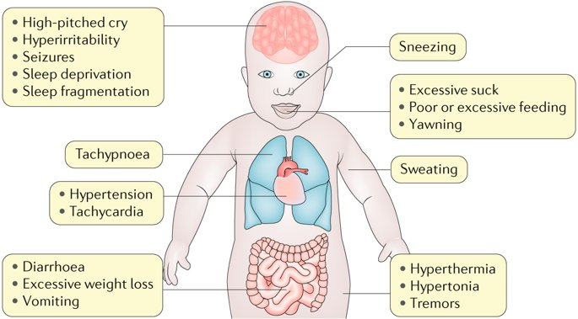
Symptoms of NOWS
https://twitter.com/diseaseprimers/status/1066311218976227330?lang=hu

Slide 7
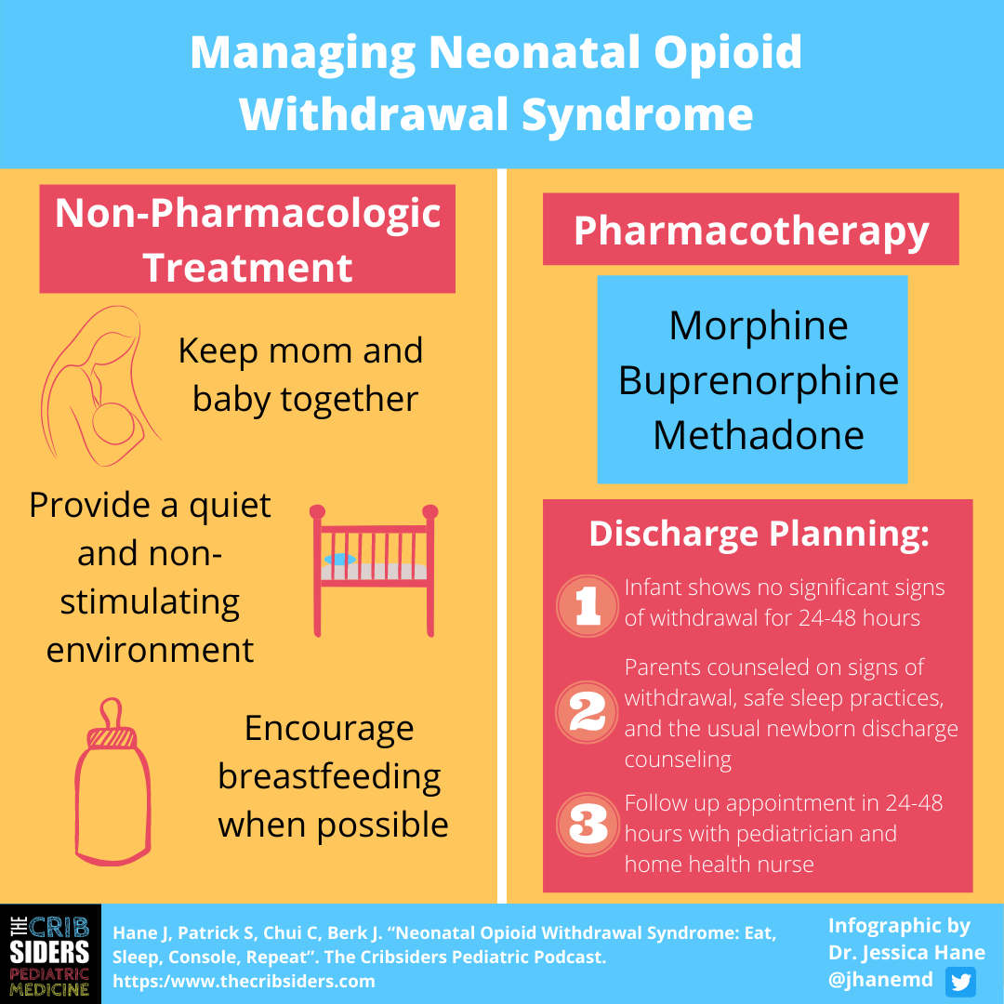

Slide 8
Neural Circuits are Wired in a
Bottom-Up Sequence
(700 synapses formed per second in the early years)
Language
Higher Cognitive Function
Sensory Pathways
(Vision, Hearing)
FIRST FIVE YEARS
1 2 3 4 5 6 7 8 9 10 11 1 2 3 4 5 6 7 8 9 10 11 12 13 14 15 16 17 18 19
Months
Years
Source: C.A. Nelson (2000)
Notes:
8
Brain is not mature at birth
Critical windows imply timing is important
Brain is changed by experiences

Slide 9

Life Course Health Development
Critical Period of Brain Development
Birth – 2 years; critical window for hardwiring the brain for social-emotional development.
Social-Emotional development is based on secure attachment and becomes the foundation for cognitive development and sense of self-identity.
Attachment comes from a nurturing relationship with a caregiver that is consistent and caring.
Notes:
1.Attentive and nurturing parenting provides a buffer to amygdala dysfunction a/w ACES
2. Attachment allows child to see the world as a safe, predictable place

Slide 10





Skills beget skills
the “Serve and Return” Nature of Human Interaction shapes the Brain and Creates SKILL development
Skills build on what happened earlier
Notes:
1. Practice makes perfect “Do it again”
2. early parental care, brain development, and behavior interact to scaffold the maturation of emotion regulation circuitry.

Slide 11
NOWS and development
Infancy – altered arousal and motivation, visual delays
Childhood – delays in learning and executive function
Adolescence – delays in impulse control and reward processing (drug use), emotional dysregulation
Morie et al., Drug and Alcohol Dependence, 2019

Slide 12
Long term outcomes of NAS
Poor school performance
Increased drug use
Increased injuries
Future child maltreatment
Increased mental health diagnoses
Rees et al., J Pediatrics, 2020

Slide 13
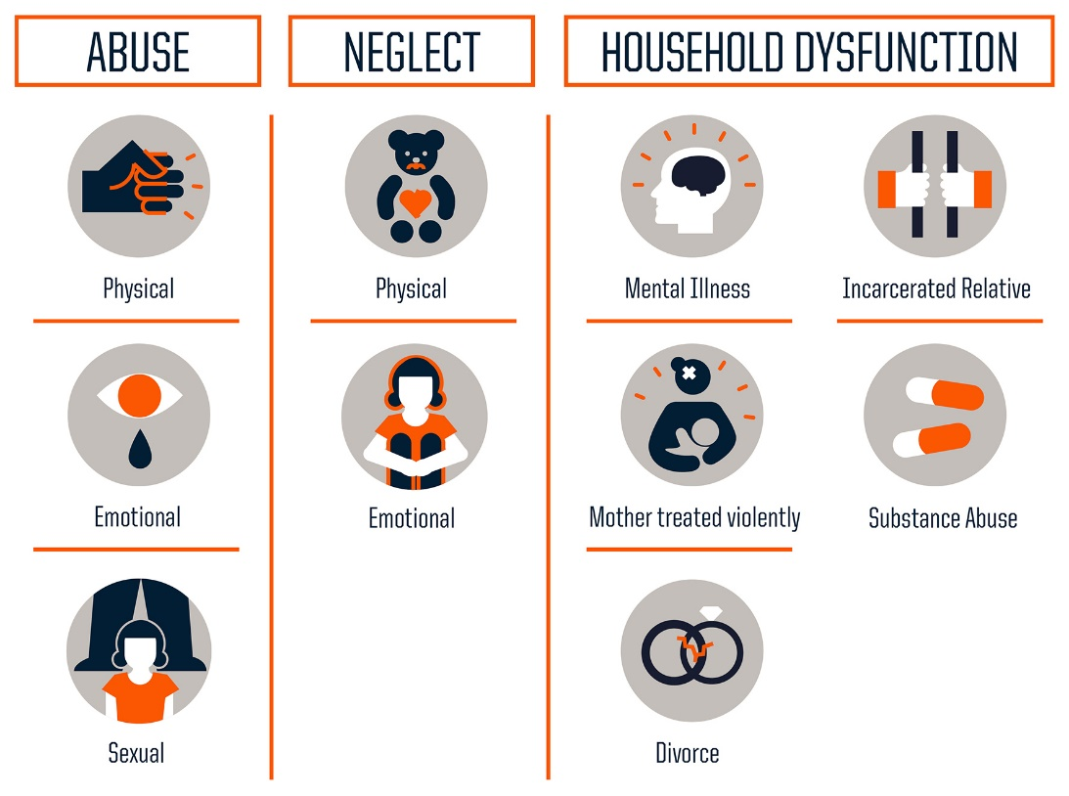
Three types of ACES:
Notes:
ACES – MDs began to wonder why certain patients receive the same care but don’t have the same outcome
Original study 1997 Kaiser Permante 17,000 patients
”Resilience”

Slide 14
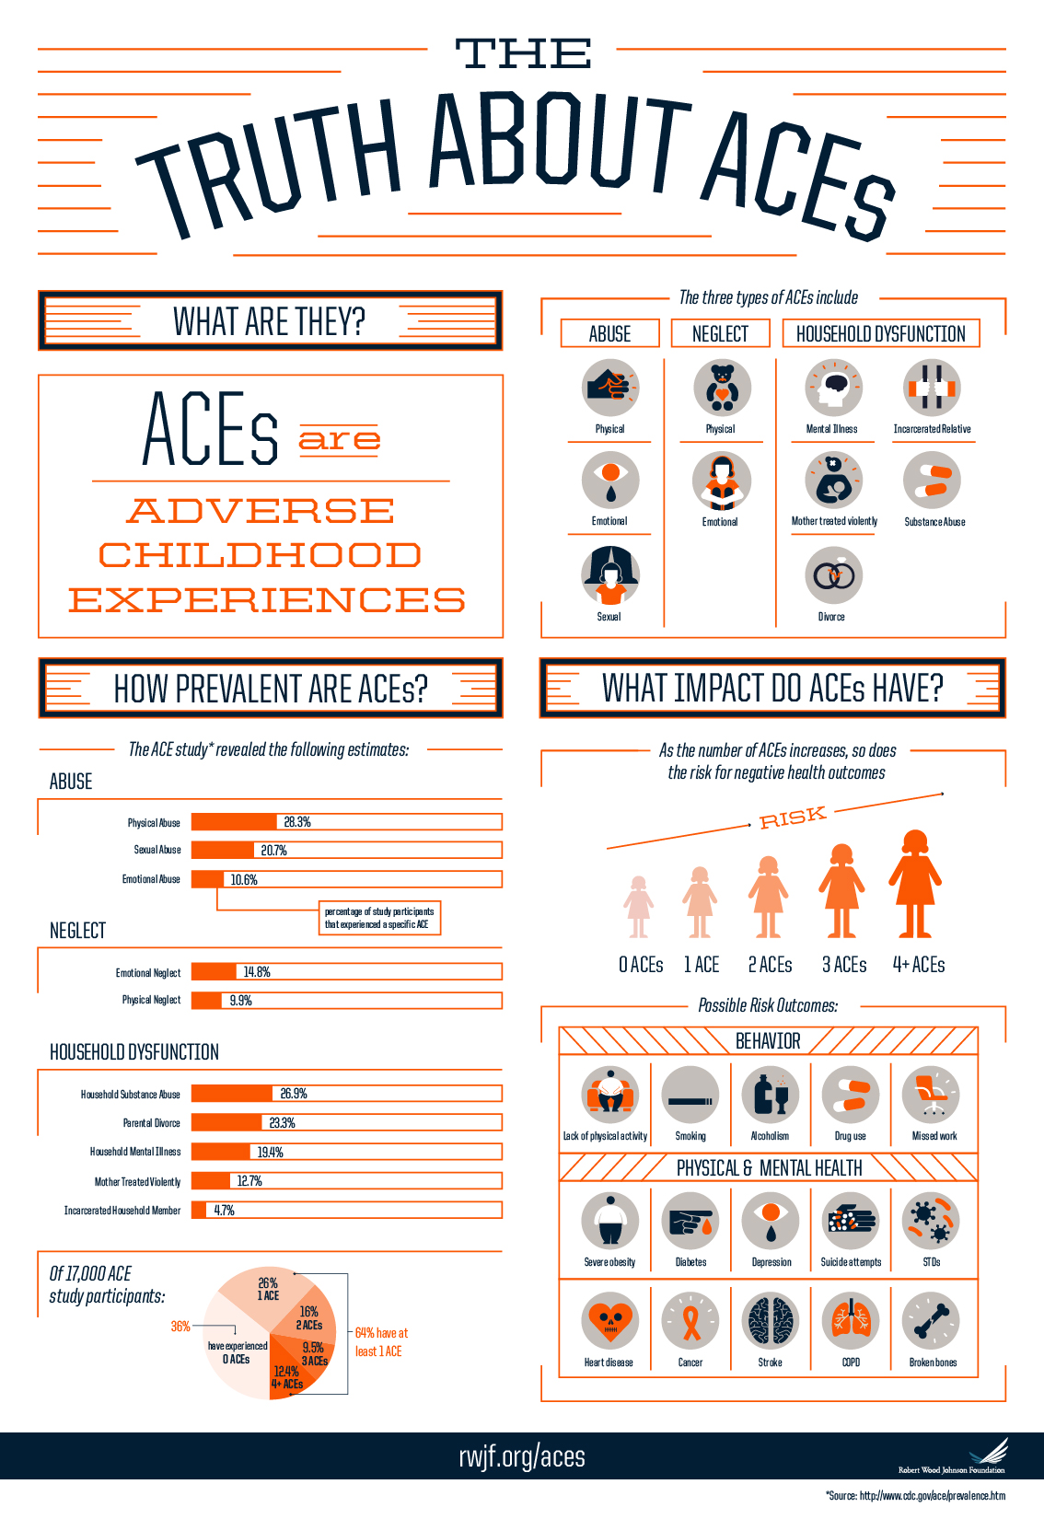
Notes:
How common are they?
Why are they important?

Slide 15
DNA methylation and adversity
Vaiserman and Koliada, Human Genomics, 2017.
Notes:
1. Prenatal stress can lead to epigenetic changes of protein production and adult outcomes

Slide 16
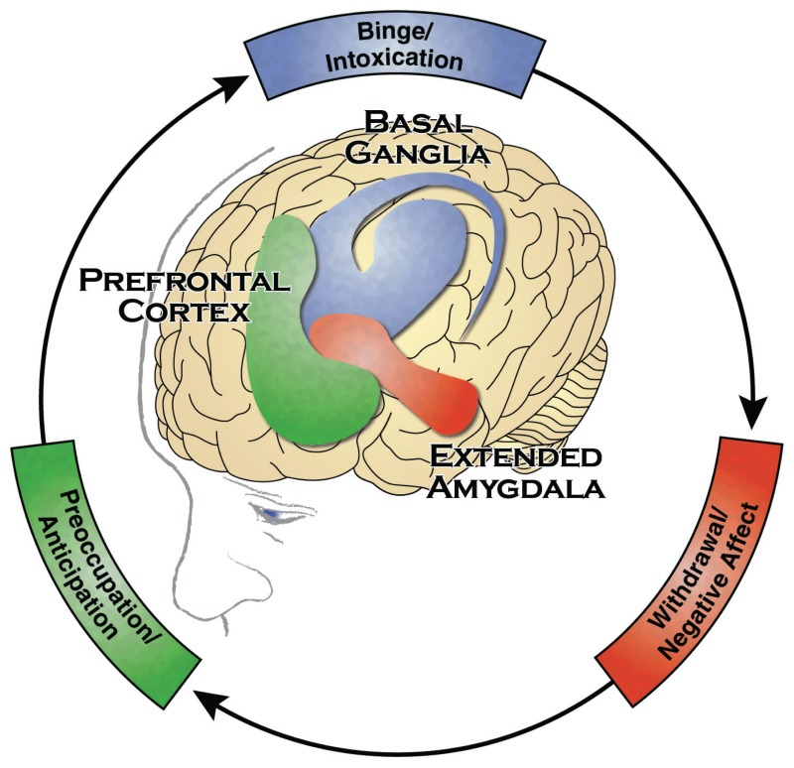
3 stages of addiction and associated neural circuits: what is the effect of ACES?
SAMHSA, 2016
Notes:
ACES effect on brain and body stress systems impact each stage of addiction
Altered set points and dysregulated reactions to Intoxication, withdrawal, and anticipation

Slide 17
States with Criminal Justice-Focused Substance Use Policies have lower rates of parental reunification
Sanmartin et al., JAMA Pediatrics, 202
Notes:
1. Given the child welfare system’s legal mandate to make every
effort toward parental reunification, a more comprehensive treatment and supportive policy
approach toward parental substance use might be warranted.
2. Specifically, non-Hispanic black children who live in a state that has adopted
criminal justice–oriented policies had a lower chance of reunification with a parent than
non-Hispanic white children who live in a state that has not adopted those policies (HR, 0.87;
95%CI, 0.81-0.94).

Slide 18
NAS as a “cascade of care”
Qualitative study of service needs and barriers in NAS
Stages
  Prevention and Social Determinants of Health
  Prenatal care and Drug Treatment
  Delivery
  aftercare
Syvertsen et al., Advances in Neonatal Care, 2018

Slide 19
Medication Assisted Treatment of Opioid abuse during pregnancy
Methadone or buprenorphine
  Greater retention (M) vs. lower NAS, decreased neonatal treatment, less need for morphine (B)
Breastfeeding
Pros
    Lower risk of NAS, less severe NAS
    More developed babies
    Reduced suicide risk
https://nida.nih.gov/publications/treating-opioid-use-disorder-during-pregnancy

Slide 22
Engaging mothers
Stigma and bias may lead to under reporting
HB 1 2018
    Expand the definition of child abuse to include a pregnant woman who abuses drugs and exposes the developing fetus, recommended because of the growing number of infants born in Kentucky in withdrawal from drugs their mothers used. Mothers who enroll in treatments would be exempted.
Keeping moms and babies together leads to more treatment and abstinence
Notes:
children entered foster care at age less than 1 year
May 2022, N=1746 (20%)
June 2018, N = 1813 (19.0%)

Slide 23
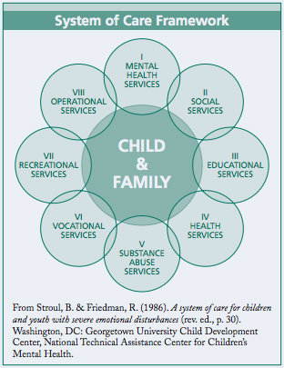
Plan of Safe Care
Strengthen the family
Child safety
  Need of infant
  Safe sleep
Link to services in the
community
  Substance abuse treatment
  Agency referrals

Slide 24
Sobriety Treatment and Recovery Team (START)
DCBS workers trained in family engagement with family mentors
Capped caseload, SOC wrap around
Target = family with child < 6 years of age and a parent with substance use as a primary child safety risk factor

Slide 25
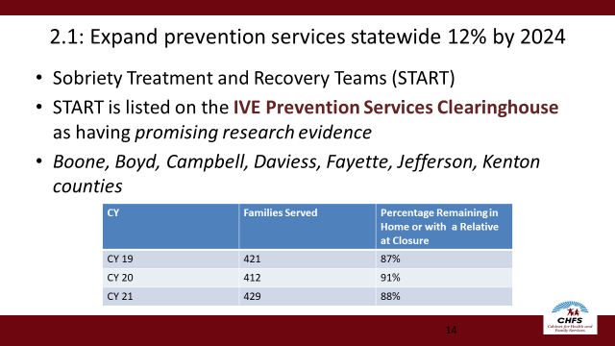

Slide 26
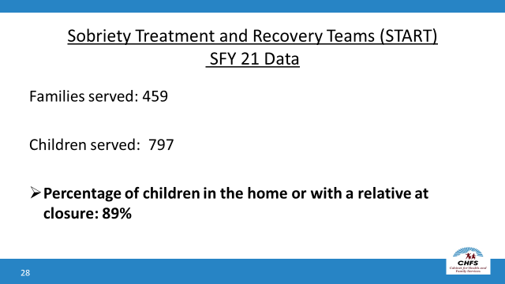

Slide 27
START outcomes at 12 months
20.3% of children treated with START were placed in OOHC (vs. 35.2%)
START children in OOHC were more likely to be reunified (OR = 1.44)
68.5% of children had no OOHC placement or child abuse/neglect (vs. 56.0%)
Huebner et al., Child Abuse & Neglect, 2021

Slide 28
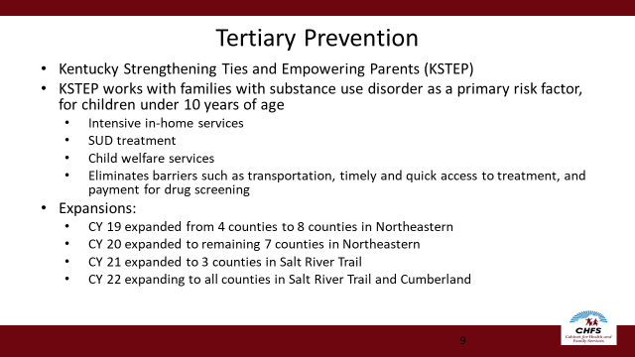
KSTEP

Slide 29
KSTEP

Slide 30
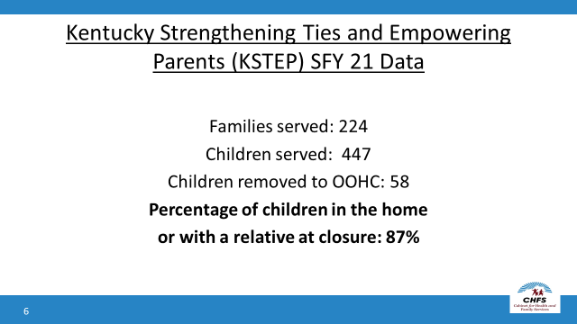
KSTEP

Slide 31
Case Study-See Attachment
What are the ACES and background factors which put her at risk?
What barriers increase her risk for relapse?
What interventions are needed to help her succeed?

