Slide 1
Self-Compassion
for Providers

Slide 2

Would you rather?
❤️

Slide 3
Course Technology Materials
https://bit.ly/scope472022

Slide 4
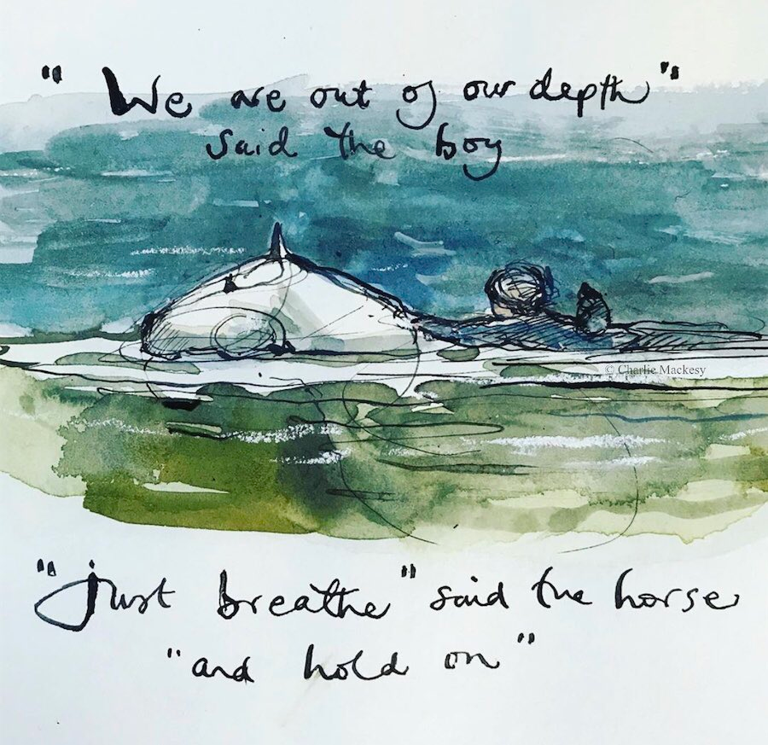

Slide 5
Learning Objectives
How to recognize responses to secondary traumatic stress in yourself and others
Strategies to practice self-compassion when working with challenging clients or situations
Mindfulness techniques that encourage resilience

Slide 6
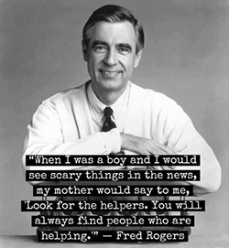
Helping Professionals
Personal Circumstances
Work-Related Grief & Loss
Exposure to Trauma
Indirect Trauma
Socio-Cultural Context
https://www.tendacademy.ca/venn-diagram/

Slide 7

Secondary Traumatic Stress

Slide 8
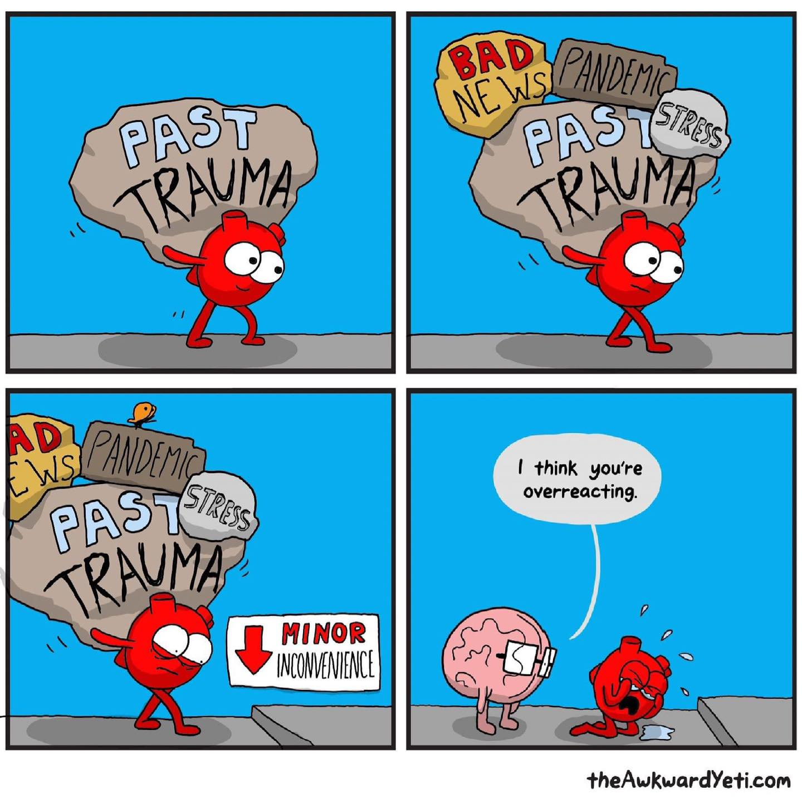
Secondary Traumatic Stress Responses

Slide 9
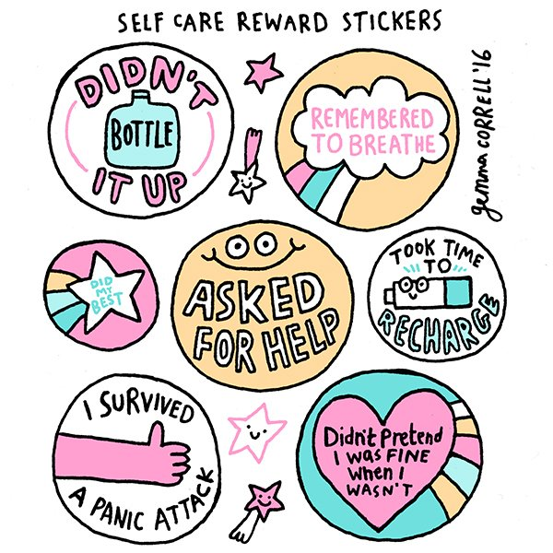
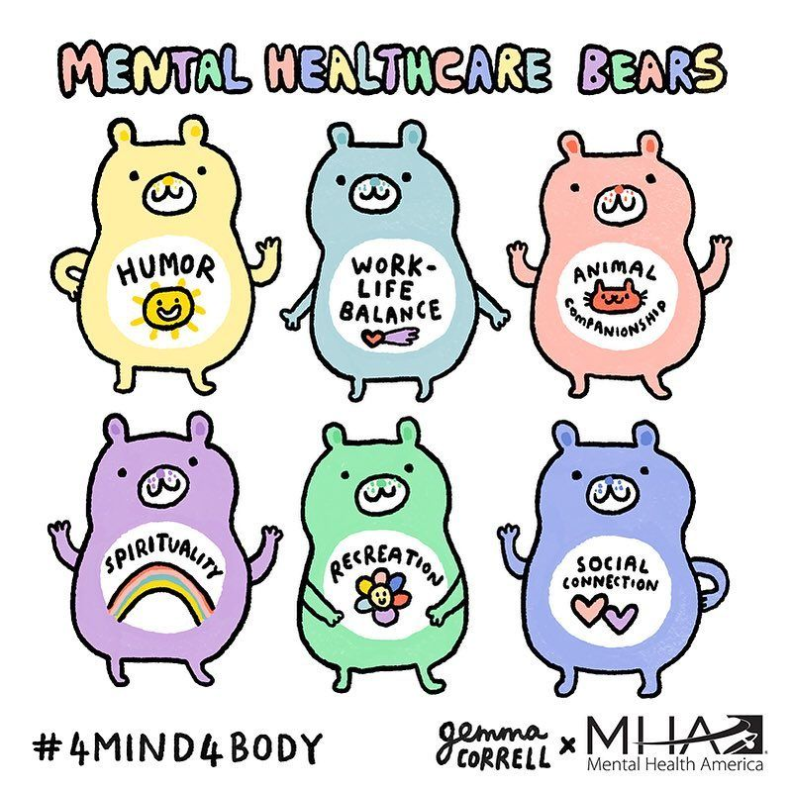
Coping with Secondary Traumatic Stress

Slide 10
Trauma-Informed Approach
Safety
Trustworthiness and Transparency
Peer Support
Collaboration and Mutuality
Empowerment, Voice and Choice
Cultural, Historical and Gender Issues

Slide 11
Self-Compassion
Self-kindness versus Self-judgement
Common humanity versus Isolation
Mindfulness versus Over-Identification

Slide 12
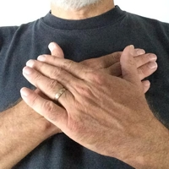
Supportive Touch
Touch activates the parasympathetic nervous system to help us calm down and feel safe.
Physical touch releases oxytocin, provides a sense of security and calms stress
https://self-compassion.org/exercise-4-supportive-touch/

Slide 13
RAIN
Recognize what is happening;
Allow the experience to be there, just as it is;
Investigate with interest and care;
Nurture with self-compassion
https://www.tarabrach.com/

Slide 14
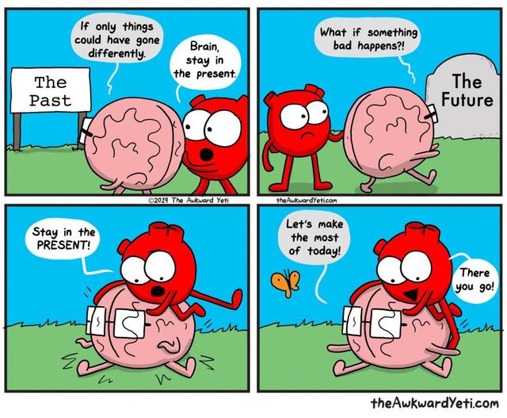
Mindfulness
Mindfulness is being fully present and aware of what we are sensing and feeling in the moment, without interpretation or judgment.

Slide 15
Mental Wellness Check
Am I aware of my emotions, thoughts, and experiences?
Am I open to difficult thoughts, emotions, and experiences without avoiding them?
Am I engaged with the present moment?

Slide 16
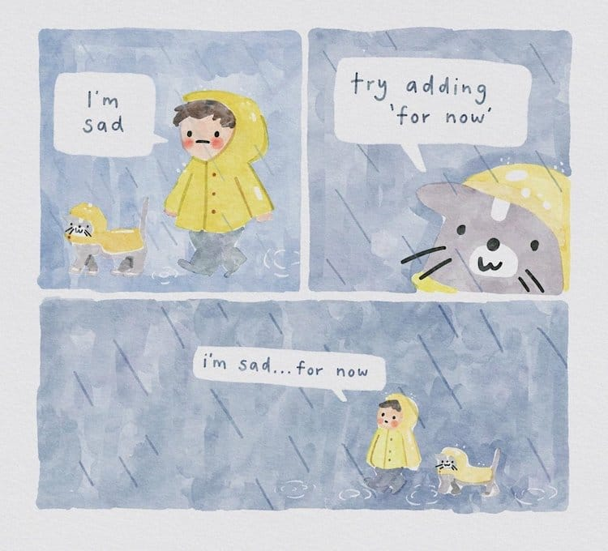
Images/Comics
Gemma Correll
Introvert Doodles
Jang and Fox
The Awkward Yeti
Charlie Macksey
Allie Brosh
Lunarbaboon
Magnificatz.com
Dilbert
Sarah Anderson
Shitty Watercolour

Slide 17
Cultivating A Meaningful Connection
Check on someone
Prioritize your own well being
Take a risk
Give someone feedback
Participate in an event
Share your failures and encourage others to
Clarify your values and boundaries
Journal
Do a gratitude check
Watch something that makes you laugh
Cultivate an environment that makes you feel good
Label your feelings
Sleep
Clean up your sleep environment
Extend grace
Do a Random Act of Kindness
Volunteer

Slide 18
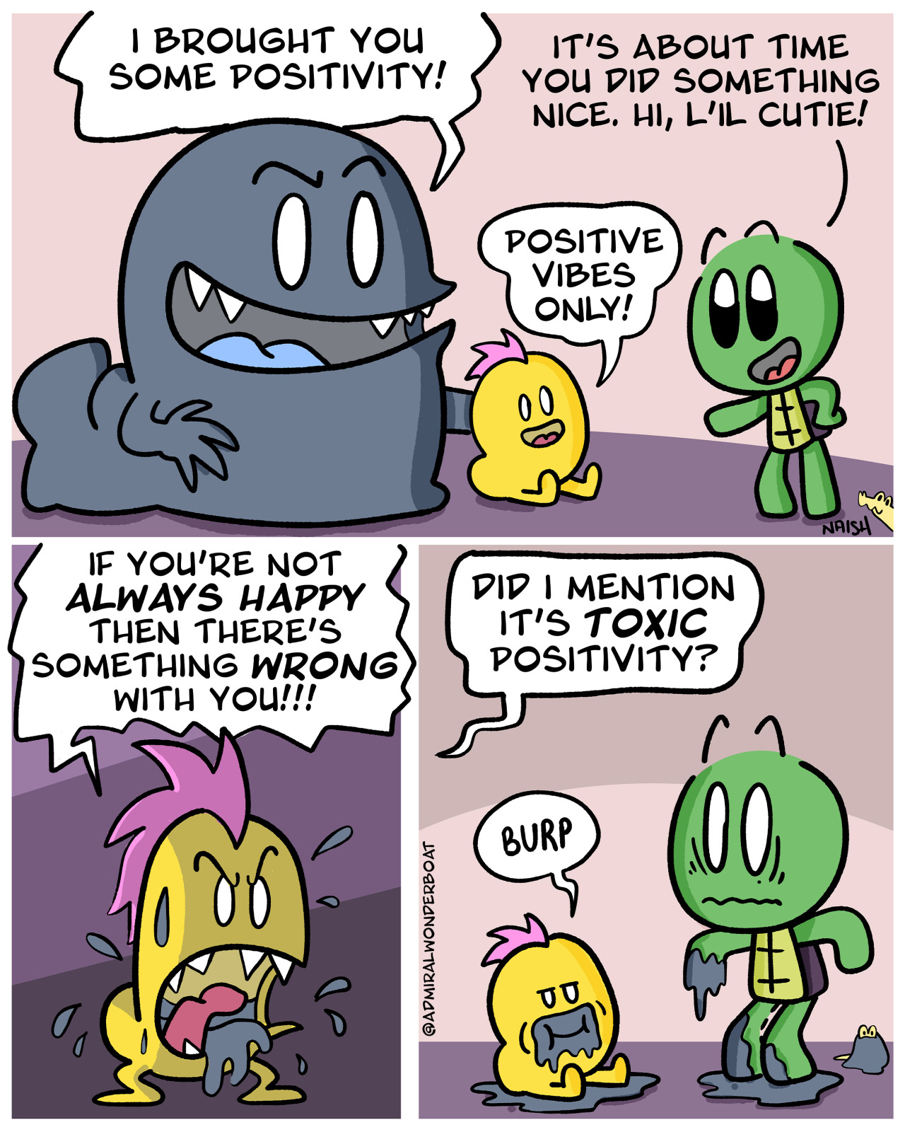
Toxic Positivity
Hiding your true feelings
Get on with it!
Feeling guilty for your feelings
Don’t worry, be happy!
It could be worse…
Shaming others for expressing feelings other than positivity
It is what it is

Slide 20
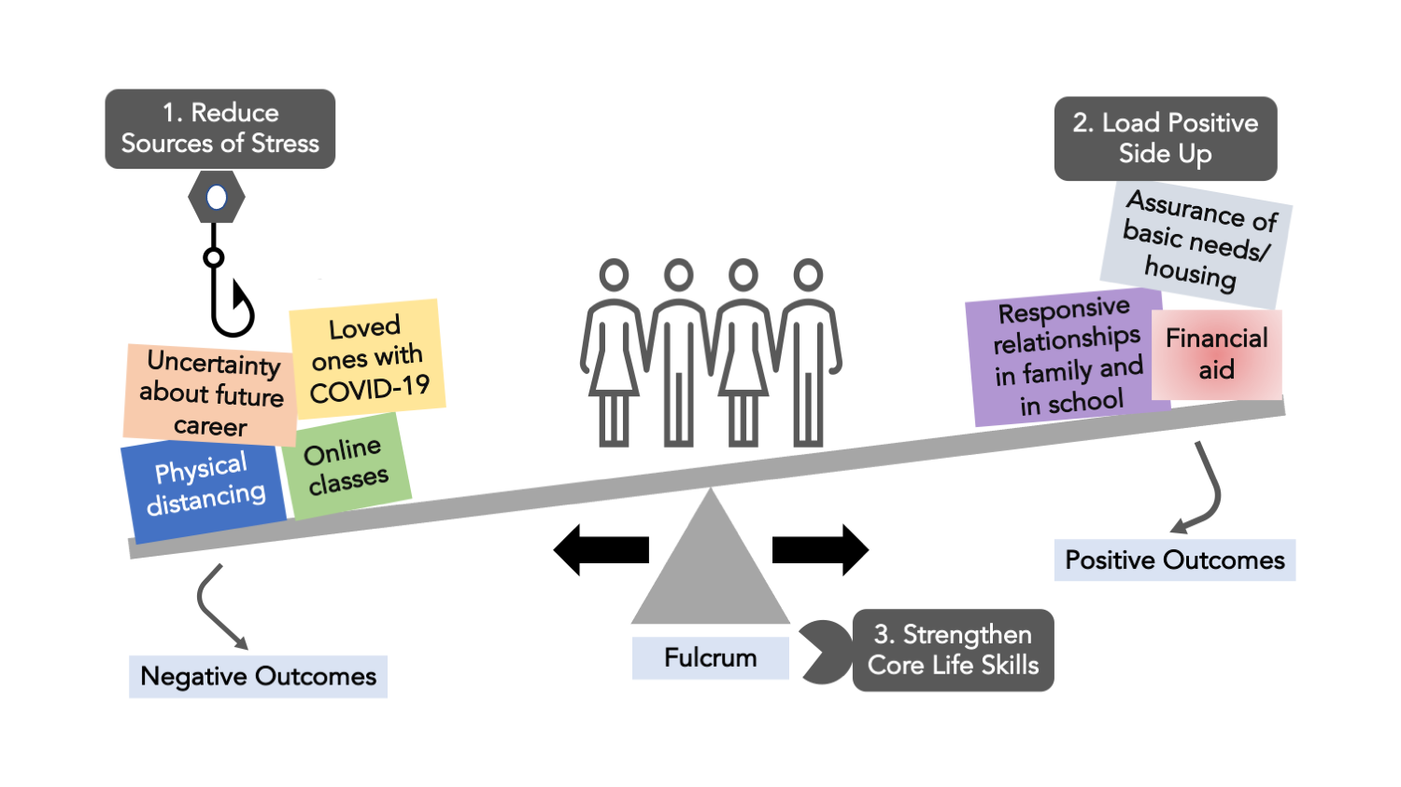
Resilience

Slide 21
Case Study
“Alex” is a peer mentor working with mothers in recovery from substance use disorder. In the past three months two of Alex’s co-workers have resigned and Alex’s caseload has been increased by 25% to help make sure every client has a peer mentor.
Alex recently recovered from COVID and has two elementary age children who have been in quarantine four times this year. Alex’s supervisor has allowed Alex to work flexible hours.
Alex feels fatigued every day and is questioning if it is worth staying at a position that they feel like they are constantly helping others but not getting help in return. The only time Alex feels like they are not overwhelmed is when they are on Tik Tok, so Alex is taking regular breaks at work to watch Tik Tok videos.
Alex’s work has an employee assistance program but Alex isn’t sure how to start using it and doesn’t want to ask anyone because of how it might look if they had to tell someone they needed help.

Slide 22
Thank you!
Kristen Dahl, LPCC, MCHES®
Human Development Institute
University of Kentucky
Kristen.dahl@uky.edu
https://hdi.uky.edu/

