Slide 1
Fetal Alcohol Syndrome and Fetal Alcohol Spectrum Disorder
Susan Barron, Ph.D.
Professor of Psychology,
University of Kentucky
Email: sbarron@uky.edu

Slide 2
Learning Objectives
Gain an understanding of what is meant by Fetal Alcohol Syndrome and Fetal Alcohol Spectrum Disorders
Gain an understanding of some of the behavioral issues that are the most common in children with FASDs.
Gain an understanding of some of the best strategies to ensure success in children/adolescents with FASDs

Slide 4
What is FAS and FASD?
FAS –first recognized in the United States in 1973
Specific characteristics observed in later infancy or childhood after a history of alcohol exposure during pregnancy.
Syndrome observed in babies following exposure to heavy amounts of alcohol
Fetal Alcohol Spectrum Disorders – a range of effects that occur following exposure to alcohol prenatally

Slide 5
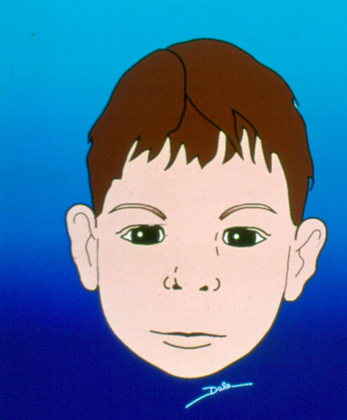
Fetal Alcohol Syndrome
Can be diagnosed -
Requires 3 characteristics
1. Born small and slow growth after birth
2. Evidence of some type of brain-related damage
Could include small head, small brain, learning problems, attention problems, hyperactivity, low IQ,
3. Characteristic facial features
Incidence of full FAS .2 - 1.5/1000 live births
(from CDC)
Diagnosis in KY –
Weisskopf Developmental Center (U of Louisville)
Genetics Department (U Kentucky)

Slide 7
FASD – Fetal Alcohol Spectrum Disorders

Slide 8
FAS – Only the tip of the iceberg-
Many more kids are affected with Fetal Alcohol Spectrum Disorders
Estimates of kids in school with an FASD can be as high as 1 in 20.
Often unrecognized (since they do not show the face of FAS)
Share many of the behavioral symptoms with FAS but are unrecognized
Often either undiagnosed or misdiagnosed (most often misdiagnosis is ADHD)
May not be recognized until preschool or school
FASD is not a diagnostic category
FAS
Alcohol related birth defects (ARBD)
People with ARBD may have problems with heart, kidneys, bones, ear infections
ARND (alcohol-related neurodevelopmental disorder)
Learning and behavior problems (as examples)
More difficult to diagnose FASDs
No facial features, no “blood test” or other markers
FAS
FASDs
Adapted from Streissguth

Slide 9
Hippo analogy…….
What we see?
Other health effects “below the surface”
We think about the brain because behavior changes, learning issues, etc are perhaps more obvious….. But alcohol also has other health effects (hence the hippo analogy).
Examples of other health issues: chronic ear infections (140x higher than normal population), heart defects, hormone and thyroid problems, increased risk for arthritis, celiac (4X higher than same aged population)

Slide 10
Behaviors often associated with Fetal Alcohol Spectrum Disorders
attention deficits
hyperactivity
learning issues
impulsive behavior
poor judgment
Sensory integration issues
Can easily be overstimulated
Balance and coordination difficulties
Language comprehension difficulties
These changes in behavior are due to brain damage. These are not just developmental delays that a child can “grow out of”. No two children may have the exact same issues.

Slide 11
Notes:
From Department of Health and Human Services (DHHS) Recovering Hope - Part 1 - Mothers & Children on FASD- there are three parts (https://www.youtube.com/watch?v=LCz7C05kTRw), Part 2 - https://www.youtube.com/watch?v=02By-2riXzA, Part 3; https://www.youtube.com/watch?v=rkNRMqRYHdA

Slide 13
Important things to consider for interventions/treatments
FASD lasts a lifetime.
Each child has their own strengths and areas that need help.
Early intervention and support throughout life can help tremendously
Many treatment options
Pharmacotherapy
Appropriate therapy, environment, etc
Important interventions
Loving, nurturing stable home environment
Absence of violence
Taking advantage of needed education and social services

Slide 14
Misinterpretations of behavior (from Diane Malbin “Is it that the child won’t or is it that the child can’t”. Some examples…..
If the child shows | “standard interpretation” | “defense responses”
Poor short-term memory | Not listening, not paying attention | Anger, avoidance
Inconsistent performance | Not trying | anxiety
Remembers some things but not others | Lazy | Confusion, depression
Forgets words, ideas | Doesn’t try, could do it | frustration
Doesn’t see similarities/differences | “should” know better | Isolated, fearful
 |  | .
http://www.come-over.to/FAS/cantwont.htm

Slide 15
Helpful techniques for working (or living with a child with FASDs
Concentrate on strengths and talents
Cannot expect that usual parenting or classroom practices will work.
Helpful techniques with kids with FASD
Accept limitations but also recognize strengths
Consistency is crucial
Concrete language and development
Use stable routines that do not change
Keep it simple
Be very specific to say exactly what is meant
Structure daily work; Use visual aides, hands on activities to help with learning
Supervise friends, visits
Repeat, repeat, repeat

Slide 16
Some behavior and education therapies shown to be effective for some children with FASDs (summarized from CDC guidelines)
Good Buddies – A children’s friendship training to teach individuals with an FASD appropriate social skills
Families Moving Forward (FMF) program to provide support for families who deal with challenging FASD behaviors
Math Interactive Learning Experience (MILE) program to help with mathematics difficulty
Parents and Children Together (PACT) a neurocognitive habilitation program to improve self-regulation and executive function
Notes:
Good buddies - Children with FASDs often have difficulty learning subtle social skills from their own experiences; those kinds of skills are typically “learned by osmosis” on the playground, such as how to slip into a group, appropriate sharing, or dealing with teasing. This intervention uses a group format to teach age-appropriate social skills over 12 weekly sessions for parent and child. Sessions are organized around and toward each child hosting a play date with a classmate or peer.
Families moving forward - This intervention is most appropriate for children with severe, clinically significant behavior problems based in part on positive behavior support techniques. It is a feasible, low-intensity, sustained model of supportive consultation with a parent or caregiver (rather than directly with the child). The intervention lasts 9 to 11 months, with at least 16 every-other-week sessions, typically lasting 90 minutes each. Services are carried out by mental health providers with specialized training.
Deficits in mathematical functioning have been reported consistently among alcohol-affected individuals. The MILE program is designed to improve the child’s mathematical knowledge and skill. Children complete 6 weeks of one-to-one tutoring using specifically adapted materials (eg, vertical number line, timers, etc.) that are appropriate to their academic level. Parents also receive training on behavioral regulation techniques to optimize the child’s readiness to learn.
Parents and Children Together (PACT) a neurocognitive habilitation program to improve self-regulation and executive function⁴ Building upon techniques developed from the brain injury literature, this intervention used 12 weekly sessions with parents and children to address and improve behavior regulation and executive function (that is, planning, organizing, and understanding of others). It uses a particularly engaging metaphor of “how does my engine run” to teach children awareness of their current behavioral state and specific techniques for optimizing that state for the current situation.
O’Connor MJ, Frankel F, Paley B, et al. A controlled social skills training for children with fetal alcohol spectrum disorders. J Consult Clin Psychol. 2006;74(4):639–648.
Carmichael Olson H, Leavitt S. Families Moving Forward. Platform Presentation on October 23, 2010. FASD Fall Conference at Emory University, Atlanta, GA
Kable JA,Coles CD,Taddeo E. Socio-cognitive habilitation using the math interactive learning experience program for alcohol affected children. Alcohol Clin Exp Res. 2007; 31: 1425-1434. Bertrand J, Floyd L, Chasnoff I, Wells A, Bailey G, et al. Interventions for children with fetal alcohol spectrum disorders (FASDs): Overview of findings for five innovative research projects. Res Dev Disab. 2009;30(5):986–1006.
Wells, A.M., Chasnoff, I.J., Schmidt, C.A., Telford, E., & Schwartz, L. (2012). Neurocognitive habilitation therapy for children with fetal alcohol spectrum disorders: An adaptation of the Alert Program®. American Journal of Occupational Therapy, 66, 24-34.

Slide 17
Some important and useful resources
National Organization on Fetal Alcohol Syndrome (NOFAS)
http://fasdunited.org/
Center for Disease Control
https://www.cdc.gov/ncbddd/fasd/index.html
National Institute on Alcohol Abuse and Alcoholism
https://www.niaaa.nih.gov/fetal-alcohol-spectrum-disorders
Arkansas None for Nine
https://arkansasnonefornine.org/
Families moving forward
https://fasdcenter.org/projects/health-equity/model-programs

Slide 18
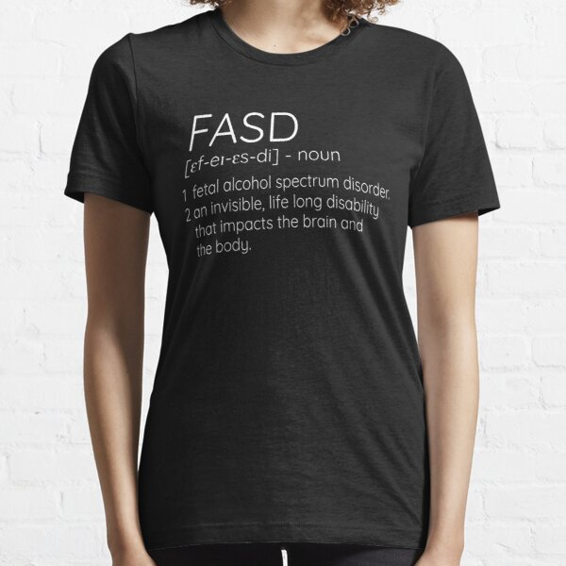
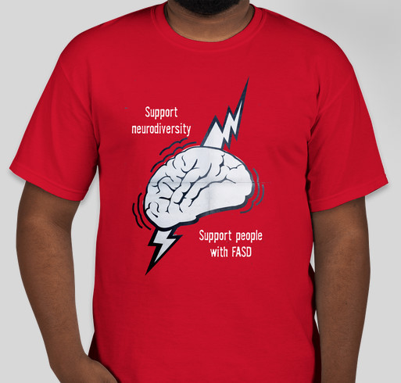
Thank you for your attention!
Questions or comments welcome!
Susan Barron, Ph.D.
Psychology Department,
University of KY; sbarron @uky.edu

Slide 19
Case study
Background: Katie is a sweet, affectionate, very active 3 year old who has been living with a foster family. It is suspected that her mom consumed alcohol and perhaps other drugs during pregnancy but it is not possible to discern her history because she has lost contact.
Katie was born 4 weeks prematurely and was at about 1% for both body weight and height on the growth curve for her age. She continues to be small both in weight and height. Her foster parents asked about the possibility of Fetal Alcohol Syndrome with her pediatrician but Katie doesn’t have the facial features that are necessary for this diagnosis.

Slide 20
Katie may have some delays in language and the foster parents are waiting for a referral for speech therapy. She is very sensitive to rough clothing or tags on her clothes and her foster parents have figured out the types of clothes she can wear comfortably. Katie loves music and will dance or sit quietly (for at least a few minutes) when her foster mom plays the piano.
Katie’s foster parents had hoped that enrollment in a preschool program could be beneficial for her verbal and social development. They found a preschool that looked promising with plenty of stimulation and toddler interactions.
Katie has struggled with this new school. Her teachers say that she has good days but also becomes very upset very easily. She has begun having tantrums at home and at school and no longer wants to go… crying each morning. Her foster parents are currently considering other options and seeking advice from professionals.

