Slide 1
Visual Development for Children with Prenatal Substance Exposure
Elsie Bush, MS OTR/L

Slide 2
Meet the Speaker Elsie Bush, MS OTR/L
Occupational Therapist at Cincinnati Children’s Hospital Medical Center
Therapist in the Pediatric Low Vision and Cortical Visual Impairment Programs
Project SCOPE National Training Initiative/Buckeye SCOPE research staff

Slide 3
Today’s Objectives
Participants will gain knowledge in typical visual development in children
Participants will understand potential adverse visual outcomes in children with prenatal substance exposure
Participants will learn the functional implications of adverse visual outcomes

Slide 4
Why Visual Development Matters
Vision is our foundation for:
Interaction/Exploration
Play
learning
Vision will later play a function in cognitive, motor, and behavioral development ¹
Notes:
Braddick, O., & Atkinson, J. (2011). Development of human visual function. In Vision Research (Vol. 51, Issue 13, pp. 1588–1609). Elsevier BV. https://doi.org/10.1016/j.visres.2011.02.018

Slide 5
Typical Visual Milestones
Age | Typical Visual Development/Visual Behaviors
1 year | Visual acuity ranges from 20/20 to 20/60 Follows object moving circularly Begins to imitate body movements of others Begins to separate object from background Begins to scribble with a crayon Uses vision to monitor motor activities
2 years | Identifies pictures of familiar objects Points to different body parts Stacks objects horizontally
3 years | Demonstrates visual memory Completes simple puzzles Identifies outline drawings of familiar objects Identifies objects partially hidden Starts to identify and name colors
Corn, A. L., Erin, J. N., & Ferrell, K. A. (2010).
Notes:
Corn, A. L., Erin, J. N., & Ferrell, K. A. (2010). Visual Development. In Foundations of Low Vision: Clinical and functional perspectives. essay, AFB Press.

Slide 6
Typical Visual Milestones
Emerging school aged skills
Age | Typical Visual Development/Visual Behaviors
4 years | Maintains eye contact at a 10-16 foot distance Identifies basic colors (red, yellow, blue, green) Differentiates facial expressions and body language that reflects various moods Plays with toys without looking at hands Groups objects by physical attributes Sequences pictures to tell a story
5 years | Describes details in pictures and drawings Matches by size and shape Cuts between lines with scissors Builds a bridge with blocks
Corn, A. L., Erin, J. N., & Ferrell, K. A. (2010).
Notes:
Corn, A. L., Erin, J. N., & Ferrell, K. A. (2010). Visual Development. In Foundations of Low Vision: Clinical and functional perspectives. essay, AFB Press.

Slide 7
Visual Impairment & Prenatal Substance Exposure
Disclaimer: This is an area of emerging knowledge, and further studies are still needed/recommended. However many studies have started to identify adverse visual outcomes, further exploration is needed to understand how this impacts function and root cause of these effects.
Changes in visual functioning observed
Decreased/slower Visual Evoked Potentials (VEP)^{1, 4}
Atypical brain development
Decreased functional connectivity in visual areas ²
Atypical brain structure size/formation ³
Impaired visual pursuits ⁶
Impaired global motion perception ⁵
Notes:
1. McGlone, L., Hamilton, R., McCulloch, D. L., MacKinnon, J. R., Bradnam, M., & Mactier, H. (2013). Visual outcome in infants born to drug-misusing mothers prescribed methadone in pregnancy. British Journal of Ophthalmology, 98(2), 238–245. https://doi.org/10.1136/bjophthalmol-2013-303967
2. Merhar, S. L., Jiang, W., Parikh, N. A., Yin, W., Zhou, Z., Tkach, J. A., Wang, L., Kline-Fath, B. M., He, L., Braimah, A., Vannest, J., & Lin, W. (2021). Effects of prenatal opioid exposure on functional networks in infancy. In Developmental Cognitive Neuroscience (Vol. 51, p. 100996). Elsevier BV. https://doi.org/10.1016/j.dcn.2021.100996
3. Merhar, S. L., Kline, J. E., Braimah, A., Kline-Fath, B. M., Tkach, J. A., Altaye, M., He, L., & Parikh, N. A. (2020). Prenatal opioid exposure is associated with smaller brain volumes in multiple regions. In Pediatric Research (Vol. 90, Issue 2, pp. 397–402). Springer Science and Business Media LLC. https://doi.org/10.1038/s41390-020-01265-w
4. McGlone, L., Mactier, H., Hamilton, R., Bradnam, M. S., Boulton, R., Borland, W., Hepburn, M., & McCulloch, D. L. (2008). Visual evoked potentials in infants exposed to methadone in utero. In Archives of Disease in Childhood (Vol. 93, Issue 9, pp. 784–786). BMJ. https://doi.org/10.1136/adc.2007.132985
5. Chakraborty, A., Anstice, N. S., Jacobs, R. J., LaGasse, L. L., Lester, B. M., Wouldes, T. A., & Thompson, B. (2015). Prenatal exposure to recreational drugs affects global motion perception in preschool children. In Scientific Reports (Vol. 5, Issue 1). Springer Science and Business Media LLC. https://doi.org/10.1038/srep16921
6. Melinder, A., Konijnenberg, C., & Sarfi, M. (2013). Deviant smooth pursuit in preschool children exposed prenatally to methadone or buprenorphine and tobacco affects integrative visuomotor capabilities. In Addiction (Vol. 108, Issue 12, pp. 2175–2182). Wiley. https://doi.org/10.1111/add.12267

Slide 8
Visual Impairment & Prenatal Substance Exposure
visual diagnoses with higher prevalence than non-exposed populations: ^{1,2,3,4,5}
Nystagmus
Strabismus
Decreased visual acuity
Delayed visual maturation
Cortical/Cerebral visual impairment
Most frequently referenced in literature
Notes:
Sources:
Yoo, S. H., Jansson, L. M., & Park, H.-J. (2017). Sensorimotor outcomes in children with prenatal exposure to methadone. Journal of American Association for Pediatric Ophthalmology and Strabismus, 21(4), 316–321. https://doi.org/10.1016/j.jaapos.2017.05.025
McGlone, L., et. al. (2013). Visual outcome in infants born to drug-misusing mothers prescribed methadone in pregnancy. British Journal of Ophthalmology, 98(2), 238–245. https://doi.org/10.1136/bjophthalmol-2013-303967
Hamilton R, McGlone L, MacKinnon JR, et al. (2010). Ophthalmic, clinical and visual electrophysiological findings in children born to mothers prescribed substitute methadone in pregnancy. British Journal of Ophthalmology, 94:696-700.
4. Spiteri Cornish, K., et al. (2013). The short- and long-term effects on the visual system of children following exposure to maternal substance misuse in pregnancy. Am. J. Ophthalmol, 156, 190–194.
5. Mactier, H., & Hamilton, R. (2020). Prenatal opioid exposure – Increasing evidence of harm. In Early Human Development (Vol. 150, p. 105188). Elsevier BV. https://doi.org/10.1016/j.earlhumdev.2020.105188

Slide 9
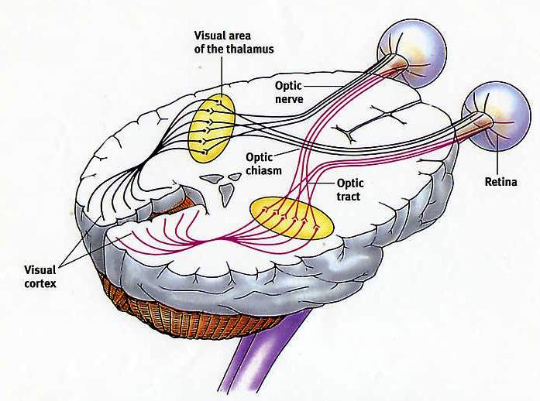
Components of Visual System
Visual structures
Brain structures
Notes:
Image source: Visual pathway (edoctoronline.com)
Anterior vs. posterior pathway: Visual structures vs brain based

Slide 10
Basic Visual Skills
Visual Skill | Description
Eye Movement Control | Ability to move both eyes together and focus on a stimulus. All muscles in the eye cooperate together to move up, down, right, left, diagonally
Binocular Coordination | Eyes working together as a team – improper coordination can lead to a lazy eye
Pursuits | Eyes moving between two focus points – Ex: adult demonstrating how to play with a toy, moving eyes between adult and a toy child is holding
Visual Memory | Ability to remember information such as words or images previously seen – Ex: learning and memorizing shapes & letters
Visual Motor | Ability to complete gross or fine motor tasks using visual information to guide you – Ex: preventing bumping into objects while walking, or completing close-up activities like writing, reading, puzzles)
Lazarus, R. (2020).
Notes:
Lazarus, R. (2020). The 17 Key Visual Skills. Retrieved from https://www.optometrists.org/vision-therapy/guide-vision-and-learning-difficulties/the-17-key-visual-skills/

Slide 11
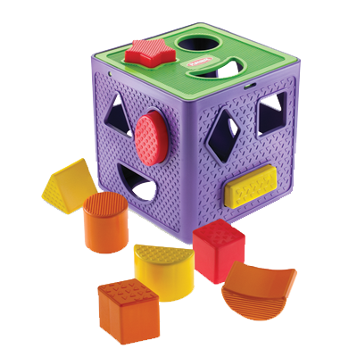
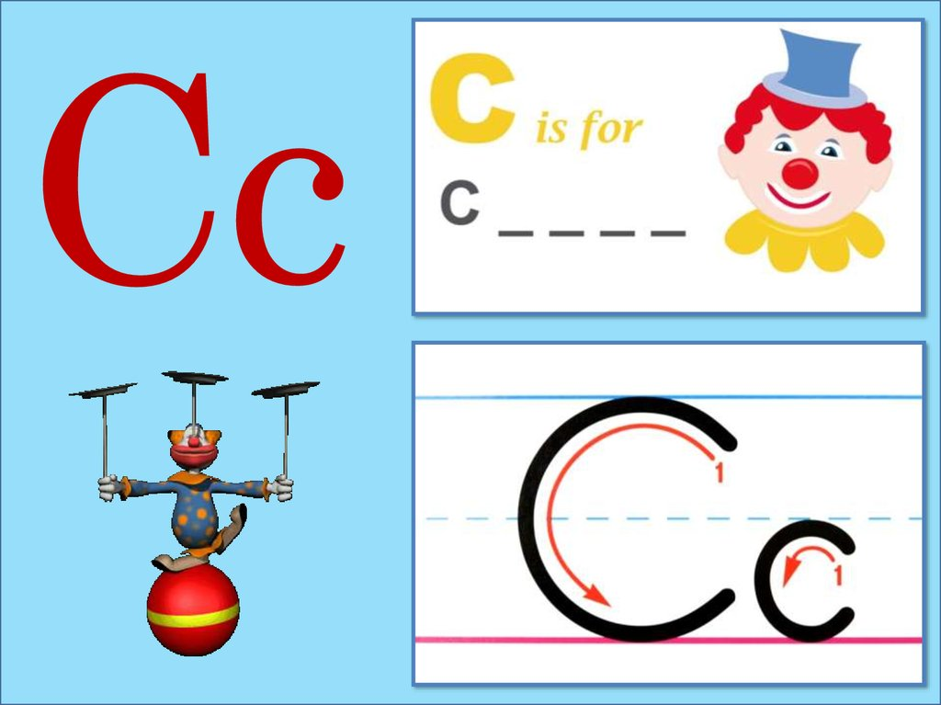
Examples of Visual skills in Play/learning
Shape Sorter
Puzzles
Handwriting/Spelling
Skills for success:
Visual Discrimination
Visual scanning
Visual Motor Integration
Skills for success:
Visual Motor Integration
Visual Memory
Skills for success:
Visual memory
Visual Motor integration

Slide 12
Visual Processing
First: The eyes must look
Then: They will send information back to the brain to interpret
General Rule of Thumb We must be able to:
Visually attend
Filter visual information
Determine what is the purpose and role for the item we interact with
Notes:
General Rule of Thumb We must be able to:
Filter out what visual information is important/necessary for task completion
Focus/maintain visual attention
Determine what is the purpose and role for the item we interact with

Slide 13
Visual Processing Sensory Perspective
Craving
A child may “seek” or “crave” visual stimulation
Under-Responsive
Need higher levels of visual stimulation for awareness (brighter, moving, increased stimulation).
Over-responsive
Child visually distractible, visual stimulation can overwhelm, may avoid activity that is visually stimulating.
Day, N. (2020).
Notes:
Day, N. (2020). How Visual Sensory Processing Works. Retrieved from: ttps://hes-extraordinary.com/visual-sensory-processing.

Slide 14
General Visual Processing Strategies
Consider clutter/complexity
In the activity
In the environment
Use materials that are visually motivating to the child
Shiny
Reflective
light components
Color highlighting

Slide 15
Visual Challenge Example
Please type in the chat your thoughts on how this environment may be difficult for a child from a visual stand point.
Notes:
Ask for participation - Please type in the chat your thoughts on how this activity may be difficult for a child from a visual stand point

Slide 16
What Can We Do?
Children with visual processing concerns may perform best:
Facing walls with less decorations
Back facing busy walkways
Back facing doors/windows

Slide 17
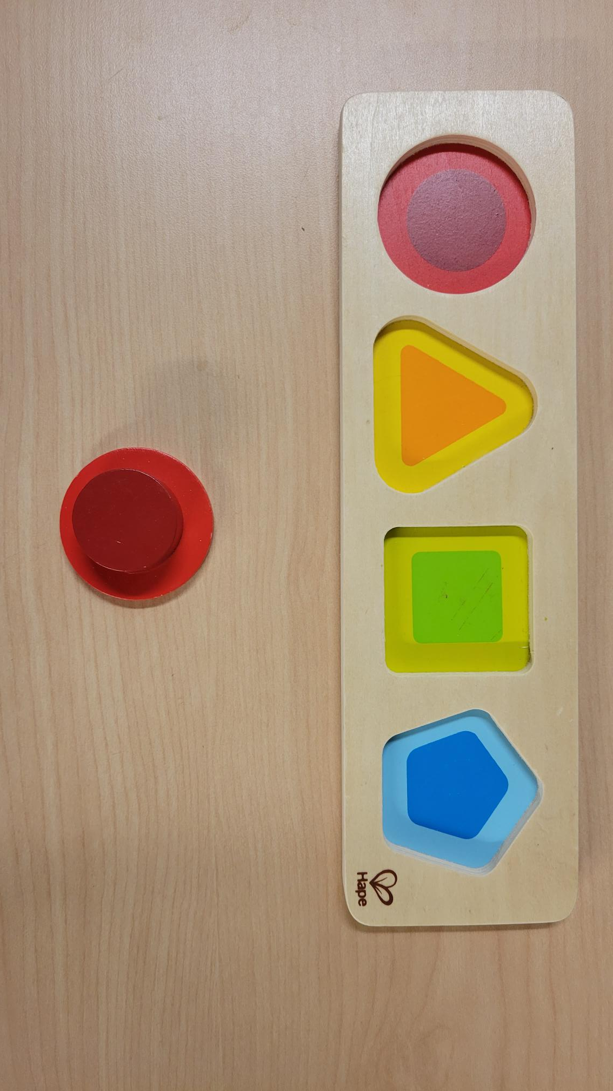
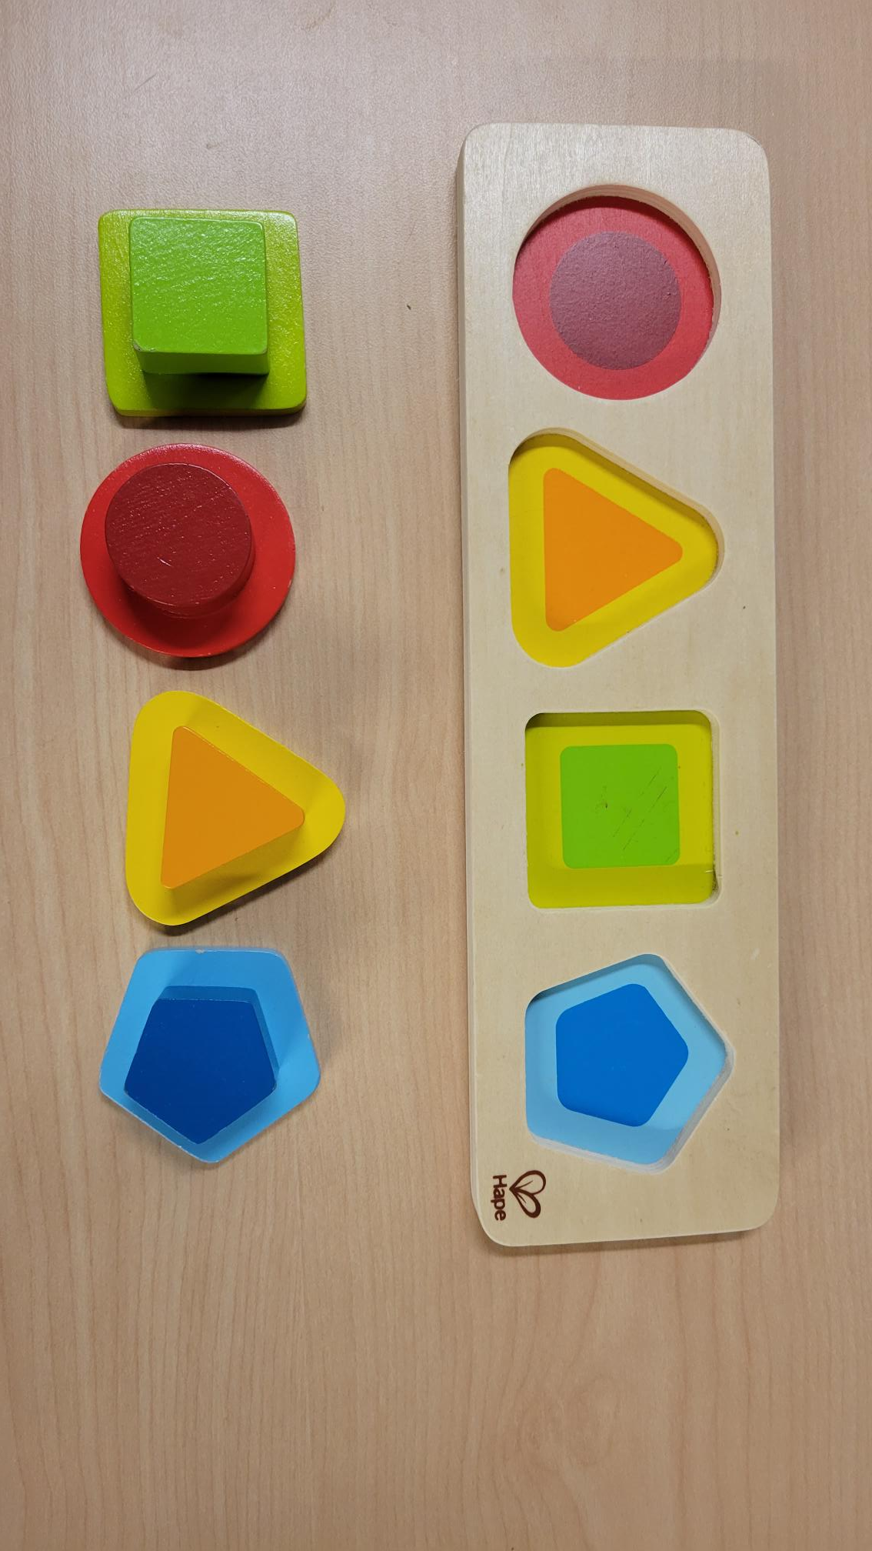
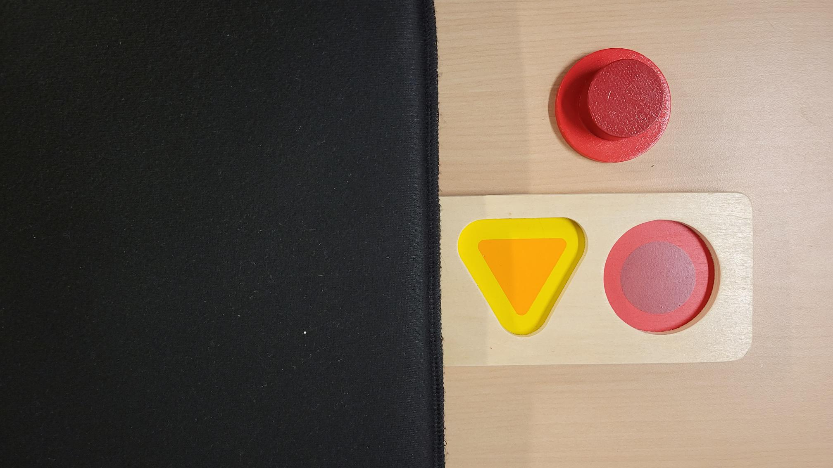
Toy Adaptation Examples
Notes:
Zoo puzzle source - CVI DIY: Adapting Puzzles – Everyday CVI

Slide 18
Visual Challenge Example
4 year old child with prenatal exposure and cortical visual impairment
decreased visual interest in fine motor learning tasks
high preference of playing with light based toys and shiny/bright colored toys.
Notes:
A child with delayed visual maturation, visual seeking/under-responsive tendencies, or brain based visual impairment may experience this concern

Slide 19
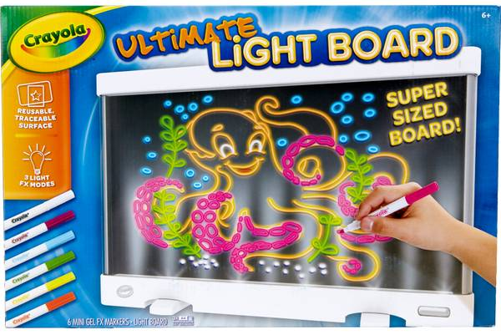
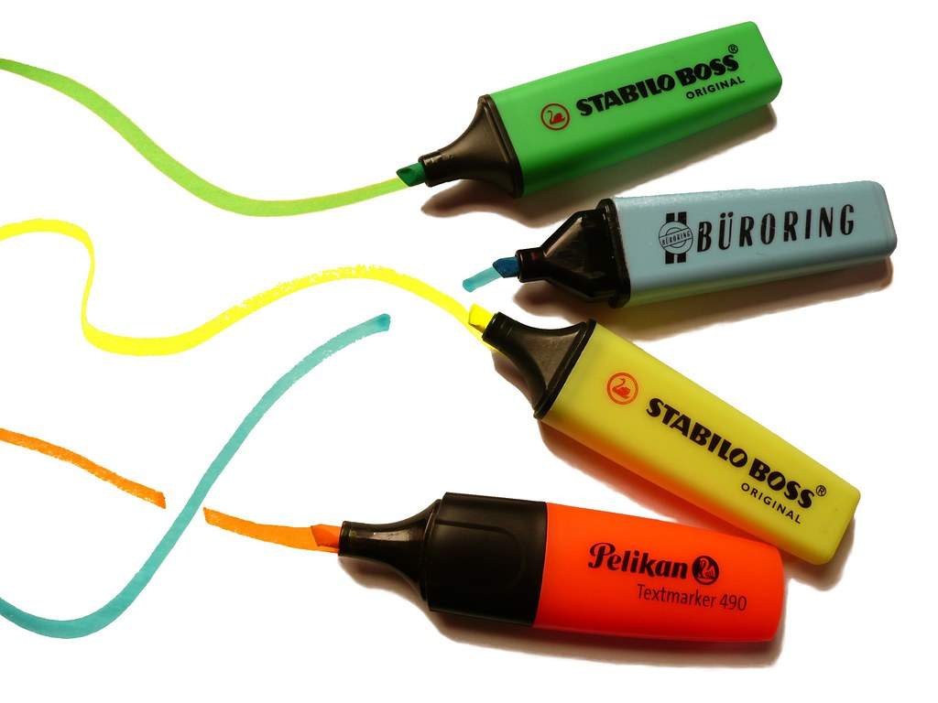
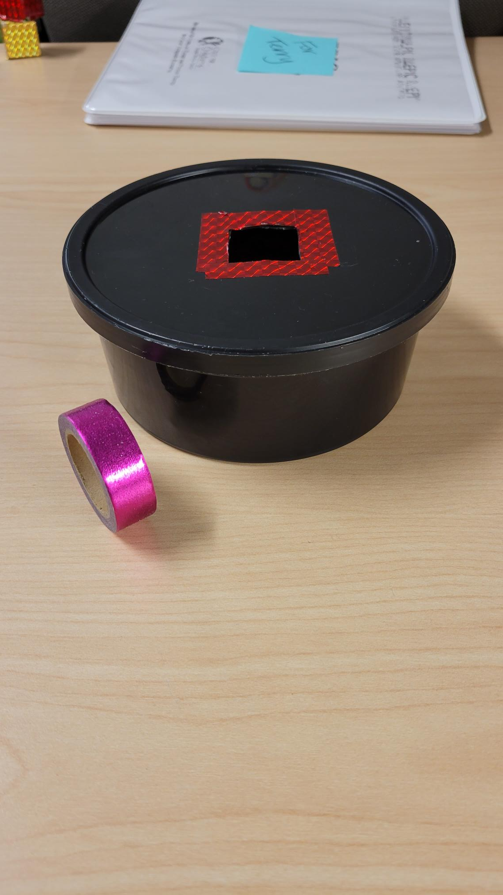
Adaptation Ideas
Find ways to incorporate light or interests!

Slide 20
How to Monitor and Intervene
Regular vision screening by a trained professional should occur throughout early childhood
The American Academy of Ophthalmology recommends vision screens at:
Birth
6-12 months
12-36 months
3-5 years
Abnormal screens can lead to vision consults as needed
Gudgel, D. (2021)
Notes:
Gudgel, D. (2021). Eye Screening for Children. Retrieved from https://www.aao.org/eye-health/tips-prevention/children-eye-screening.
Screens with abnormal results can result in consultation with an ophthalmologist or optometrist to determine appropriate intervention

Slide 21
How to Monitor and Intervene
If visual-motor concerns are present as a child is developing a referral to an occupational therapist can support participation in:
Play skills
Educational skills
Self care skills

Slide 22
Helpful Resources
Description | Access Link/File
Visual Milestones from birth to 6 years from Stanford Children’s Health | https://www.stanfordchildrens.org/en/topic/default?id=age-appropriate-vision-milestones-90-P02305
Visual Milestones from birth to 6 years from the Children’s Hospital Of Philadelphia | https://www.chop.edu/conditions-diseases/age-appropriate-vision-milestones
Fine Motor and Visual Motor Milestones from birth to 3 years from the Children’s Hospital of California | https://www.choc.org/userfiles/file/Rehab-Developmental%20Milestones%20final.pdf

Slide 23
References
References in order of appearance – can also be found in individual slide notes
Braddick, O., & Atkinson, J. (2011). Development of human visual function. In Vision Research (Vol. 51, Issue 13, pp. 1588–1609). Elsevier BV. https://doi.org/10.1016/j.visres.2011.02.018
Corn, A. L., Erin, J. N., & Ferrell, K. A. (2010). Visual Development. In Foundations of Low Vision: Clinical and functional perspectives. essay, AFB Press.
McGlone, L., Hamilton, R., McCulloch, D. L., MacKinnon, J. R., Bradnam, M., & Mactier, H. (2013). Visual outcome in infants born to drug-misusing mothers prescribed methadone in pregnancy. British Journal of Ophthalmology, 98(2), 238–245. https://doi.org/10.1136/bjophthalmol-2013-303967
Merhar, S. L., Jiang, W., Parikh, N. A., Yin, W., Zhou, Z., Tkach, J. A., Wang, L., Kline-Fath, B. M., He, L., Braimah, A., Vannest, J., & Lin, W. (2021). Effects of prenatal opioid exposure on functional networks in infancy. In Developmental Cognitive Neuroscience (Vol. 51, p. 100996). Elsevier BV. https://doi.org/10.1016/j.dcn.2021.100996
Merhar, S. L., Kline, J. E., Braimah, A., Kline-Fath, B. M., Tkach, J. A., Altaye, M., He, L., & Parikh, N. A. (2020). Prenatal opioid exposure is associated with smaller brain volumes in multiple regions. In Pediatric Research (Vol. 90, Issue 2, pp. 397–402). Springer Science and Business Media LLC. https://doi.org/10.1038/s41390-020-01265-w
McGlone, L., Mactier, H., Hamilton, R., Bradnam, M. S., Boulton, R., Borland, W., Hepburn, M., & McCulloch, D. L. (2008). Visual evoked potentials in infants exposed to methadone in utero. In Archives of Disease in Childhood (Vol. 93, Issue 9, pp. 784–786). BMJ. https://doi.org/10.1136/adc.2007.132985
Chakraborty, A., Anstice, N. S., Jacobs, R. J., LaGasse, L. L., Lester, B. M., Wouldes, T. A., & Thompson, B. (2015). Prenatal exposure to recreational drugs affects global motion perception in preschool children. In Scientific Reports (Vol. 5, Issue 1). Springer Science and Business Media LLC. https://doi.org/10.1038/srep16921
Melinder, A., Konijnenberg, C., & Sarfi, M. (2013). Deviant smooth pursuit in preschool children exposed prenatally to methadone or buprenorphine and tobacco affects integrative visuomotor capabilities. In Addiction (Vol. 108, Issue 12, pp. 2175–2182). Wiley. https://doi.org/10.1111/add.12267
Yoo, S. H., Jansson, L. M., & Park, H.-J. (2017). Sensorimotor outcomes in children with prenatal exposure to methadone. Journal of American Association for Pediatric Ophthalmology and Strabismus, 21(4), 316–321. https://doi.org/10.1016/j.jaapos.2017.05.025
McGlone, L., et. al. (2013). Visual outcome in infants born to drug-misusing mothers prescribed methadone in pregnancy. British Journal of Ophthalmology, 98(2), 238–245. https://doi.org/10.1136/bjophthalmol-2013-303967
Hamilton R, McGlone L, MacKinnon JR, et al. (2010). Ophthalmic, clinical and visual electrophysiological findings in children born to mothers prescribed substitute methadone in pregnancy. British Journal of Ophthalmology, 94:696-700.
Spiteri Cornish, K., et al. (2013). The short- and long-term effects on the visual system of children following exposure to maternal substance misuse in pregnancy. Am. J. Ophthalmol, 156, 190–194.
Mactier, H., & Hamilton, R. (2020). Prenatal opioid exposure – Increasing evidence of harm. In Early Human Development (Vol. 150, p. 105188). Elsevier BV. https://doi.org/10.1016/j.earlhumdev.2020.105188
Lazarus, R. (2020). The 17 Key Visual Skills. Retrieved from https://www.optometrists.org/vision-therapy/guide-vision-and-learning-difficulties/the-17-key-visual-skills/
Day, N. (2020). How Visual Sensory Processing Works. Retrieved from: ttps://hes-extraordinary.com/visual-sensory-processing.

Slide 24
Thank You!
Please reach out with any questions!
Elsie Bush
Elsie.bush@cchmc.org

