Slide 1
Trauma-Informed Interventions for Families with Young Children
Miriam Silman MSW
Trauma Informed Care Program Administrator/ Project AWARE
Department for Behavioral Health, Developmental & Intellectual Disabilities
19 October 2021

Slide 2
Topics for Today
3 key strategies to support children
Revisiting the Adverse Childhood Experiences Study from a place of hope
Connecting families with trauma-focused intervention services

Slide 3
Self-Awareness is Key
Pay attention to your own needs & responses
Take care of yourself however you need to during our discussion
Effects can linger, or surface later
Use coping skills that help you metabolize and process your responses to trauma
Find a safe space in which you can process your experiences – this may mean using coping strategies including talking to colleagues, friends, family, or a professional provider

Slide 4
Poll #1
What is your stress level today (with 1 = no stress to 10 = the most stress you have ever had)? (Answer choices 1, 2, 3, 4, 5, 6, 7, 8, 9, 10)
How well are you able to manage that stress (with 1 = not able to manage it at all to 10 = totally in control of your stress)? (Answer choices 1, 2, 3, 4, 5, 6, 7, 8, 9, 10)

Slide 5
Trauma
“Trauma occurs in layers, with each layer affecting every other layer. Current trauma is one layer. Former traumas in one’s life are more fundamental layers. Underlying one’s own individual trauma history is one’s group identity or identities and the historical trauma with which they are associated.”
Bonnie Burstow (2003), Toward a Radical Understanding of Trauma and Trauma Work

Slide 6
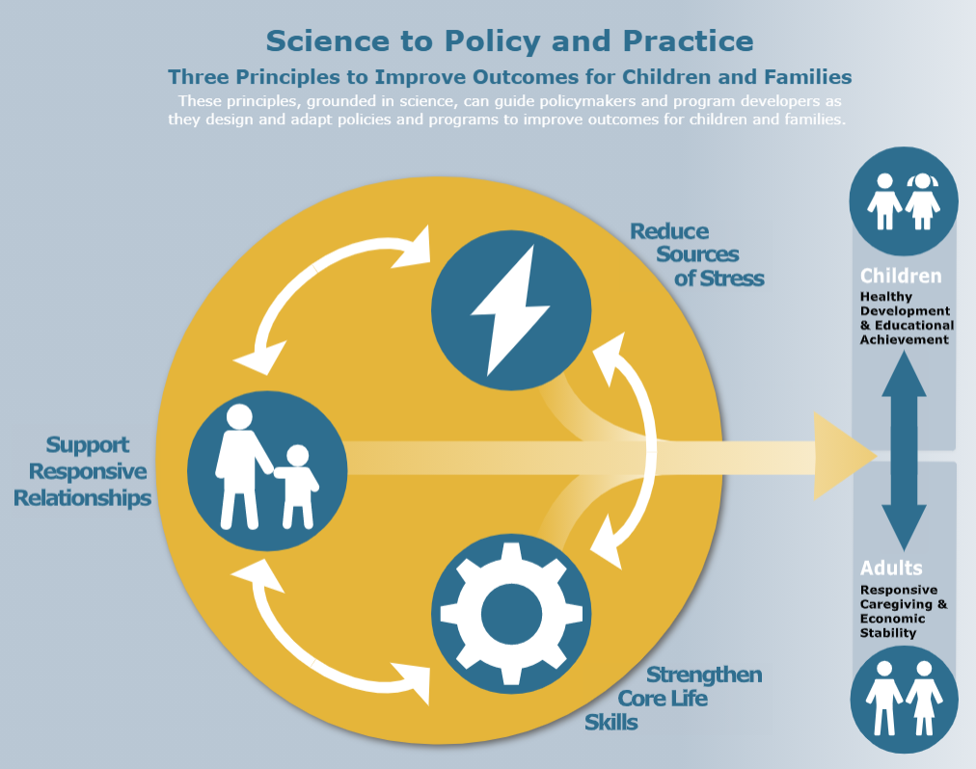
Three Key Strategies to Support Children
Support Responsive Relationships
Strengthen Core Life Skills
Reduce Sources of Stress
Center for the Developing Child at Harvard University: https://developingchild.harvard.edu/resources/three-early-childhood-development-principles-improve-child-family-outcomes/#strengthen-skills

Slide 7
1. Support Responsive Relationships
Child–Adult relationships, “serve & return”, promote healthy brain development and buffer challenges & stress
“The more healthy relationships a child has, the more likely he will be to recover from trauma and thrive. Relationships are the agents of change and the most powerful therapy is human love.” Bruce Perry, MD
Adult–Provider relationships build resilience through support & hope
“[W]hen adults are supported and can model responsive relationships with each other and with children, the benefits come full circle, ultimately helping children become healthy, responsive parents themselves.” Center for the Developing Child at Harvard University

Slide 8
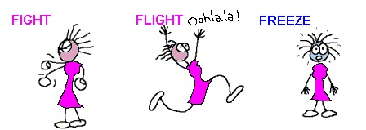
Brain/Body Response to Trauma
Notes:
Poll:
Have you ever been with a client who has been in the FIGHT response mode?
Have you ever been with a client who has been in the FLIGHT response mode?
Have you ever been with a client who has been in the FREEZE response mode?

Slide 9
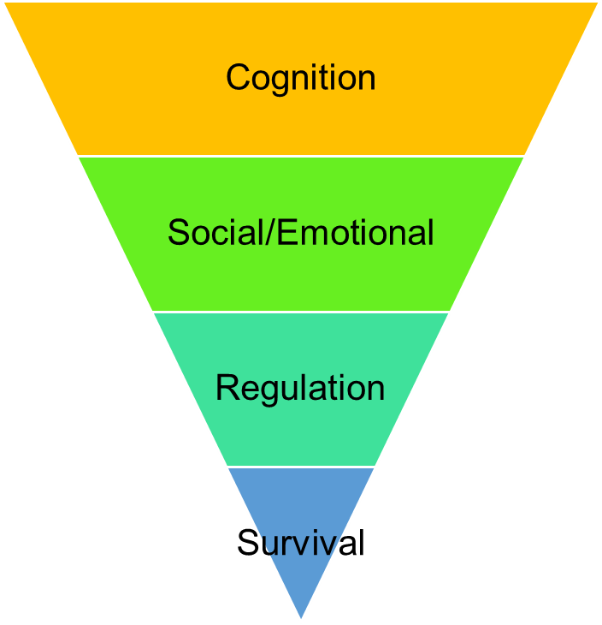
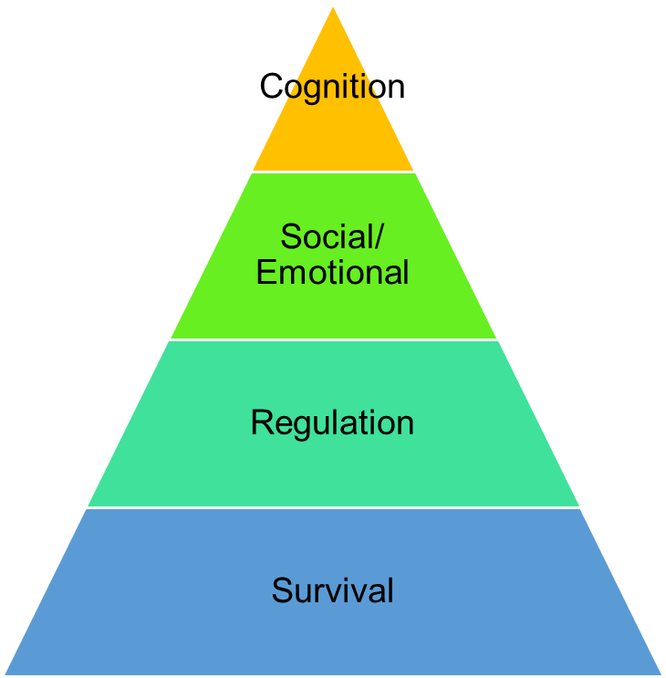
Brain Energy Allocation When Regulated
Brain Energy Allocation When Experiencing Harm
Adapted from Holt & Jordan, Ohio DoE based on Perry, B. (2006); Courtesy of Leora Wolf-Prusan, Pacific Southwest MHTTC
Notes:
Presenter Notes:
The diagram here represents the different levels of brain functioning and how the brain functions depending upon whether it senses danger or threat.
As discussed on the previous slide, higher functioning parts of the brain such as the cortex, decision making, moral reasoning, and many other functions involve rational thinking.
The lower point of brain known as the survival part of the brain mobilizes the body for action (i.e., fight or flight response) when danger is perceived, and overrides the upper part of the brain, effectively diminishing executive functioning and social & emotional regulation capacity.
Important connection to development: The typical child who is not living with lots of trauma exposure, spends little time focused on survival and can devote most of her/his waking time to cognition and social-emotional functioning. For a child who has experienced developmental trauma, the triangle can become inverted with the majority of the brain’s attention focused on survival, leaving little left for cognitive development.

Slide 10
Poll #2
Have you ever been with a client who has been in the FIGHT response mode? (yes/no/unsure)
Have you ever been with a client who has been in the FLIGHT response mode? (yes/no/unsure)
Have you ever been with a client who has been in the FREEZE response mode? (yes/no/unsure)

Slide 11
2. Strengthen Core Life Skills
Executive Function: The set of skills that enable us to focus on multiple streams of information simultaneously, monitor mistakes, make decisions, adapt and revise plans as necessary, and exert control over impulses to allow frustration to result in hasty actions (Center for the Developing Child at Harvard University).
Self-Regulation: Managing thoughts, feelings and behaviors to facilitate adaptive & successful navigation of required and desired goal-directed activities, including those necessary for successful school, relational, workplace functioning (McClelland & Tominey, 2014; Murray, Rosanbalm, Christopoulos, & Hamoudi, 2015).

Slide 12
Self-Regulation requires Co-Regulation
Co-Regulation: The interactive process between caring adults and children, youth, or young adults to facilitate a child’s ability to understand, express, and modulate their thoughts, feelings, and behavior through support, coaching, and modeling (Murray, Rosanbalm, Christopoulos, & Hamoudi, 2015)

Slide 13
3. Reduce or Buffer Sources of Stress
Normal Stress
Tolerable Stress
Toxic Stress
Constant stress depletes precious energy the brain needs for healthy development in childhood (Center for the Developing Child at Harvard University)

Slide 14
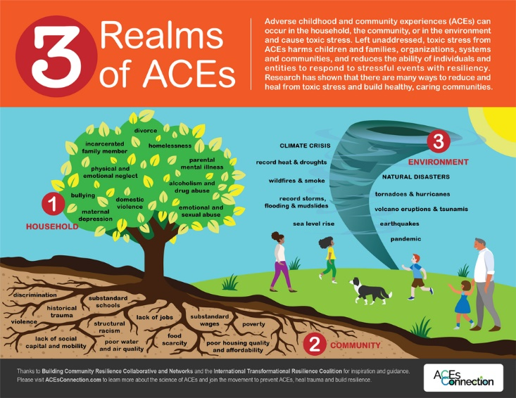

Slide 15
HOPE: Health Outcomes From Positive Experiences
“[I]mproving the lives of children exposed to experiences or conditions that create toxic stress requires expanding the conventional approach to responding to ACEs by elevating the importance of maximizing positive experiences for children, in addition to minimizing risks and the effects of negative experiences on the child.
“The HOPE framework grows out of and complements prior holistic approaches to child health care.”
Sege & Harper Browne, 2017

Slide 16
Positive Childhood Experiences (PCEs)
Family & Home | School & Community
Felt able to talk with their families about their feelings Felt their families stood by them during difficult times Enjoyed participating in community traditions Felt safe and protected by an adult in their home | Felt a sense of belonging in high school Felt supported by friends Had at least two non-parent adults who took genuine interest in them
Bethell, Jones, Gombojav, Linkenbach & Sege (2019)
Notes:
Presenter Notes:
We are now recognizing that the absence of negative experiences is not necessarily all that is needed to have a positive childhood. What we now understand is that it’s important to also promote positive experiences.
Further, recent research tells us that the presence of positive childhood experiences can make a difference in how youth respond to ACE exposure: those youth with ACEs but who also have PCEs do better than those with ACEs but no PCEs. In fact, they can even do better than those youth who don’t have any ACEs, but who also are lacking PCEs.
Published in 2019, the PCEs study lead by Christina Bethell, PhD (Johns Hopkins University) looked at seven (7) questions related to positive childhood experiences
This study was designed to measure a dose-relationship between how many positive experiences adults reported along with mental and relational health
There were a total of 6,000 adults from Wisconsin who participated in the study
Both ACEs and PCEs surveys measure aggregate experiences in the same way
“This study offers the hopeful possibility that children and adults can thrive despite their accumulation of negative childhood experiences.”
Christina Bethell, PhD, MPH, MBA

Slide 17
4 Key Positive Experiences (Sege & Harper Browne, 2017)
being in nurturing, supportive relationships
living, developing, playing, and learning in safe, stable, protective, and equitable environments
having opportunities for constructive social engagement and connectedness
learning social and emotional competencies

Slide 18
Indicators of Flourishing in Children (Bethell, Gombojov & Whitaker, 2019)
Child’s interest and curiosity in learning new things
Child’s persistence in completing tasks
Child’s capacity to regulate emotions

Slide 19
Finding & Securing Trauma-Focused Interventions
Questions for Behavioral Health Providers:
What interventions are you/your staff trained or certified to provide?
What is your philosophy in working with families who have experienced substance use disorder or neonatal abstinence syndrome?
What are your expectations for caregivers and families? Anything additional for caregivers engaged in medically-assisted treatment for recovery?
How will you collaborate with other providers working with the family?

Slide 20
Bottom Line
All interactions with families can and should be trauma-informed and resilience-oriented
Intervention should always address relational dynamics – model what you want to see parents do
Build the positive relationships and dynamics even when adverse ones are present
Strengthening adults capabilities is key to supporting healthy children, families and communities

Slide 21
Miriam Silman MSW
Project AWARE/ Trauma Informed Care Program Administrator
Department for Behavioral Health, Developmental & Intellectual Disabilities
miriam.silman@ky.gov

