Slide 1
Respectful Conversations with Families Experiencing Substance Use Disorders and the Vital Role of Peer Support
Tonya Jernigan, LCSW, UK Pediatric Forensic Medicine
Amanda Metcalf, System of Care Family Leadership Coordinator, Kentucky Partnership for Families and Children, Inc.

Slide 2
Mentimeter Activity

Slide 3
Who are Substance-Exposed Babies?
A substance exposed infant is an infant that was exposed to substances, legal or illegal, while in the womb.
These infants may have been exposed to illegal substances, such as heroin, methamphetamine or marijuana, or to prescribed opioids, antidepressants or other medications (benzodiazepines, gabapentin, etc.).
A substance exposed infant is not an “addicted baby.” Babies are not addicts.

Slide 4
Why are Babies not “addicted” to Substances?
Addiction is defined as: “a treatable, chronic medical disease involving complex interactions among brain circuits, genetics, the environment and an individual’s life experiences. People with addiction use substances or engage in behaviors that become compulsive and often continue despite harmful consequences.” (American Society of Addiction Medicine, 2019)

Slide 5
Why are Babies not “addicted” to Substances?
Babies have not had the complex interplay of the environment and life experiences that individuals living with a substance use disorder (SUD) have had.
Babies are not engaging in compulsive behaviors despite harmful consequences.
Babies are born with a withdrawal syndrome, not an addiction to a substance.

Slide 6
A Part of the Family…
As a childcare worker you have an intimate relationship with families you serve.
You may be the first to notice when something with a child or his/her family seems different – in good ways or not so good ways.
Parents and guardians may look to you as an expert in child development or at the least, another expert in the life of their child.
When having conversations with families about their children, it will be important to stick to the facts, work within your area of expertise, offer hope and have referrals ready if needed.

Slide 7
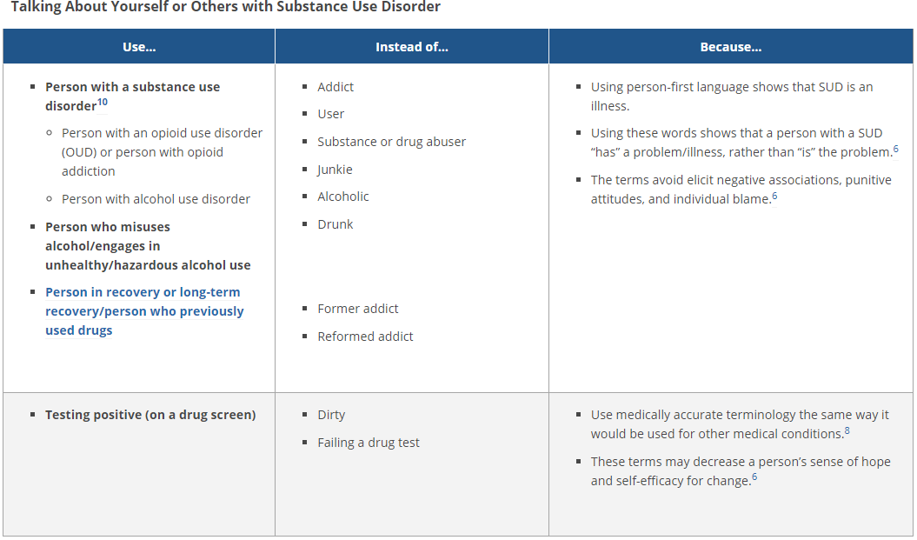
What is the Best way to Talk About Substance Use Disorders?
National Institute on Drug Abuse

Slide 8
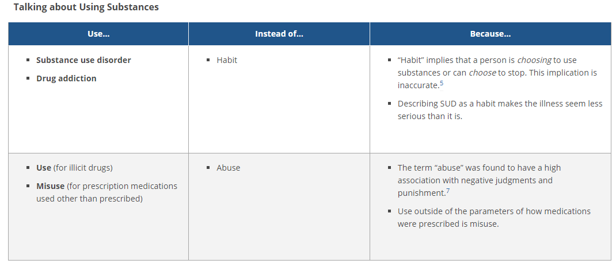
What is the Best way to Talk About Substance Use Disorders?
National Institute on Drug Abuse

Slide 9
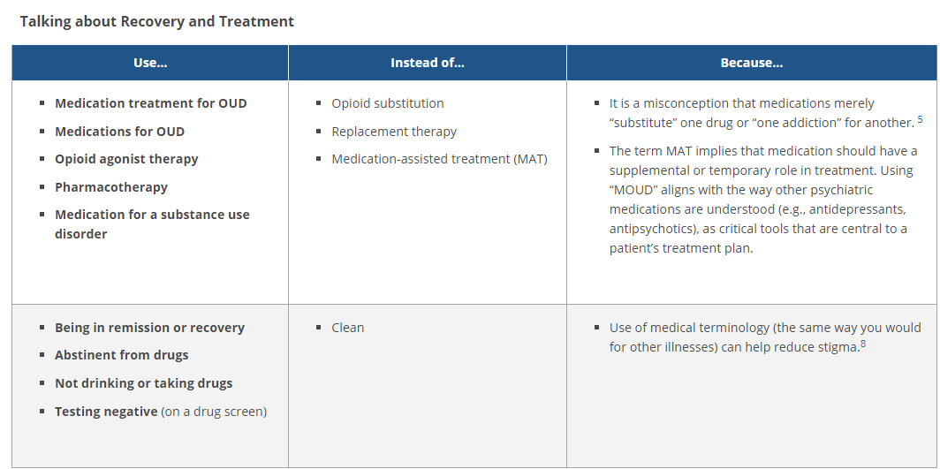
What is the Best way to Talk About Substance Use Disorders?
National Institute on Drug Abuse

Slide 10
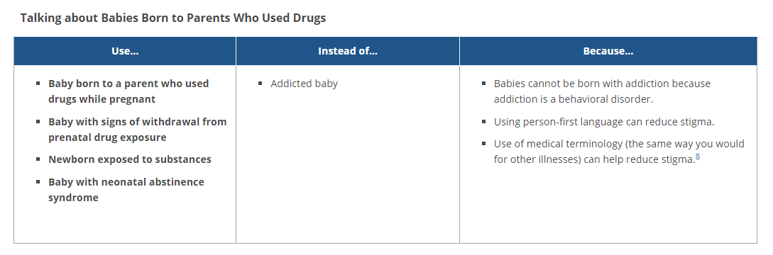
What is the Best way to Talk About Substance Use Disorders?
National Institute on Drug Abuse

Slide 11

Words Matter
“What we do and how we speak is either constructive or destructive. Choose to be constructive. Don’t be a bulldozer where life calls on you to be a builder.”
~Cleo Wade, Heart Talk: Poetic Wisdom for a Better Life

Slide 12
Shame and Stigma
Stigma is society’s negative attitudes towards a group of people created by stereotypes, prejudices and discrimination. Stigma has historically been strong regarding issues of addiction (National Movement to End Addiction Stigma)
Individuals living with an active substance use disorder and in recovery often internalize that stigma – meaning they really begin to believe those stereotypes society tells them. They may believe they really are bad people.
Families will often avoid services and asking for help because they fear being put down, blamed and further shamed.

Slide 13
How Can I Support a Family in Recovery?

Slide 14
Signs a family I am Serving is Struggling
Disclaimer: These signs are not a direct indication that a family is struggling with substance disorder or relapse.
It’s important to understand that substance disorder affects everyone differently.
Although there can be signs of substance issues, some families may never show those signs and will not “fit the mold” of what we think substance disorder looks like. Anyone can have a substance disorder.
However, when we fit all the pieces together and talk with the family, we can use this information to better understand the position the family is currently in.
Notes:
Disclaimer: Not all of these are signs that a family may be struggling with substance abuse or relapse. Other factors must be included such as; lack of transportation, lack of natural supports, etc…. There is no magic check list to show that people are using. Think about doctors and lawyers who function normally and them come out as a user. It could be anyone here.

Slide 15
Signs a Family I am Serving is Struggling
Missing scheduled appointments
No longer attending support groups or treatment
Not taking medication as prescribed
Unable to identify natural supports
Lack of confidence
Focusing on problems and not solutions
Lack of motivation to move forward in their recovery journey
Unable to contact family by phone, email, or text
Families expressing a “lack of hope” or “hopelessness” with you
Notes:
Families have lives outside of treatment and services. Sometimes we forget that. Families have issues with transportation, housing, child care, etc. Families may have to balance multiple issues at one time and also try and maintain their recovery.

Slide 16
How Can Peer Supports Help Families?
Peer Supports have “been there” and “done that”. They can use their lived experience to relate to families that have substance disorders and mental health issues.
Peers can share their stories and relate to families who are going through similar issues. They are just like the families they serve.
Peer Supports can assist with system navigation and find local community resources to support a family in their recovery journey.
Peer Supports hold hope for families. Peers Offer a nonjudgmental and peer to peer form of support…
Notes:
Peer Support Specialist have lived experience within the systems of care. They have experience in navigating these systems and coming out the other side of these systems…
When peer supports share their stories they show families that recovery is possible. “I did it and so can you”.
Peers know where to locate services and supports in their communities. They have used these services and supports for their own families.
I used to tell the families and parents that I worked with that, “If you feel hopeless and have no hope then I will hold the hope for you until you can hold it for yourself.” That showed families that they have someone in their corner that is on their side.

Slide 17
How Can I Share my Concerns with Families Compassionately?
Communicate with families in a way that demonstrates a collaboration, a joint-effort to help their child thrive.
Provide feedback to families about the positive and challenging moments you experience with their children.
Approach scenarios with the idea that most people are doing the best they can with what they have or with what they have been taught.
Put yourself in their shoes. How would you want someone to treat you in that situation? Withhold judgement for understanding.

Slide 18
Mentimeter Break #2

Slide 19
Three Take Away Points to Serve Families with Respect
Substance Use Disorder is a chronic disease. Like any chronic disease, there may be flare ups of symptoms.
Substance Use Disorder affects all types of people and effects everyone differently.
Although there are signs of substance use, that doesn’t mean that all signs lead to substance use or relapse in recovery.
Notes:
2) Families may be going through something that is not related to substance abuse. This is when we need to use positive and strength-based communication to ask them how they are doing. Let them know that you care and that you are there for them.

Slide 20
Key Strategies You Can Use Today
Use person-first, respectful language when talking about substance use disorders.
Know the agencies in your community that offer peer support services to families living with substance use disorder.
Initiate conversations with families who you think may be struggling with a strengths-based approach to offer support and hope. Families can be struggling with many different issues; it does mean that they have returned to drugs and/or alcohol.

Slide 21
Resources for families
Kentucky Partnership for Families and Children INC.
KPFC is a statewide, not for profit, family and youth organization that offers trainings, support, and information to families and youth throughout the state of Kentucky.
KPFC offers peer support by certified family, youth and adult peer support specialist throughout the state of Ky.
KPFC provides leadership opportunities for families and youth who want to support other families in their communities.
For more information, please visit the Kentucky Partnership for Families and Children website.

Slide 22

Resources You Can Use…
Treatment Locator
www.findhelpnowky.org
Text HOPE to 96714
Call 1-833-8KY-HELP
Parenting Education and Support
Kentucky’s HANDS Program (www.kyhands.com)
KY-Moms Maternal Assistance Towards Recovery
https://dbhdid.ky.gov/dbh/documents/kmm/infosheet.pdf
Notes:
NOTE: To change images on this slide, select a picture and delete it. Then click the Insert Picture icon in the placeholder to insert your own image.

Slide 23
Resources You Can Use…
Avoiding Stigmatizing Language
https://www.drugabuse.gov/nidamed-medical-health-professionals/health-professions-education/words-matter-terms-to-use-avoid-when-talking-about-addiction
https://www.shatterproof.org/sites/default/files/2021-02/Stigma-AddictionLanguageGuide-v3.pdf
Notes:
NOTE: To change images on this slide, select a picture and delete it. Then click the Insert Picture icon in the placeholder to insert your own image.

Slide 24
References
Substance Abuse and Mental Health Services Administration. Clinical Guidance for Treating Pregnant and Parenting Women with Opioid Use Disorder and Their Infants. HHS Publication No. (SMA) 18-5054. Rockville, MD: Substance Abuse and Mental Health Services Administration, 2018.
Shatter Proof. Addiction Language Guide. Retrieved from https://www.shatterproof.org/sites/default/files/2021-02/Stigma-AddictionLanguageGuide-v3.pdf.
National Institute on Drug Abuse. Words Matter: Preferred Language for Talking About Addiction. Retrieved from https://www.drugabuse.gov/drug-topics/addiction-science/words-matter-preferred-language-talking-about-addiction.
National Institute on Drug Abuse. Your Words Matter – Language Showing Compassion and Care for Women, Infants, Families and Communities Impacted by Substance Use Disorder. Retrieved from https://www.drugabuse.gov/nidamed-medical-health-professionals/health-professions-education/words-matter-language-showing-compassion-care-women-infants-families-communities-impacted-substance-use-disorder.

Slide 25
Team KY SCOPE Child Challenge

Slide 26
Background on Case
“Lilly” is a 3-year-old girl who attends an early head start program affiliated with a local long-term treatment center for parenting women with substance use disorders. Lilly lives with her natural mother, her 8-year-old sister and mother’s boyfriend. Lilly was separated from her mother for the first 1.5 years of her life while her mother was incarcerated in a state prison and lived with her maternal grandmother. Lilly was able to move in with her mother while her mother was in residential treatment and has lived her with ever since. Lilly has been in the early head start program for the last 8 months. Lilly is receiving occupational and speech therapy while at the head start program.

Slide 27
Child and Family Strengths
Lilly has adapted well to the head start program and has made significant improvements, per her occupational and speech therapists. Lilly engages with her peers well and appears to enjoy attending the head start program and learning. Lilly’s mother has participated in parenting education groups and Lilly and her mother seemingly have a strong, secure attachment despite the early separation. Lilly’s mother has been in recovery for approximately one and half years and reports that she has some support, has had stable employment for the past 6 months, and reports no violence in her current relationship.

Slide 28
Primary Areas of Challenge
Lilly has been late to the Center more days than not over the last month or has not been dropped off at all. Staff have also noticed that she has regressed in her progress with her speech therapy and has been much more “clingy” when dropped off at the center and struggling with transitions throughout the day. While usually her mom drops her off to school and communicates well with the teachers about any changes at home, Lilly has been dropped off by mom’s boyfriend with increasing frequency and mom has not been returning calls or emails from the head start staff.

Slide 29
Barriers and Goals for this Challenge
Barriers: Tardiness and increasing absences for Lilly; changes in Lilly’s behavior and in Mom’s engagement and accessibility
Goals: Provide family with support and reduce barriers for attending school; help with stability and reduce stressors that may impede mom’s progress in her recovery

