Slide 1

Sensory Processing: What we know so far
Project Scope: Supporting Children of the opioid Epidemic Felicia Bernhard, OTR/L BCP
Kathy Krebs, OTR/L
(Occupational Therapists)

Slide 2
Presenter Information
◆ Felicia Bernhard, OTR/L
Cincinnati Children’s Hospital

Slide 3
Disclosure
◆ Nothing at this time

Slide 4
Learning Objectives
At the end of this session, participants will be able to
◆ Understand the definitions of Sensory Under-Responsive, Sensory Over-Responsive and Sensory Craving
◆ Discuss the differences in how behaviors in each category show in children
◆ Describe basic treatment principles to address Sensory behaviors

Slide 5
References
◆ STAR Institute for Sensory Processing Disorder
◆ Lucy Jane Miller Sensational Kids: Hope and Help for Children with Sensory Processing Disorder
◆ Kelly Mahler Interoception: the eight sensory system

Slide 6
Overview of Sensory Systems
◆ Tactile (touch)
◆ Auditory (sound)
◆ Visual (sight)
◆ Olfactory (hearing)
◆ Gustatory (taste)
◆ Vestibular
position and movement in relation to gravity
◆ Proprioception
input from muscles and joints regarding body is in space as
well as the concept of pressure
◆ Interoception temperature
sensations in organs; feeling of hunger, pain, itch, body

Slide 7
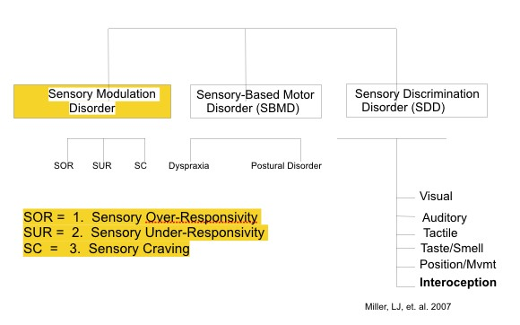
Sensory Processing Disorders:
Focus on Sensory Modulation Disorder

Slide 8
Sensory Processing Disorder Subtype:
Sensory Modulation Disorder (SMD)
◆ Difficulty regulating responses to input
◆ Difficulty getting and keeping an appropriate arousal level for different environments and tasks
◆ Difficulty adapting to challenges in daily life

Slide 9
Sensory Modulation Disorder Subtype: Sensory Over-Responsivity (SOR)
Also known as sensory avoiding or sensory defensiveness- A little bit of input can be interpreted as a larger amount of input
◆ Can be over-responsive in any of the previously mentioned sensory systems (very rarely in proprioception). Responds too much, too long to sensory stimuli
◆ Sensory Over-Responsivity Behaviors:
◆ Easily overwhelmed by input, can become aggressive, irritable, fussy, moody, tactile defensiveness (to touch)
Treatment Principles: raise tolerance for input, get and stay regulated; activities are slow/low intensity, maintain a calm-alert state

Slide 10
Sensory Modulation Disorder Subtype: Sensory Under-Responsivity (SOR)
◆ Can be under-responsive in any of the previously mentioned sensory systems – less sensitive to and less aware of input
◆ Sensory Under-Responsivity Behaviors:
◆ Doesn’t cry when hurt
◆ May not notice when touched
◆ Prefers sedentary (inactive) activities
Treatment Principles: increase arousal in organized way, integrate/include high intensity activities into the day

Slide 11
Sensory Modulation Disorder Subtype Sensory Craving
Individual seems to need more sensory input than most
◆ Sensory Craving Behaviors:
◆ Constantly wants control of every situation
◆ Interrupts, cannot wait
◆ Angry/explosive response to redirection
◆ Tends to engage in dangerous behaviors
◆ Often intense, demanding, hard to calm
◆ Constantly on the move

Slide 12
Sensory Craving continued
◆ Likes to rough-house
◆ Constantly touches objects
◆ Intrudes on personal space
Sensory seeking used to be the term that lead people to believe that the individual needed more input. We are learning that they do not need more. If they get more, they will only want more.

Slide 13
Sensory Craving treatment
Treatment Principles
◆ Giving the sensory craver more input makes him want more input
◆ These individuals are not under aroused- they don’t need more input
◆ Provide lots of structure to movement-based activities, make them purposeful and functional
◆ Teach awareness of difference
◆ Incorporate heavy work with interruptions
◆ hop to get a puzzle piece and return to puzzle
◆ help move

Slide 14
More Sensory Craving treatment
Incorporate resistance movement- not just free movement
Push pull activities
Body compression and pressure
Whenever possible, assign jobs: stack chairs
Don’t take recess away, but also don’t think that recess will provide appropriate input to help child stay organized
Set limits, create boundaries, provide opportunities to succeed at following simple directions to allow for praise

Slide 15
Arousal Thresholds
 | Threshold | Goal | Activities
Sensory over responsive | Low | Raise threshold | Slow/low
Sensory under responsive | High | Lower threshold | Fast/blast
Sensory craving | Does not fit threshold model

Slide 16
Sensory Under-Responsive
Fill the cup
Sensory Over-Responsive
Empty the cup
Sensory Craver
Cup has a hole in it!

Slide 17
Findings from my experience:
◆ Children who have been exposed often live in Sensory Craving
◆ Children do not respond to threshold theory of practice, so much of what is known about sensory treatment does not necessarily apply to this group of children
◆ It is very important to remind caregivers that the child does not need MORE movement. They need organized movement.
◆ Start with setting limits, following rules and simple one-step directions to allow for success with everyday activities. This can help child experience a different sensation and a different reaction from adults.
◆ Remember these are kids who are often redirected for unsafe behaviors and require constant reminders. It can be helpful to give the child an opportunity to get praise for doing something calming.

Slide 18
Key Strategies
For children who are over responsive, raise tolerance for input, get and stay regulated; activities are slow/low intensity, maintain a calm-alert state
For children who are under responsive, increase arousal in organized way, integrate/include high intensity activities into the day
For children who are sensory seeking, they need organized movement

Slide 19
Questions?

