Slide 1
Trauma Informed Interventions for Families with Young Children
Miriam Silman, MSW
Project AWARE, Trauma Informed Care Program Administrator
miriam.silman@ky.gov
502-782-3662

Slide 2
Road Map
Three Core Principles of Child Development from a Trauma-Informed Perspective
Trauma-Informed Evidence Based Practices (EBP) for Families with Young Children
Six Principles of Trauma-Informed Systems
Traumatic Stress Assessment Tools

Slide 3
Self-Awareness is Key
Pay attention to your own needs & responses
Take care of yourself however you need during our discussion
Effects can linger, or surface later
Use coping skills that help you metabolize your responses to trauma
Find safe space in which you can process your experiences – may mean using coping strategies including talking to colleagues, friends, family, or professional provider

Slide 4
Trauma
“Trauma occurs in layers, with each layer affecting every other layer. Current trauma is one layer. Former traumas in one’s life are more fundamental layers. Underlying one’s own individual trauma history is one’s group identity or identities and the historical trauma with which they are associated.”
Bonnie Burstow (2003), Toward a Radical Understanding of Trauma and Trauma Work

Slide 5
What’s the Goal?
Resilience
Regulation
Relation-ships

Slide 6
Six Principles of Trauma-Informed Systems
Safety
Trustworthiness & Transparency
Peer Support
Collaboration & Mutuality
Empowerment, Voice & Choice
Cultural, Historic & Gender Issues
SAMHSA, (2014), SAMHSA’s Concept of Trauma and Guidance for a Trauma-Informed Approach

Slide 7
TI Elements are Always Present
Outreach
Prevention & Promotion
Intake & Assessment
Triage & Referral
Service Planning
Service Delivery
Service Completion
Post-Service Planning

Slide 8
Safety (Physical & Psychological)
Consistency, Predictability
Regular routine
Clear boundaries
Responsive caretaking
Soothing response to distress
Unconditional love & acceptance
No physical punishment
Avoid re-traumatization, acknowledge stress response

Slide 9
Trustworthiness & Transparency
Do what we say, say what we do
Informed consent, alternatives known
Clear, specific releases of information
Implications/consequences of actions (inactions) clearly articulated
Accessible language & information (literally & figuratively)
Intervention plan known to all
No surprises

Slide 10
Peer Support
Value lived experience
Value all individuals as worthy
De-stigmatization
Avoid perfectionism, tolerate setbacks, normalize failure
“Nothing about us without us”

Slide 11
Collaboration & Mutuality
True consumer collaboration
Discussions, not lectures
Active listening
Reducing power differentials
Consumers are the experts on themselves, their family, their needs
Dignity for all

Slide 12
Empowerment, Voice & Choice
Authentic consumer voice
Real choices
Shared decision-making
Strengths-focused
Resilience-oriented
Self-advocacy encouraged & supported
Providers = facilitators (not directors/ controllers)

Slide 13
Cultural, Historical & Gender Concerns
Cultural humility
Recognition of racial & historical trauma
Equity in policy, programming, practice
Recognition of intersectionality
Diversity in staff & consumer domains
Active redress of disparities & micro- and macro-aggressions
Advocacy on behalf of oppressed persons
Disaggregate data to understand disparities

Slide 14
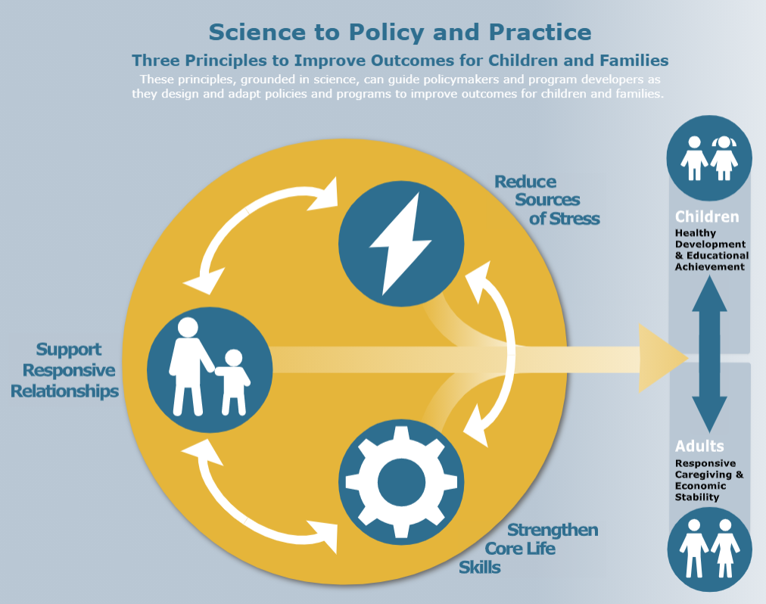
Three Core Components of Child Development
Support Responsive Relationships
Strengthen Core Life Skills
Reduce Sources of Stress
Center for the Developing Child at Harvard University: https://developingchild.harvard.edu/resources/three-early-childhood-development-principles-improve-child-family-outcomes/#strengthen-skills

Slide 15
Support Responsive Relationships
Child–Adult relationships, “serve & return”, promote healthy brain development and buffers challenges & stress
“The more healthy relationships a child has, the more likely he will be to recover from trauma and thrive. Relationships are the agents of change and the most powerful therapy is human love.” Bruce Perry, MD
Adult–Provider relationships build resilience through support & hope
“[W]hen adults are supported and can model responsive relationships with each other and with children, the benefits come full circle, ultimately helping children become healthy, responsive parents themselves.” Center for the Developing Child at Harvard University

Slide 16
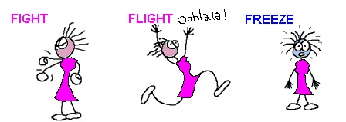
Brain/ Body Response to Trauma
What happens when the frontal lobe goes offline?
How do we learn to calm & re-regulate?
How does Substance Use Disorder impact stress response & recovery processes?

Slide 17
Strengthen Core Life Skills
Executive Function: The set of skills that enable us to focus on multiple streams of information simultaneously, monitor mistakes, make decisions, adapt and revise plans as necessary, and exert control over impulses to allow frustration to result in hasty actions (Center for the Developing Child at Harvard University).
Self-Regulation: Managing thoughts, feelings and behaviors to facilitate adaptive & successful navigation of required and desired goal-directed activities, including those necessary for successful school, relational, workplace functioning (McClelland & Tominey, 2014; Murray, Rosanbalm, Christopoulos, & Hamoudi, 2015).

Slide 18
Self-Regulation requires Co-Regulation
Co-Regulation: The interactive process between caring adults and children, youth, or young adults to facilitate a child’s ability to understand, express, and modulate their thoughts, feelings, and behavior through support, coaching, and modeling (Murray, Rosanbalm, Christopoulos, & Hamoudi, 2015)

Slide 19
Reduce or Buffer Sources of Stress
Normal Stress
Tolerable Stress
Toxic Stress
Constant stress depletes precious energy the brain needs for healthy development in childhood (Center for the Developing Child at Harvard University)

Slide 20
Traumatic Stress Assessment for Young* Children
Measure | Authors | Ages
Child Behavior Checklist (CBCL) | Achenbach & Rescoria (2001) | 1.5 – 6 years
PTSD Semi-Structured Interview & Observation Record | Scheeringa & Zeanah (1994) | Birth – 4 years
Posttraumatic Symptom Inventory for Children (PT-SIC) | Eisen (1997) | 4 – 8 years
Preschool Age Psychiatric Assessment (PAPA) | Egger & Angold (1999) | 2 – 5 years
PTSD Symptoms in Preschool Aged Children (PTSD-PAC) | Levendosky, Huth-Bocks, Semel, & Shapiro (2002) | 3 – 5 years
Traumatic Events Screening Inventory-Parent Report Revised (TESI-PRR) | Ghosh et al. (2002) | 0 – 6 years
Trauma Symptom Checklist for Young Children (TSCYC) | Briere et al (2001) | 3 – 12 years
Violence Exposure Scale for Children-Preschool Version (VEX-PV) | Shahinfar, Fox, and Leavitt (2000) | 4 – 10 years
Violence Exposure Scale for Children-Revised Parent Report (VEX-RPR) | Shahinfar, Fox, and Leavitt (2000) | 4 – 10 years
*Note: There are additional measures for older youth

Slide 21
Trauma-Focused EBPs for Young Children (1)
 | # Sessions | Notes | Ages
Alternatives for Families: A Cognitive Behavioral Therapy (AF-CBT) | 20 | Target: physically abusive/coercive parents with concurrent emotional abuse | 5 – 17 years
Attachment, Self-Regulation & Competence: A Comprehensive Framework (ARC) | 12 – 52+ | Target: complex trauma Multiple modalities: individual, family, group; home-based prevention; | 2 – 21 years
Bounce Back | 10 | Target: Any trauma Modality: School based group + caregiver & individual sessions | 5 – 9 years (K – 4th grade)
Child Parent Psychotherapy (CPP) | 50 | Target: DV & child maltreatment; intergenerational, historical, | Birth – 6 years

Slide 22
Trauma-Focused EBPs for Young Children (2)
 | # Sessions | Notes | Ages
Family Centered Treatment (FCT) | 2 sessions/week for 6 months | Target: families at risk for disruption Modality: home-based family therapy | 0 - 17
Parent Child Care (PC-CARE) | 7 | Target: DV, child maltreatment, traumatic grief | 1 – 10 years
Parent Child Interaction Therapy (PCIT) | 14 - 25 | Target: complex trauma | 2 – 7 years
Trauma Informed Parenting Skills for Resource Parents (TIPS4RP; UK CTAC) | 12 | Target: all trauma Modality: Foster & Adoptive Parents | 0 – 17 years
Trust-Based Relational Intervention (TBRI) | 6-8 hrs/day, 4-5 days/wk, 2-5 wks | Target: all traumatic stress Modality: intensive in-place intervention for home, school, residential, etc. | 1 – 17 years
Trauma aligned: Attachment & Behavioral Catch-Up (ABC); Incredible Years; Triple P Parenting

Slide 23
Additional Trauma-Focused EBPs for Older Children & Adolescents
 | # Sessions | Notes | Ages
Trauma Affect Regulation Guide for Education & Therapy (TARGET) | 10 | Target: all trauma & complex trauma Modality: individual, family, group | 10+
Trauma-Focused Cognitive Behavioral Therapy (TF-CBT) | 8-25 | Target: All types of trauma & traumatic grief Modality: individual with 2-3 caregiver sessions | 3 - 17

Slide 24
Finding & Securing Trauma-Focused Interventions
Do you do a comprehensive trauma assessment? If so, please describe how you do this.
What interventions are you/your staff trained/certified to provide?
What is your philosophy in working with families who have experienced SUD and/or NAS?
What are your expectations for caregivers & families? Anything additional for caregivers engaged in MOUD treatment?
How will you collaborate with us while working with families?

Slide 25
Bottom Line
All interactions with families can & should be trauma-informed and resilience-oriented
Recognize and assess signs & symptoms of traumatic stress in children
Intervention should always address relational dynamics
Trauma-focused EBPs should be utilized:
When children exhibit signs and symptoms of traumatic stress
If relational attachment is impeded
If risk of disruption/removal is present
Strengthening adults capabilities is key to supporting healthy children, families & communities

Slide 26
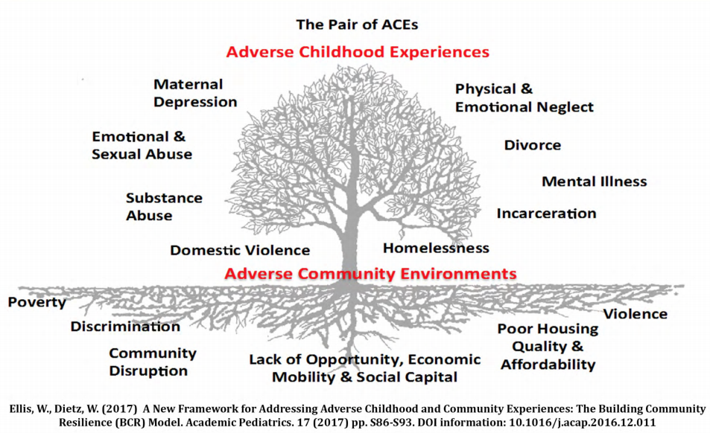
The Pair of ACEs

Slide 27
ACEs +
Abuse & Neglect | Household Dysfunction | PEARLS
Emotional abuse Physical abuse Sexual abuse Emotional neglect Physical neglect | Mother Treated Violently Household Substance Abuse Household Mental Illness Parental Separation or Divorce Incarcerated Household Member | Witnessed or experience violence in community/school Experience racism or discrimination Homelessness Food insecurity Separation from caregiver (foster care, immigration) Caregiver illness/ injury Caregiver death
The Pediatric ACEs and Related Life-events Screener (PEARLS): https://www.dhcs.ca.gov/provgovpart/Documents/PEARLS_FAQ_1.15.19.pdf

Slide 28
The Pair of ACEs

Slide 29
Complex Trauma
Complex Trauma: “children’s experiences of multiple traumatic events that occur within the caregiving system – the social environment that is supposed to be the source of safety and stability in a child’s life.”
(NCTSN, 2003)
Complex Trauma: The exposure to multiple traumatic events. The experience of harm at the hands of a caretaking person often creates a sense of betrayal and loss of trust in others. The long term effects and impacts of that exposure to multiple traumatic events which can disrupt numerous areas of development and functioning.

