Slide 1
Having Difficult Conversations in Field and Clinical Settings Jason Joy, MS, LMFT UK PATHways Program Director

Slide 2
Having Difficult Conversations with Patients
Sensitive Topics
Demeanor of the Patient
Language and Cultural Differences
Education and Knowledge Base
Other Issues?

Slide 3
Diving Head-First Into Difficult Conversations
Started at UK Healthcare 2011 as Brief Interventionist with Bell Consultation Service
Provided evidence-based Screenings and Brief Interventions for patients identified with at-risk alcohol and substance use
1000+ Interventions per year from 2011-2016
Every intervention provided a “Pause for Apprehension”
Learned to become comfortable with the uncomfortable

Slide 4
What is SBIRT?
S = Screening
Universal screening in primary care settings
Use of an evidence-based screening tool
Use of biological screens
BI = Brief Intervention
Goal is to educate and motivate
Address risky/ unhealthy behavior
RT = Referral to Treatment
Linkage from primary care settings to specialty treatment services
“Warm-hand” off preferred
-SBIRT Whitepaper 2011

Slide 5
What is SBIRT?
Defined by SAMHSA: as a comprehensive, integrated, public health approach to the delivery of early interventions for individuals with risky alcohol and drug use, and the timely referral to more intensive substance abuse treatment for those who have substance abuse disorders.
Applications for- Tobacco Use, Depression and Trauma/Anxiety Disorders.
Based on Motivational Interviewing and Stages of Change
- SBIRT Whitepaper 2011

Slide 6
What is Motivational Interviewing?
Motivational Interviewing (MI) was developed by Miller and Rollnick and is an evolution of Carl Roger’s client-centered therapy.
It is a client-centered yet directive approach.
It is a therapeutic style rather than a set of techniques that aims to help clients explore and resolve their ambivalence to changing.
Notes:
It is predicated on the belief that the client is the expert on their lives and has the inherent knowledge of what is best for them. It works to empower them and give them the authority to make changes in their life.

Slide 7
Motivational Interviewing- Central Principles
Express Empathy
Develop Discrepancy
Rolling with Resistance
Supporting Self-Efficacy
Examination and Resolution of Ambivalence
Avoid Arguing

Slide 8
Expressing Empathy
Show interest and caring.
Convey that you are trying to understand the client’s experience.
Show unconditional positive regard.
Help create a collaborative relationship.
Notes:
Empathy in action- responding to the nonverbals- ex. Leave me alone, give me my space- working with a teen

Slide 9
Rolling With Resistance
Strategies for Dealing with Resistance:
Simple reflection
Shifting focus
Reframing
Notes:
Client: But I can’t quit drinking! All of my friends drink!
Counselor: And it may very well be that way when we’re through. You may decide that it isn’t worth it to quit drinking or that it is too difficult to make the change. That will be up to you.
Avoids arguing, you’re not here to tell them not to drink or use!!!

Slide 10
Simple Reflection
Approaching resistance with nonresistance.
Reflecting what the client has said in a way that is neutral.
It is not repeating word for word what they said.
Reflect not only what they are saying, but their emotional responses.
Acknowledges and validates what the client has said and sometimes can elicit an opposite response.
Notes:
Client: I don't plan to quit drinking anytime soon.
Clinician: You don't think that abstinence would work for you right now.
Ex. You’re children are living with you right now, and that seems painful for you.
Having them hear what they are saying in a slightly different way.

Slide 11
Shifting Focus
Defuse resistance by helping the client to shift his/her focus away from obstacles and barriers.
Often it is not motivational to address resistant or counter-motivational topics.
Focus on potential strengths or positives in their life.
Notes:
Example:
Client: I can't stop smoking reefer when all my friends are doing it.
Clinician: You're way ahead of me. We're still exploring your concerns about whether you can get into college. We're not ready yet to decide how marijuana fits into your goals.

Slide 12
What is Ambivalence?
Ambivalence is a state of mind in which a person has conflicting feelings about something.
Ambivalence is not reluctance to do something, but rather conflict about choosing between two courses of action.
Notes:
Seen in the substance abuse population when trying to change.
“I really want to change and know that I should but I just can’t do it because all my friends do.

Slide 13
Develop Discrepancy
Seek to identify inconsistencies between clients intrinsically held values desires and their current behaviors.
Difference between how the person is now and where they would like to be in the future.
This cognitive dissonance is necessary for change to occur.
Notes:
Example:
Mother who wants to be there for her kids, but is addicted to substances and in unable to care for them appropriately because of the addiction.

Slide 14
Support Self-Efficacy
Build their confidence.
Help them recognize themselves as the authority and expert with the inherent knowledge of what is best for them and the freedom to make their own choices.
Promote their ability to make choices with the heightened awareness of their best interests and values.

Slide 15
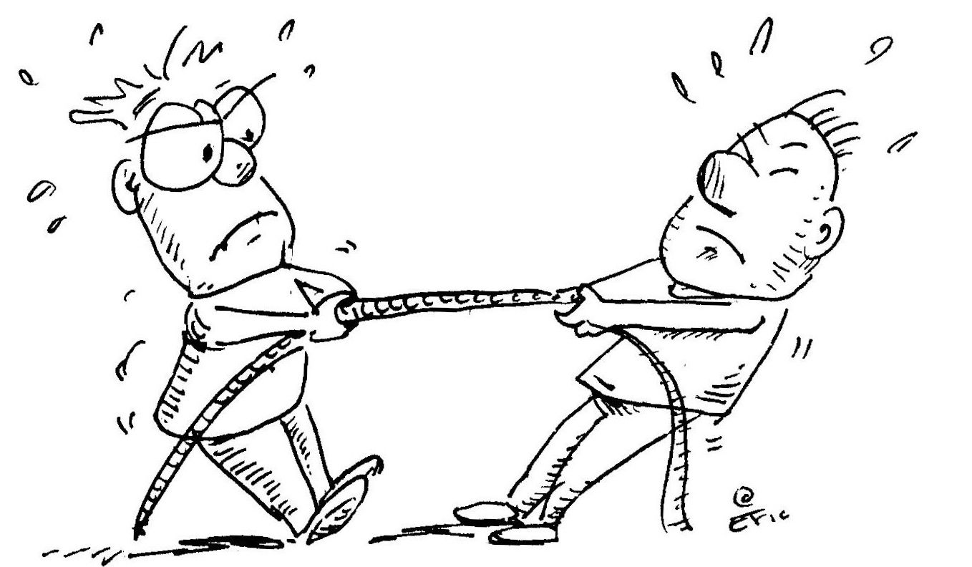
Avoid Arguing
Avoid arguing with clients.
Do not engage in a power struggle.
Resist Lecturing
Ask to Educate
Notes:
Engaging in a power struggle with clients will damage the relationship and nothing will get accomplished.
If a client is only interested in arguing, the intervention will not be successful
Tug of war, exerting a lot of energy, but not going anywhere. Drop the rope.

Slide 16
Stages of Change Model
Stages of Change Model was developed separate from MI.
Views stages of change as a continuum rather than discrete events.

Slide 17
Prochaska and Di Clemente’s Transtheoretical Model of Behavior Change
Pre-Contemplation
Contemplation
Preparation
Action
Maintenance
Relapse

Slide 18
Stages of Change
Stage of Change | Characteristics | Provider’s Goal
Pre-Contemplation | No intention to change behavior. No awareness of limited awareness of problems associated with behavior | Help patient identify they have a problem associated with a particular behavior.
Contemplation | Aware of the problem and considering a change but no commitment to take action | Raise awareness of the problem and identify possible ambivalence to taking action toward change.
Preparation | Patient intends to change and makes small steps towards making a decisive action step. | Encourage these steps, support the change process and facilitate patient to commit to making a change a top priority
Action | Patient decides to a decisive step to change | Reinforces change, provides support and guidance
Maintenance | Works to prevent relapse and capitalize on gains | Support continued change and help with relapse prevention

Slide 19
MI and Stages of Change
Identifying what stage of change a client is in allows the provider to better match what type of intervention to use.
MI is useful for clients who are in the early stages of change.
The goal of MI should be to move the person into the next stage of change (i.e. from pre-contemplation to contemplation). One stage at a time

Slide 20
References
Miller, W.R.& Rollnick, S. (2013) Motivational Interviewing: Helping people to change (3rd Edition). Guliford Press.
Prochaska, J.; Di Clemente, C. (2005) “The transtheoretical approach” in Handbook of psychotherapy integration (2nd ed.) Oxford University Press
SAMHSA (2011). Whitepaper: SBIRT.

Slide 21
Contact UK PATHways
Phone: 859-218-6165
By E-mail:
jason.joy@uky.edu
Or
pathways@uky.edu

