Slide 1
Neonatal Abstinence Syndrome
Diana Frankenburger, MSN, RNC-OB, CCE, CLS

Slide 2
Learning Objectives
Participant will be able to define Neonatal Abstinence Syndrome (NAS) and recognize its symptoms
Participants will be understand potential short and long term effects of NAS
Participants will be able to state initial nonpharmacological and pharmacological interventions for treatment of infants with NAS
Participants will be able to state potential supportive measures for children and parents through early childhood

Slide 3
The Opioid Crisis
2017:
US Department of Health and Human Service (HHS): opioid crisis in America is a public health emergency
11.1 million Americans misused prescription meds
47,872 deaths from unintentional overdose
2.6 million had opioid use disorder
Use of heroin and pain medications by women nearly doubled since 2009
Delivery records indicate quadrupling of opioid use disorder since 1999
(Kondili & Duryea, 2019)

Slide 4
Result of Opioid Exposure
Increase in health care spending for prolonged hospitalizations
50-80% of exposed infants develop NAS symptoms
Symptoms begin 24-48 hours
Symptoms can last up to 60 days

Slide 5
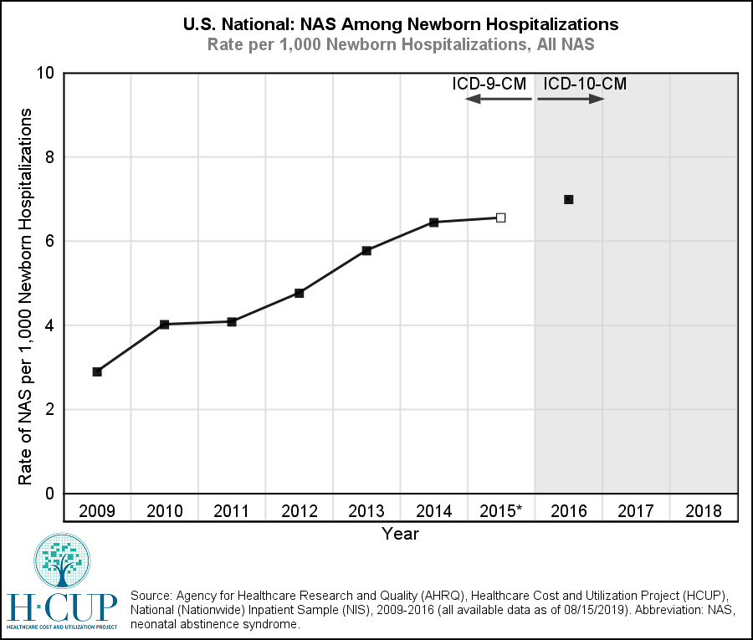
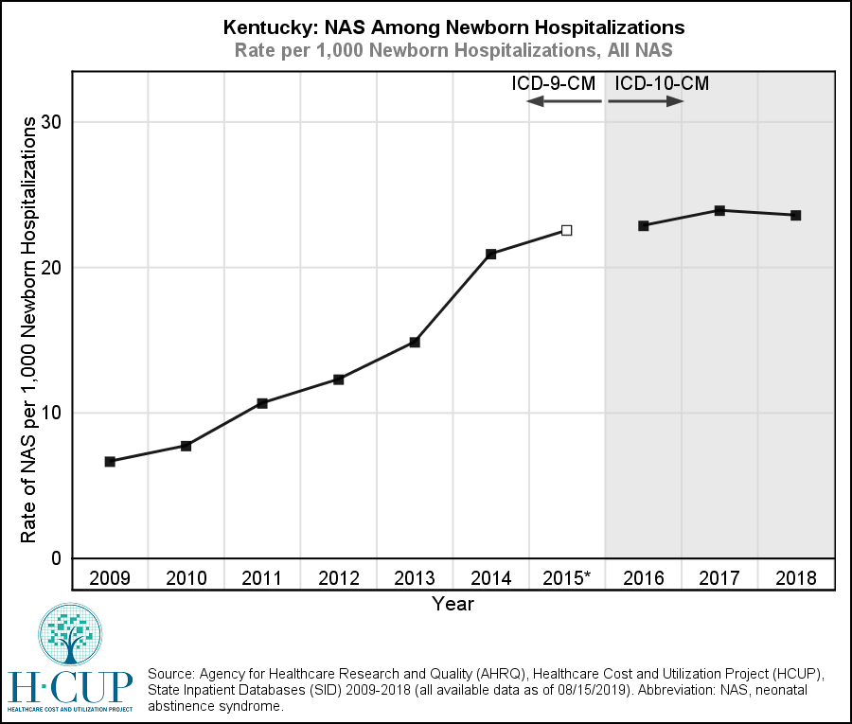
NAS in the United States and in Kentucky

Slide 6
Rate of NAS in southeastern Kentucky is approximately
three times higher than the statewide rate.

Slide 7
Definition of NAS
(Neonatal Abstinence Syndrome)
NAS can be characterized as an infant’s response to withdrawal of prescribed or illicit medications or substances they were exposed to in utero. This withdrawal may be potentiated by other medications or substances including nicotine and caffeine.
This response is evaluated using one of several scoring tools, most popular being Finnegan Neonatal Abstinence Scoring Tool.
Scoring involves evaluating how the infant functions in specific areas and scores response from normal to mild, moderate, or severe dysfunction.
(Reddy, et al.,2017)

Slide 8
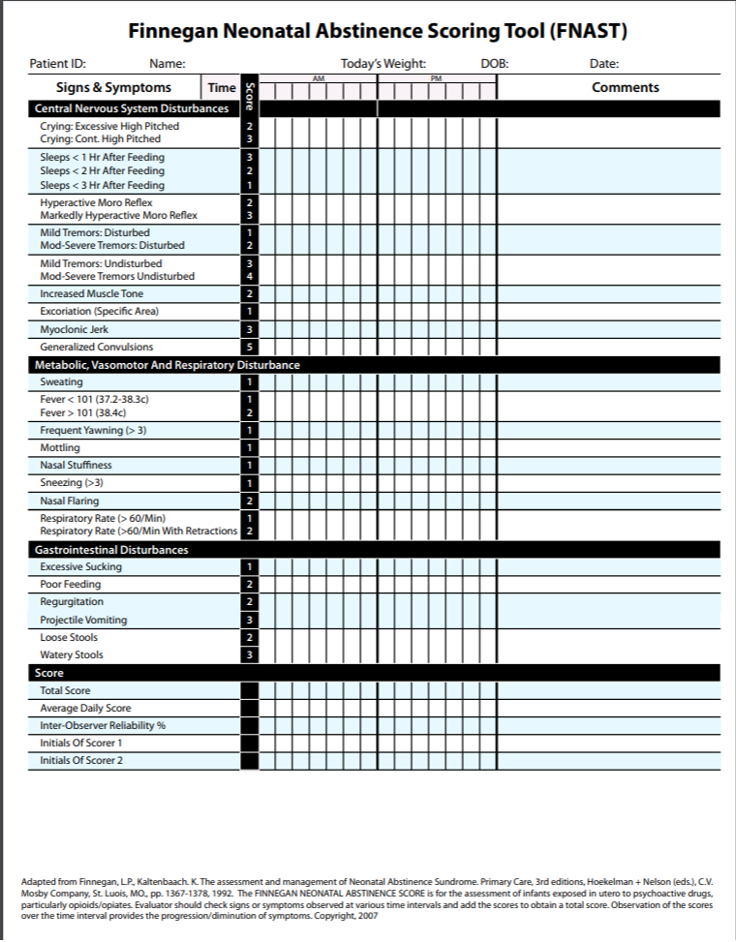

Slide 9
Areas of Short-term Dysfunction and Symptoms with NAS
Central Nervous System (high pitched cry, irritability, hypertonia, hyperreflexia, difficulty sleeping)
Gastrointestinal System (disorganized swallow and suck, poor feeding, weight loss, loose stools, spitting up)
Autonomic Nervous System (hyperthermia, nasal stuffiness, sweating, sneezing, mottling, yawning, tachypnea)

Slide 10
Symptoms of changes in neurotransmitters after loss of opioid supply
Dopamine decrease
Hyperirritability
Anxiety
Noradrenaline
Increase
Hyperthermia
Hypertension
Tremors
Tachycardia
Serotonin decrease
Sleep deprivation
Sleep fragmentation
Acetylcholine Increase
Diarrhea
Vomiting
Yawning
Sneezing
Sweating
(Kocherlakota, 2014)

Slide 11


NAS Crying

Slide 12
When Should Treatment for NAS Begin?
Evaluation begins with symptoms
Usually appear within 72 hours of birth
Scoring every 3-4 hours
Scoring >8 in 3 consecutive scorings/ >12 in two consecutive scorings
Length of stay for evaluation: 5 days
(Kondili & Duryea, 2019) (ACOG, 2017)

Slide 13
Why Treat Women with Opioid Agonists?
Prevents opioid withdrawal symptoms
Decreases use of non-medical opioids
Improves adherence to prenatal care
In combination with prenatal care, decreases risk of OB Complications:
Decreases risk of IUGR, abruption, preterm labor, fetal death
Decreases participation in high-risk behaviors, STIs, violence
Decreases risk of relapse during pregnancy
(ACOG Committee Opinion Number 711, 2017)

Slide 14
What About Medically Supervised Withdrawal?
Associated with higher relapse rates (59-90%)
Poorer pregnancy outcomes
Accidental overdose due to loss of tolerance
Higher obstetrical complications
Increased fetal stress or death
Decreased adherence to prenatal care/ lost to care
Often requires prolonged inpatient care or intensive outpatient care
(ACOG Committee Opinion Number 711, 2017)

Slide 15
Responsible Care
Obstetricians must use screening tools to evaluate all patients for SUD
Obstetricians must be educated on the risks and benefits of Opioid Agonist Therapy during pregnancy AND MUST EDUCATE THEIR PATIENTS
Methadone: prescribed by Addiction Medicine Specialist in licensed outpatient setting with daily dosing/dispensing
Patients stable on Methadone should continue it
Dosage may require adjustment during pregnancy
Buprenorphine/Buprenorphine with naloxone: prescribed by OB Care Provider with specialized training
Can be self-administered, prescribed in office setting, stigma
Buprenorphine has increased street value/potential for diversion. Buprenorphine with naloxone safe in pregnancy because is given sublingually (dangerous to fetus if injected)
Naltrexone is not currently recommended in pregnancy
Risk of NAS symptoms exist with Opioid Agonist Therapy-must be communicated
(ACOG Committee Opinion Number 711, 2017),(Reddy, et al., 2017)

Slide 16
Non-Pharmacological Supports
Breastfeeding when appropriate (ACOG, ABM)
Rooming in (AAP, ACOG)
Maternal involvement- Bonding and Attachment
Skin to skin (Kangaroo Care)
Infant massage, positioning
5 Ss Soothing Techniques
https://www.youtube.com/watch?v=crdQy8zliZw
(Kondili & Duryea, 2019)

Slide 17
Prenatal Support for Mothers: PATHways
Stabilization of Addiction
Prenatal Care and Education
Group and Individual Therapy
Social Service Support
Peer Support
NAS Symptom Reduction training
Breastfeeding encouragement
Smoking Reduction/Cessation

Slide 18

Impact of Group Prenatal Sessions
For every prenatal session attended, a patient was 13-18% more likely to have a negative screen for illicit drugs on admission (Adams, 2017).
Tracking patients’ progress though educational offerings
Incentives for completion
Involvement of Hospital staff (Neonatologists, PTs, RNs, IBCLCs, Music Therapist)
Empowers women to have tools for assisting infants through withdrawal. Gives them knowledge and decreases fear/anxiety about how to help
Notes:
As the impact of these group educational sessions was recognized, they were expanded and women are now required to complete sessions prior to delivery if possible. To help encourage this, we received a grant from MOD to provide car seats and packnplays to women who complete the curriculum. We are also using a similar education in surrounding communities via telehealth and group prenatal education, to decrease NAS in those areas as well.

Slide 20
Breastfeeding
Women who have appropriate drug screens are encouraged to breastfeed (ABM Protocol, 2015)
Breastfeeding decreases NAS symptoms (Kondili & Duryea, 2019).
Breastfed infants are less likely to require medication for withdrawal (Kondili & Duryea, 2019).
Women who have relapsed in the 30 days prior to delivery should not breastfeed (ABM Protocol, 2015).
Women who have relapsed in 30-90 days prior should be evaluated case by case (ABM Protocol, 2015)
Breastfeeding reinforces sobriety, bonding, and self-esteem. The biggest benefit is likely skin to skin contact and participation in care at the bedside (Saia, et al., 2016).
Notes:
We provide this information in clinic. In our current setting, women are not evaluated case by case if they have less than 90 days of appropriate screens. They must have 90 days.

Slide 21
Hospital Support: Keeping Moms and Babies Together
Staff trained in Trauma-Informed Care
Nurses receive ongoing training/evaluation in Finnegan Scoring
Rooming In
Nurses teach/encourage non-pharmacological soothing techniques: skin to skin, swaddling, white noise, swaying, rocking, pacifiers, calm environment
Lactation Consultants for Breastfeeding
Avoid alcohol wipes (use water wipes or 4x4s with sterile water; Aquaphor for breakdown)
Encourage Safe Sleep environments/practices
Dedicated Unit/Space/Staff for NAS
Care by Parent

Slide 22
Why Care By Parent?
AAP states first line of therapy for babies being evaluated for NAS is non-pharmacological supportive care (Highleyman, L., 2017).
Studies using Rooming-in models that keep mothers and infants together have found a decrease in the number of infants requiring pharmacological treatment and a decrease in infants’ length of stay (Knopf, 2018).
Rooming-in increases breastfeeding rates, decreases need for medication for NAS, and cuts average cost of treatment by 50%. (Knopf, 2018),(McQueen, 2018).
Notes:
Evidence now supports care by parent as the most effective way to decrease NAS symptoms and pharmacological treatment. Care by parent starts with delivery, and continues throughout mom’s stay on our MBU.
We prepare our moms to stay with their infants throughout their hospitalization.

Slide 23
Pharmacological Supports
Morphine: (average Length of Stay (LOS) 21 days)
Methadone: ( average LOS 14-21days)
Buprenorphine: (average LOS 9-15 days)
Clonidine: adjunctive; may assist in decreasing LOS
Phenobarbital: adjunctive; may assist in decreasing LOS (Kondili & Duryea, 2019).
Treatment is considered adequate if the infant has rhythmic sleep and feeding cycles and appropriate weight gain (Reddy, et al., 2017).

Slide 24
Short and Long Term Effects: Drugs, Environment, Genetics
Like prematurity, issues don’t resolve with infancy
More studies are needed on long term effects
When looking at any information on NAS and its long term effects, the lifestyle, economic, genetic, and social issues surrounding the development of these children have to be considered, whether raised by biological parents or the foster system.
Attachment is sometimes very difficult for mothers with SUD, either because of a lack of attachment from their own mothers, not being able to parent their infants from birth, or other struggles in their recovery.
Support may be needed mentally and physically through young adulthood.
(Oei, 2019).

Slide 25
Continued Support
Home Based Visitation Programs (HANDS)
Beyond Birth
New Vista
Voices of Hope
Women/infants are often lost to care after delivery, making follow up and continued support difficult.
Continued Medically Assisted Treatment until the woman feels ready to cease treatment may allow better accountability and access to healthcare for them and their children.

Slide 26
Beyond Birth
Continuation of support/care after PATHways for up to 5 years
Parenting Classes approved for DCBS
Attorney services
Job Prep Services KY Dept of Vocational Rehab
GED assistance KY Career Center
Group and Individual Therapy
Peer Support
Medically Assisted Therapy available

Slide 27
It takes a Village
Coordinated multisystem approach for pregnant women with SUD
Non-pharmacological therapies for NAS must be taught and encouraged
Women and families must feel supported and empowered to help their infants during evaluation/ treatment for NAS
Continued support and attachment assessment in first year
Home-based programs show promise in improving outcomes for children long term with continued resources
(Kondili & Duryea, 2019)
(Oei, 2019)

Slide 28
Questions

Slide 29
References
ACOG Committee Opinion (2017). Opioid use and opioid disorder in pregnancy, Number 711. Retrieved from https://www.acog.org/clinical/clinical-guidance/committee-opinion/articles/2017/08/opioid-use-and-opioid-use-disorder-in-pregnancy
Adams, E. (2017). PATHways program demonstrates success of evidence-based, collaborative approaches to perinatal opioid treatment. UKnow: University of Kentucky News. Retrieved from: https://uknow.uky.edu/uk-healthcare/pathways-program-demonstrates-success-evidence-based-collaborative-approaches.
Casper, T., & Arbour, M. (2014). Evidence-based nurse-driven interventions for the care of newborns with neonatal abstinence syndrome, Advances in Neonatal Care, 14(6): p. 376-380. doi: 10.1097/ANC.0000000000000118.
Highleyman, L. (2017). New approaches help babies get through opioid withdrawal, MedPage Today, May 12, 2017. Retrieved from: http://www.medpagetoday.com/meetingcoverage/pas/65259.
Knopf, A. (2018) More research needed on NAS, but evidence for breastfeeding and rooming in is clear, Alcoholism and Drug Abuse Weekly, 30(15): 1-3. Retrieved from: http://dx.doi.org.ezproxy.uky.edu/10.1002/adaw.31921
Kocherlakota, P. (2014). Neonatal Abstinence Syndrome, Pediatrics, 134(2): p.e-547-e-561. doi:10.1542/peds.2013-3524
.

Slide 30
References cont’d
Kondili,E. & Duryea,D. (2019) The role of mother-infant bond in neonatal abstinence syndrome (NAS) management, Archives of Psychiatric Nursing, 33(3): p. 267-274.
McQueen, K. (2018). Rooming-in could be an effective non-pharmacological treatment for infants with neonatal abstinence syndrome, Evidence Based Nursing. doi: 10.1136/eb-2018-102948.
Oei, J.L.(2019). After NAS, Seminars in Fetal and Neonatal Medicine, 24(2019): 161-165. Retrieved from https://doi.org/10.1016/j.siny.2019.01.012
Reddy, U., Davis, J., Ren, Z., & Green, M. (2017). Opioid use in pregnancy, neonatal abstinence syndrome, and childhood outcomes, Obstetrics & Gynecology, 130:1, p. 10-27.
Reece-Stremtan, S., Marinelli, K. (2015). ABM clinical protocol #21: Guidelines for breastfeeding and substance use or substance use disorder, revised 2015, Breastfeeding Medicine, 10(3): 135-141. doi: 10.1089/bfm.2015.9992
Saia,K., Schiff, D., Wachman, E., Mehta, Pl., Vilkins, A., Sia, M., Price, J., Samura, T., DeAngelis, J., Jackson, C., Emmer, S., Shaw, D., & Bagley, S. (2016). Caring for pregnant women with opioid use disorder in the USA: Expanding and improving treatment, Current Obstetrics and Gynecology Report, 5:257-263. doi: 10.1007/s13669-016-0168-9.

