Slide 1
Addiction
IN T R O TO A D D ICT I O N , TREATMENT & STIGMA
Presented by:
Sharon A. Hesseltine, Opioid Response Network
Maggie Schroeder, KY DBHDID

Slide 2
ADDICTION IS NOT:
Caused by another mental illness or trauma
A moral or ethical problem
A personality disorder
A choice
Caused by lack of social connection or isolation

Slide 3
Understanding Addiction
Defining Addiction
The American Society of Addiction Medicine (ASAM) defines “Addiction” as:
A treatable, chronic medical disease involving complex interactions among brain circuits, genetics, the environment, and an individual’s life experiences. People with addiction use substances or engage in behaviors that become compulsive and often continue despite harmful consequences.
Key Takeaways:
Addiction is a chronic brain disease, with the possibility of remission and recovery
Prevention efforts and treatment approaches for addiction are generally as successful as those for other chronic diseases.
~American Society of Addiction Medicine, 2019
Notes:
Presenter
2020-06-16 14:57:58
--------------------------------------------
Citation:
American Society of Addiction Medicine. (2019). Definition of Addiction. Retrieved from https://www.asam.org/Quality-Science/definition-of-addiction

Slide 4
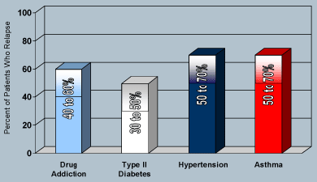
Like Other Chronic Diseases, Addiction Often Involves Cycles Of Recurrence And Remission

Slide 5
Risk Factors for Addiction
Biological factors
Genetics/epigenetics
Psychological factors
People with mental health concerns are at a greater risk for drug misuse and addiction
Examples: Stress, high impulsivity, depression, anxiety, eating disorders (Center on Addiction, 2017)
Environmental Influences
Exposure to physical, social, or emotional abuse or trauma (Center on Addiction, 2017)
Home and family environment – parents/family who misuse drugs or criminal record, decreased parental supervision
Peers and school – peers who misuse drugs, difficulties in school performance, and having poor social skills
Community – poverty, lack of resources
(NIDA, 2018)
Notes:
Presenter
2020-06-16 14:57:58
Protective Factors Against Addiction
Good self control
The initial decision to take drugs is typically voluntary. But with continued use, a person's ability to exert self-control can become seriously impaired
Parental monitoring and support
Positive relationships
Neighborhood resources
In youth & adolescents – Good grades and school anti-drug policies
Prevention
An important component of prevention is delaying the onset of first use until the brain has fully matured
Targeted intervention on individual risk factors (trauma, family member addiction, poverty), and strengthening protective factors that we can control (positive relationships, community, social engagement) can support prevention of substance use/addiction
--------------------------------------------
Citations:
Center on Addiction. (April 14, 2017). Who Develops Addiction. Retrieved from https://www.centeronaddiction.org/addiction/addiction-risk-factors
NIDA. (2018, July 20). Drugs, Brains, and Behavior: The Science of Addiction. Retrieved from https://www.drugabuse.gov/publications/drugs-brains-behavior-science-addiction on 2020, June 8

Slide 6
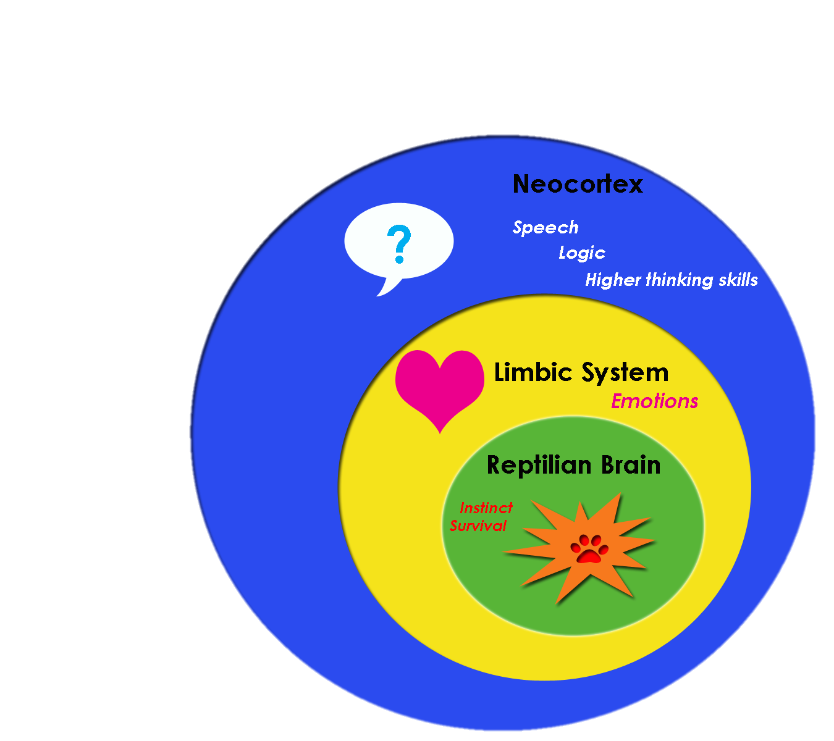
“Old Brain”
Three Main Functions:
Regulate physiological functions
Experience basic emotions (anger, fear, hunger, thirst, lust, pain and pleasure)
Imprint survival memories
Overrides new brain in times of stress
Can be thought of as the “go” or reactive part of the brain

Slide 7
The New Brain: Prefrontal Cortex
Executive Functions
(not fully developed until age 25)
Judgment
Impulse control
Self-monitoring
Coping Functions
Attention span
Organization
Learning from experience
Empathy
Problem Solving

Slide 8
DOPAMINE
Neurotransmitter
Signals reward in our brains
Also increased by stimuli that predict a reward
Brain itself will drive the repeating of what it perceives as life-sustaining activity
Over time when the brain is regularly flooded with dopamine (and other neurotransmitters) it will reduce the natural production

Slide 9
BRAIN CHANGES
INHERENT TO ADDICTION
Less dopamine produced
Fewer dopamine receptors
Ability to experience normal reward – feel joy reduced significantly
Using no longer pleasurable, but about trying to get dopamine function back to a normal level
Brain is driven to seek out and use substances compulsively
Ability to make sound decisions and control impulses is compromised
NIDA – Drugs, Brains and Behavior: The Science of Addiction

Slide 10
Stigma of Addiction
An article in the International Journal of Drug Policy provides a break down three types of stigma:
Public – when the general population endorses stereotypes and decides to discriminate against people labeled with a behavioral health disorder
Self – occurs when people with behavioral health challenges internalize corresponding stereotypes and prejudices.
Label Avoidance – occurs when public stigma impacts care seeking of people with behavioral health disorders.
The next slide shows how the authors break down stereotypes, prejudices, and discrimination that can occur as a result of these types of stigma
(Corrigan & Nieweglowski, 2018)
Notes:
Presenter
2020-06-16 14:57:59
--------------------------------------------
Citation:
Corrigan, P. W., & Nieweglowski, K. (2018). Stigma and the public health agenda for the opioid crisis in America. International Journal of Drug Policy, 59, 44–49. https://doi.org/10.1016/j.drugpo.2018.06.015

Slide 11
Stigma of Addiction
 | Public Stigma | Self Stigma | Label Avoidance
Stereotypes & Prejudices | People who use opioids are: dangerous, immoral, to blame for their disorder, criminal. | Because I use opioids, I am dangerous, immoral, and ashamed. Leads to lower self-esteem and self-efficacy | I perceive the public disrespects and discriminates against people with substance use disorders.
Discrimination | Employers should not hire, landlords do not rent to them, primary care providers offer a lower standard of care | Someone like me is not worthy or unable to work, live independently, or have good health. | I do not want this. I will Avoid the label by not seeking out treatment
(Corrigan & Nieweglowski, 2018)
Notes:
Presenter
2020-06-16 14:57:59
--------------------------------------------
Citation:
Corrigan, P. W., & Nieweglowski, K. (2018). Stigma and the public health agenda for the opioid crisis in America. International Journal of Drug Policy, 59, 44–49. https://doi.org/10.1016/j.drugpo.2018.06.015

Slide 12
Stigma of Addiction – Language Matters!
Words to Avoid | Words to Use
Addict | Person with substance use disorder
Drug Problem/Habit | Substance use disorder
Drug abuse | Drug misuse Harmful use
Drug Abuser | Person with substance use disorder
Clean | Abstinent not actively using
Dirty | Actively using
A clean drug screen | Testing negative for substance use
A dirty drug screen | Testing positive for substance use
Former/reformed addict | Person in recovery Person in long-term recovery
Opioid replacement Methadone maintenance | Medications for addiction treatment
The Office of National Drug Control Policy’s
Stigma Reducing Language
Notes:
Presenter
2020-06-16 14:57:59
--------------------------------------------
Citation:
Office of National Drug Control Policy. (2017). Changing the Language of Addiction. Retrieved from https://www.shatterproof.org/about-addiction/stigma/stigma-reducing-language

Slide 13
Treatment
The National Institute on Drug Addiction (NIDA) outlines 13 principles for effective treatment of drug addiction in their 2018 publication “Principles of Drug Addiction Treatment: A Research-Based Guide (Third Edition)”
(NIDA, 2018)
Notes:
Presenter
2020-06-16 14:57:59
--------------------------------------------
Citation
NIDA. (2018, January 17). Principles of Drug Addiction Treatment: A Research-Based Guide (Third Edition). Retrieved from https://www.drugabuse.gov/publications/principles-drug-addiction-treatment-research-based-guide-third-edition on 2020, June 5

Slide 14
Treatment
The National Institute of Drug Addiction (NIDA) emphasizes that treatment of addiction is a long-term process that involves multiple interventions and regular monitoring.
NIDA outlines an approach to comprehensive treatment in the diagram to the right
(NIDA, 2018)
Notes:
Presenter
2020-06-16 14:57:59
--------------------------------------------
Citation:
NIDA. (2018, January 17). Principles of Drug Addiction Treatment: A Research-Based Guide (Third Edition). Retrieved from https://www.drugabuse.gov/publications/principles-drug-addiction-treatment-research-based-guide-third-edition on 2020, June 5

Slide 15
Treatment
The American Society of Addiction Medicine outlines treatment for substance use disorders as being on a continuum and organized into levels of care.
Higher severity in substance use will require a more intense level of care. As a patient moves through treatment they step down to lower levels of care.
Levels of care inform both the setting for care and the number of hours of clinical behavioral health services.
(Addiction Policy Forum, n.d.)
Notes:
Presenter
2020-06-16 14:57:59
--------------------------------------------
Is specialized
Level of care determined based on assessment (ASAM 6 dimensions) conducted by a trained and licensed professional
Ideally includes availability of full continuum of care and ongoing recovery management support services
Includes organized programming and services designed to meet the complex needs of people with addiction and co-occurring conditions
Includes a variety of evidence-based treatment approaches and modalities delivered by trained and licensed addiction professionals
1.0 – Outpatient – less than 9 hours/week
2.1 – Intensive Outpatient (IOP) – 9 + service hours/week
2.5 – Partial Hospitalization – 20 + service hours/week
3.1 – Low-Intensity Residential – 24 hr. structured living/5 hrs. clinical services/week
3.5 – Clinically Managed High -Intensity Residential – 24 hr. care with trained addiction treatment counselors
3.7- Medically Monitored High-Intensity Inpatient – 24 hr. nursing care, counseling available 16 hrs/day, physician availability
4.0 – Medically Managed Intensive Inpatient – 24 hr. including nursing and daily physician
Citation;
Addiction Policy Forum. (n.d.). Levels of Care. Retrieved from https://www.addictionpolicy.org/levels-of-care

Slide 16
Treatment
Treatment options can be categorized into three general categories:
Behavioral
Pharmacologic
Harm Reduction
The combination of behavioral therapies and pharmacologic intervention tend to be more effective. Treatment plans should be tailored to the unique needs of the individual patient
(Addiction Policy Forum, n.d.)
Notes:
Presenter
2020-06-24 15:13:04
--------------------------------------------
Citation
Addiction Policy Forum. (n.d.). Treatment. Retrieved from https://www.addictionpolicy.org/treatment

Slide 17
Behavioral Health Treatment
Behavioral treatments focus on changing attitudes and actions related to substance use. These interventions help patient with the following:
Being able to engage and remain in treatment
Modify their existing substance use behaviors
Prepare them to handle cravings and stressful situations without using substances
Examples include: Cognitive Behavioral Therapy (CBT), Contingency Management Interventions, 12-Step Facilitation Therapy, Family Behavior Therapy.
(Addiction Policy Forum, n.d.)
Notes:
Presenter
2020-06-16 14:58:00
--------------------------------------------
Citation
Addiction Policy Forum. (n.d.). Behavioral Treatment. Retrieved from https://www.addictionpolicy.org/behavioral-treatment

Slide 18
Pharmacologic Intervention
Medications that Treat Addiction & Support Recovery (previously referred to as MAT, now MOUD)
MOUD is the use of medications in combination with behavioral counseling to treat substance use disorders. FDA Approved medication for treatment of opioid use disorder, alcohol use disorder, and tobacco use disorder are currently available.
Opioid Use Disorder
MAT is considered the “gold standard” of treatment for OUD. This intervention helps to stabilize brain chemistry and relieve cravings so the patient can engage in behavioral aspects of treatment such as counseling, peer support programs, and family therapy.
(Addiction Policy Forum, n.d.)
Notes:
Presenter
2020-06-16 14:58:00
--------------------------------------------
Citation
Addiction Policy Forum. (n.d.). Medication Assisted Treatment. Retrieved from https://www.addictionpolicy.org/medication-assisted-treatment

Slide 19
Common Medication Options Include
Methadone - reduces opioid craving and withdrawal and blunts or blocks the effects of opioids.
Methadone must be taken under supervision of a physician. By law, methadone is only dispensed through SAMHSA-certified opioid treatment programs
Buprenorphine - a partial opioid agonist that produces effects such as euphoria or respiratory depression at low to moderate doses.
Buprenorphine is only dispensed through SAMHSA-certified opioid treatment programs by providers that hold a Buprenorphine waiver to oversee this treatment (see next slide for more details).
Naltrexone – blocks the euphoric and sedative effects of drugs such as heroin, morphine, and codeine. Naltrexone binds and blocks opioid receptors, which reduces cravings.
Naltrexone can be prescribed by any provider who is licensed to prescribe medications
(SAMHSA, 2020)
Notes:
Presenter
2020-06-16 14:58:00
--------------------------------------------
Citation
SAMHSA. (April 29, 2020). Medication and Counseling Treatment. Retrieved from https://www.samhsa.gov/medication-assisted-treatment/treatment

Slide 20
Harm Reduction & Overdose Prevention Strategies- Needle Exchange/Syringe Service Programs
The opioid crisis is facilitating a dramatic increase in infectious disease associated with injection drug use
Syringe service programs are comprehensive community-based prevention and intervention programs that provide services such as: vaccination, testing, linkage to infectious disease care and substance use treatment, and access to and disposal of syringes and injection equipment.
CDC data provides the following support for SSPs
estimates a 50% reduction in HIV and Hep C incidence is associated with Syringe Service Programs (SSPs)
SSPs offer referrals to MAT, new users of SSPs are 5x more likely to enter drug treatment and 3x more likely to stop using drugs than those who don’t use these programs
(CDC, 2019)
Notes:
Presenter
2020-06-16 14:58:01
--------------------------------------------
Citation
Centers for Disease Control. (May 23, 2019). Syringe Services Programs (SSPs). Retrieved from https://www.cdc.gov/ssp/syringe-services-programs-factsheet.html

Slide 21
FOUR DIMENSIONS OF RECOVERY
Individuals
and Families
HOME
↑ Permanent
Housing
COMMUNITY
↑ Peer/Family/
Recovery Network
Supports
PURPOSE
↑ Employment/
Education
HEALTH
↑ Recovery
Health
Wellness

Slide 22
Resources

Slide 23
Addiction in the United States
SAMHSA’s Behavioral Health Barometer published in 2019 presents indicators as measured through the 2017 National Survey on Drug Use and Health and the National Survey of Substance Abuse Treatment Services. State reports provide a snapshot of substance use and mental health in the United States.
(SAMHSA, 2019)
Notes:
Presenter
2020-06-16 14:58:01
--------------------------------------------
Citation:
SAMHSA. (2019). Behavioral Health Barometer: United States, Volume 5: Indicators as measured through the 2017 National Survey on Drug Use and Health and the National Survey of Substance Abuse Treatment Services. HHS Publication No. SMA–19–Baro-17-US. Rockville, MD.

Slide 24
Addiction in the United States
Reports containing national maps that provide substance abuse and mental health estimates across all states and the District of Columbia, including:
the prevalence of substance use and abuse
treatment
mental health indicators
(SAMHSA, 2019)
Notes:
Presenter
2020-06-16 14:58:01
--------------------------------------------
Citation
Substance Abuse and Mental Health Services Administration. (2019). Key substance use and mental health indicators in the United States: Results from the 2018 National Survey on Drug Use and Health (HHS Publication No. PEP19-5068, NSDUH Series H-54). Rockville, MD: Center for Behavioral Health Statistics and Quality, Substance Abuse and Mental Health Services Administration. Retrieved from https://www.samhsa.gov/data/

