Slide 1
Prenatal Outreach Representative Program
Building Relationships of Trust with Medical Providers

Slide 2
Basics of Prenatal Medical Outreach
Build relationships of trust and respect between medical providers and advocacy community.
Convey professionalism and credibility of local organization.
Provide presentations and distribute up-to-date information about genetic conditions.
Track materials distributed.

Slide 3
Understanding the Prenatal Outreach Representative Program

Slide 4
Prenatal Outreach Representative Program
Overview: The Prenatal Outreach program generally consists of a contact for each OB/GYN group in the region. The Prenatal Outreach Representatives replicate the model of a pharmaceutical representative.

Slide 5
Prenatal Outreach Representative Program Overview
Each Prenatal Outreach Rep is assigned a medical office or offices to visit quarterly and do the following:
Act as an organization representative.​
Develop relationships with medical offices.​
Distribute materials.​
Offer presentations.
Provide referrals to your organization
Offer business cards with contact information to medical professionals and are available via telephone calls or in person. Make sure business cards come from your local Down syndrome organization and identify the role of the Prenatal Outreach Representative .
Report a quarterly contact log or Qualtrics survey to the organization/Medical Contact Supervisor.​​ Find all materials at Lettercase.org.

Slide 6
Importance of Prenatal Outreach Program
Prenatal Outreach Representative training is offered so that representatives understand the organization and focus of the program. The training also instructs parents about how to act as representatives of your organization and how to navigate complex territory.
Importance of professional trained parents for medical outreach and for parent-to-parent support: each person is representing your organization
A strong professional collaboration with health care professionals will ensure more positive, supported diagnosis experiences and more referrals to your program and growth of your organization and more families will be connected and supported
Share information on how referrals can be made to org to support for patients

Slide 7
Prenatal Outreach Representative Program Benefits
Key to credibility with health care professionals
Consistent standards for volunteers
Allows different opportunities for volunteer parents where they will be the best fit
Importance of specialized prenatal training
Grants

Slide 8
Identifying Potential Prenatal Outreach Reps
Distribute your organization materials to hospitals and assigned OB/GYN and Perinatology Groups
Check the inventory each quarter and report results to the Down Syndrome Representative Coordinator
Establish a relationship of trust with the physician groups
Exhibit professionalism and professional courtesy
Be pleasant, positive, and non-judgmental
Offer office presentations as needed
Understand available resources to share with parents
Maintain confidentiality

Slide 9
Identify Potential Prenatal Outreach Reps with the following characteristics:
Able to talk about diagnosis without emotions being too raw (unable to control weeping)
Not politically motivated and meet parents where they are
Professional, positive, non-judgmental, and empathetic
Comfortable with public speaking
Organized and reliable

Slide 10
Office Resources for Expectant Parents
Print
National Center/Lettercase brochure
Understanding Prenatal Screening and Testing bi-fold
Delivering a Prenatal or Postnatal Diagnosis brochure
Delivering a Diagnosis of Down Syndrome (DSDN) postcard
“Understanding a Down Syndrome Diagnosis” booklet
“Diagnosis to Delivery: A Pregnant Mother’s Guide to DS” English and Spanish book
National Down Syndrome Adoption Network Brochure
Down Syndrome Diagnosis Network Brochure
Online
lettercase.org
downsyndromepregnancy.org
National Down Syndrome Adoption Network: ndsan.org
Down Syndrome Diagnosis Network
NDSS, NDSC, and local organizations

Slide 11
Understanding Prenatal Screening and Testing bi-fold

Slide 12
Delivering a Prenatal or Postnatal Diagnosis brochure Delivering a Diagnosis of Down Syndrome (DSDN) postcard

Slide 13
“Understanding a Down Syndrome Diagnosis” booklet

Slide 14
“Diagnosis to Delivery: A Pregnant Mother’s Guide to DS” English and Spanish book

Slide 15
National Down Syndrome Adoption Network Brochure

Slide 16
Down Syndrome Diagnosis Network Brochure

Slide 17
National Center/ Lettercase brochure

Slide 18
Accurate, Up-to-Date, Balanced Information
Available free online and print on request at lettercase.org at the University of Kentucky’s Human Development Institute in multiple languages.
Diagnosis materials reviewed by Genetic Conditions Consensus Groups which includes representatives from ACOG, AAP, NSGC, ACMG, Association of University Centers on Disabilities, and national patient advocacy groups.
Notes:
I can tell you that creating balanced resources is hard work to meet the needs of patients and navigate between the different stakeholders, but it is possible. Our program is part of the University of Kentucky’s Human Development Institute, which is a University Center for Excellence in Developmental Disabilities. This allows us to act as a middle ground between the different stakeholders, and as a university program, we’ve created a a rigorous academic editorial process to do this work.
We’ve constructed a checklist and template based on the research about the needs of patients and providers following a diagnosis.
We conduct a Literature Review of research about the different conditions, including psychosocial research. And in the cases of some rarer conditions, we end up having to do the quality of life psychosocial research if it has never been done before.
Once we create a draft, we submit it to the Genetic Conditions Consensus Group we have assembled that includes representatives of ACOG, ACMG, NSGC, AAP, the Association of University Centers on Disabilities, and national patient advocacy groups for each condition.
We undergo at least 2-3 edits with those representatives while at the same time organizing photo shoots that include a diverse representation of people with each condition. All of the photos are taken on location to reflect the interests and capabilities of the individuals.
We then undergo edits to reduce the grade level of the content—the hardest part, go through a final copy edit and submit the final version to all the respective organizations.
Once the final form is confirmed, we release the content in print form, as a web app, and then we translate as we have the funds to do it. Down syndrome is currently available in 9 languages and recommended by NIH HealthReach.
We also disseminate the materials through direct mail and email, state public health departments, and collaborations with medical and patient advocacy organizations and some labs. All of our materials are available free online, and people can also request limited quantities of free printed materials as needed and through some state departments of public health.
We started this process with Down syndrome and then replicated it for Turner and Jacobsen syndrome, so we know it works,

Slide 19
Lettercase/National Center for Prenatal and Postnatal Resources Accurate, Up-to-Date, Balanced Information
Recommended in ACMG and NSGC guidelines.
Materials cited in AJOG, Prenatal Diagnosis, Genetics in Medicine, Am Journal of Med Genetics, Obstetrics & Gynecology, Journal of Genetic Counseling, Ped in Review, etc.
Funding provided by the Joseph P. Kennedy, Jr. Foundation and HDI Fund for Excellence
Notes:
Because of the rigor of our process and the stakeholders involved, our materials are included the medical guidelines and cited in peer-reviewed journals.
We have an ideal engine, but we just don’t have enough fuel to get through all the conditions that need to be covered since we primarily rely on donations, book sales, and small but steady grants to do our work with much thanks to the Kennedy Foundation and our university endowment fund. We have managed to stay afloat for 10 years and regularly update the materials, but we can’t keep pace with the growth of testing.

Slide 20
Live training by Lettercase Trainers
Live training by the Local Organization Trainer with technical assistance from Lettercase Trainers
Online training with the Lettercase online module for Prenatal Outreach Representatives
Live training with the online module for Prenatal Outreach Representatives offered in person by the Local Organization Trainer
Options for Training

Slide 21
Sample Training Day Schedule: Overview
8am-9:30am
Explain why prenatal medical outreach is important with a quiz assessing their knowledge.
Review current prenatal testing options, medical guidelines, state Down Syndrome/Genetic Condition Information. Activity: Research the law in your state.
Review the Basics of prenatal outreach.
Discuss Prenatal Outreach Representative responsibilities, roles, and expectations.
Review the conduct policy for your organization. See the Lettercase conduct policy template.
Remember that Training Day is as much about assessing candidates as it is about teaching concepts.

Slide 22
Sample Training Day Schedule: Understand the stakeholders
9:30-10:15am
Explain the difference between prenatal and postnatal outreach.
Explain the difference between pre-decision and post-decision prenatal outreach.
Discuss obstacles confronting medical professionals delivering a diagnosis. Bright Idea: Invite a medical professional or panel of health professionals to come share their perspective.
Talk about respecting the concerns of medical professionals.
Discuss obstacles confronting the advocacy community seeking to establish relation
Talk about addressing the concerns of the advocacy community.

Slide 23
Sample Training Day Schedule: Strategies and Language
10:15-10:45am
Talk about strategies to establish trust and credibility with medical professionals
Discuss pitfalls that can cause Prenatal Outreach Representatives to lose credibility
Discuss being mindful of language.
Connotation
Precision
Ableism
Inspiration Porn
Medical Model of Disability

Slide 24
Discussions
Lose credibility:
Emotional pleas
Religious references.
Political discussions.
Judgmental comments.
Generalizations about Down syndrome, physicians, and hospitals.
Misinformation.
Tardiness.
Long stories.

Slide 25
Discussions
Establish credibility:
Emphasize that you have been trained.
Give professional and credible materials.
Use introduction letter, business cards, etc.
Offer information about local resources, credible materials.
Give brief stories about child.
Give positive stories about physicians.
Use language carefully and precisely.
Choose materials that convey your message.

Slide 26
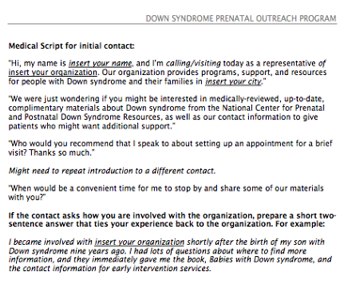
Sample Training Day Schedule
10:45-11:30am
Talk about the characteristics of a pharmaceutical rep. Bright Idea: Invite a pharma rep to be a guest speaker and share strategies.
Discuss tactics for approaching a medical office.
Activity: Give trainees a practice script to introduce themselves and practice in pairs. See Lettercase medical script template.
Activity: Invite trainees to write their own story for 15 minutes and share with a small group
11:30am-12:30pm: Lunch

Slide 27
Visiting Medical Professionals
Crafting Your Own Story
Before visiting a medical professional, craft your own story to share a little about yourself without giving too much detail. Remember your focus should be the doctor and his or her patients.
Activity
Write your own story for 15 minutes. For the next 15 minutes, get a partner and share your own birth/diagnosis story. Then, work together to trim it down to 3-4 concise sentences that you could share with a doctor. Be positive and give general information about you and your experience. If your experience was negative, don’t share it.
Example: I am the mother of a 14-year-old boy with Down syndrome and received information and support from the hospital immediately after my son was born. I just want to share materials to help other women learning about Down syndrome.

Slide 28
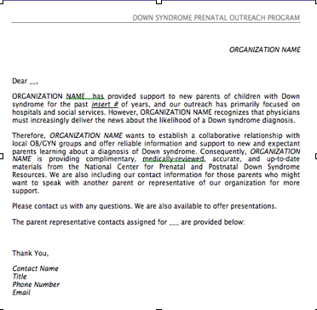
Sample Training Day Schedule
12:30pm-2:00pm
Review Introduction Letter as a group. See Lettercase Introduction Letter template.
Activity: Role plays what office visits or phone calls may be like. See Lettercase role play activity templates.
Discuss the value of tracking data and materials. Briefly describe the system you use to track the number of referrals, presentations, and materials distributed.
Survey trainees about their skills and any preferences for tasks and assignments. See Lettercase template for Trainee Survey.

Slide 29
Sample Training Day Schedule: Other training activities
Offer the Lunch and Learn Presentation and then ask training participants to present a slide each to evaluate their presentation skills.
Invite each trainee to share their own diagnosis experience for 5 minutes to understand their perspective better and also assess how measured they can be in presenting information about their own experience.

Slide 30
After Training
Assess the trainees and their survey responses to determine who should be a Prenatal Outreach Representative.
Decide what assignments and roles will be most appropriate.
Not everyone will be a good candidate as a Prenatal Outreach Representative. Give them other meaningful roles: tracking data, managing resources, working on materials and website, soliciting donors
Assign specific hospitals and offices to each Prenatal Outreach Representatives. See the lesson on Finding Medical Professionals if you do not already have a list of medical contacts.

Slide 31
Getting Started: Prenatal Outreach Rep Follow-up Meeting
Sign
Sign Conduct Policies.
Distribute
Distribute notebooks and digital files to Prenatal Outreach Reps: including the introduction letter, the script, Lunch and Learn presentation, Medical Outreach training module, the contact log, and the materials.
Make
Make Prenatal Outreach Rep assignments.
Start
Start making calls and visits and tracking the information.
Report
Report quarterly to the Medical Outreach supervisor.
Data Collection
Data Collection
Train them on the data collection tool you use so they can track their contacts, materials distributed, and presentations. Spreadsheet or database.

Slide 32
First Doctor’s Visit Instructions
After making assignments, tell them to reach out to the medical professional with a phone call or personal visit.
Instruct them to bring materials and introduction letter.
Ask them to offer to give a short presentation if they seem receptive.

Slide 33
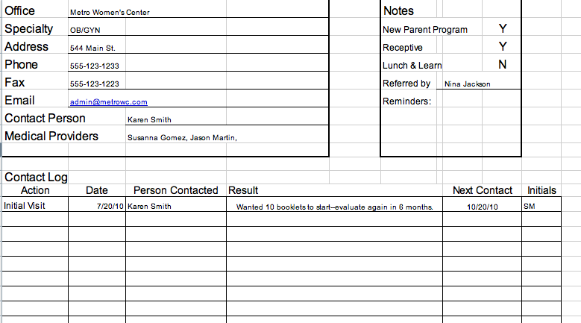
Data Tracking Instruction
Teach them which data tracking method you are using.
If using the Lettercase Prenatal Database, then instruct them to watch the instructional video on the Lettercase website.
If using the Excel spreadsheet, then provide them with the template.
If using another method, provide further instructions.

Slide 34
Instructions for Ongoing Support for Medical Professionals
Set up a presentation for the entire office. “Lunch and Learn” or breakfast an option. See Lettercase Lunch and Learn template.
Make introductions when changing volunteers.
Ask about other colleagues who might be interested in getting more information.
Make sure that all emails/phone numbers are ALWAYS covered with backup in case of illness, travel, etc,
Ongoing support for Prenatal Outreach Reps.

Slide 35
Ask your professional advisors or medical professionals involved with your organization where to begin.
Approach medical professionals whom your volunteers know personally.
Look at the websites of the professional organizations for different medical specialties. Show the “Find a Genetic Counselor” tool at NSGC.org.
Assign an intern to do online searches for different medical professionals in your area.
Partner with a local LEND or UCEDD program. Go to aucd.org.
FINDING MEDICAL PROFESSIONALS

Slide 36
FINDING MEDICAL PROFESSIONALS
Genetic Counselors: nsgc.org
Geneticists: acmg.net
Maternal Fetal Medicine Specialists: smfm.org
Hospital Social Workers
Call hospitals directly.
OB/GYNs: acog.org
Midwives: midwife.org
Public Health Department: http://www.cdc.gov/mmwr/international/relres.html
Nurses/Nurse Practitioners: awhonn.org

Slide 37
Spotlight on Affiliate Success at MDSC
Notes:
4:40

Slide 38
The National Center for Prenatal and Postnatal Down Syndrome Resources
Stephanie Meredith, MA
stephaniem@lettercase.org
facebook.com/lettercaseorg
twitter.com/lettercaseorg
twitter.com/DownSynPreg
downsyndromediagnosis.org

