Slide 1
50 Years of Advocacy: Impact on My Family

Slide 2
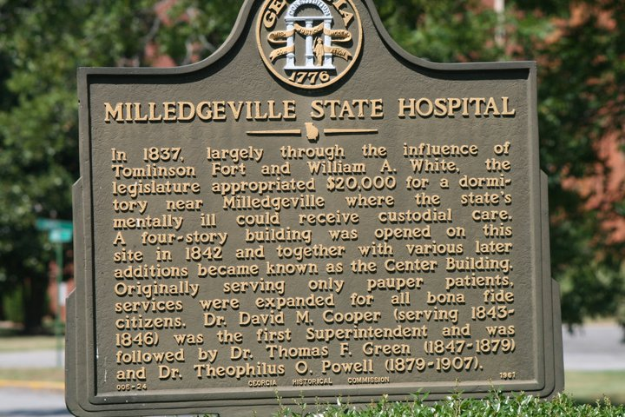
Central State Hospital: Milledgeville, GA
Notes:
When I was growing up, my dad used to tell me about his cousin Keith who was sent to the institution in Milledgeville, Georgia.

Slide 3
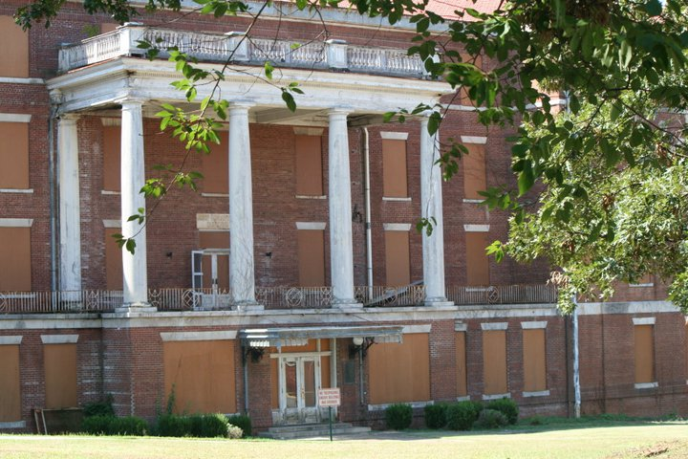
Central State Hospital: Milledgeville, GA
Notes:
The family told stories about how Keith could bend iron bars to escape the house, and they said it took three grown men to hold him down when he was 10-years-old.

Slide 4
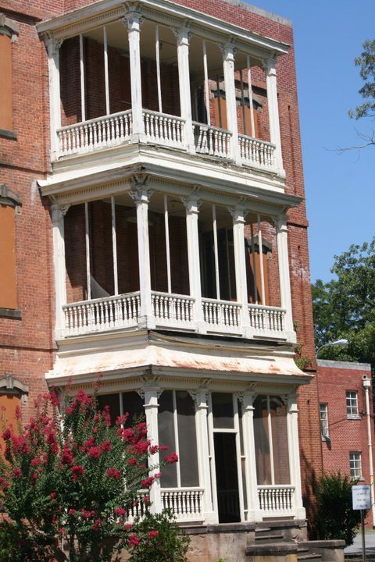
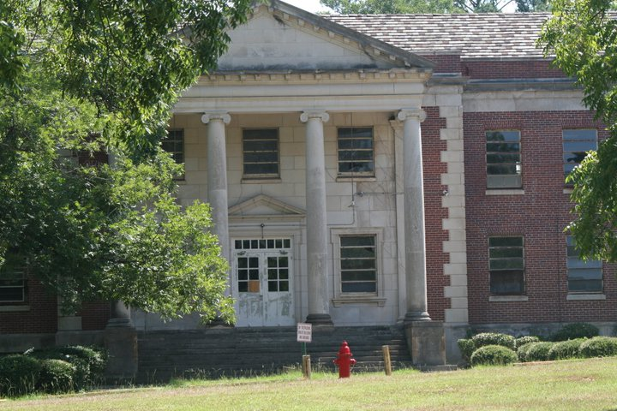
Central State Hospital: Milledgeville, GA
Notes:
The family used these stories to explain why they sent him to the institution in 1970.

Slide 5
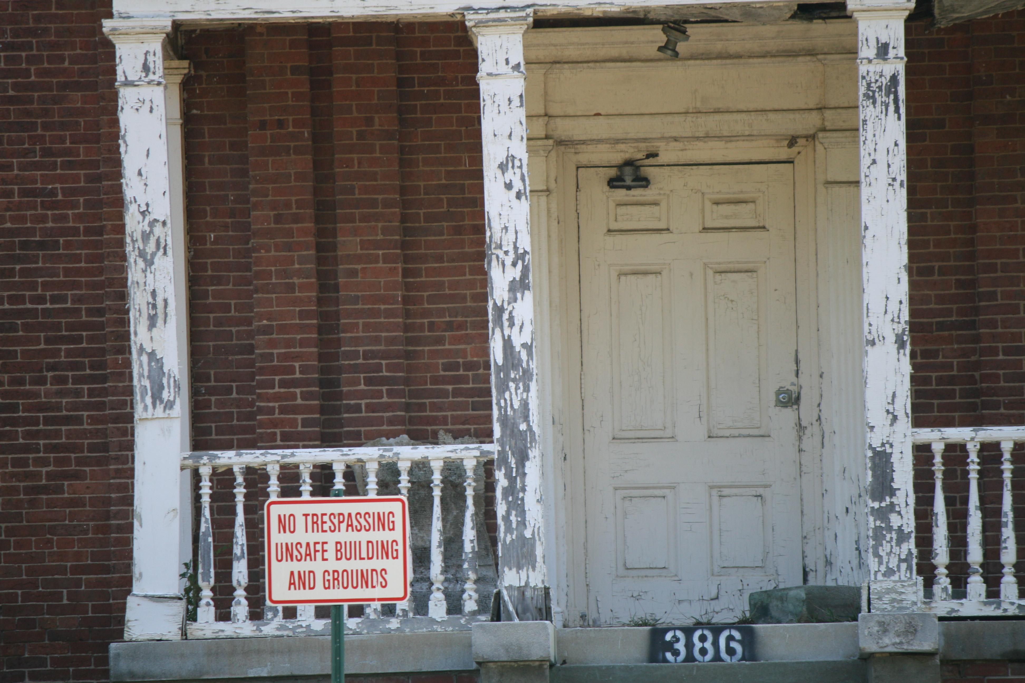
Central State Hospital: Milledgeville, GA
Notes:
As a child, I thought Milledgeville sounded scary.

Slide 6
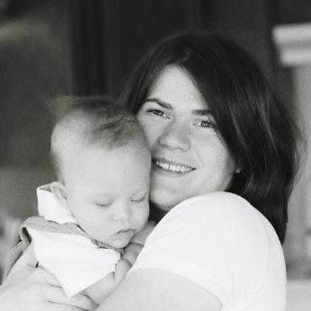
Down Syndrome Diagnosis: 2000
Notes:
But these stories started to bother me after I had my own son with Down syndrome in 2000. I wondered if Keith was anything like Andy,

Slide 7
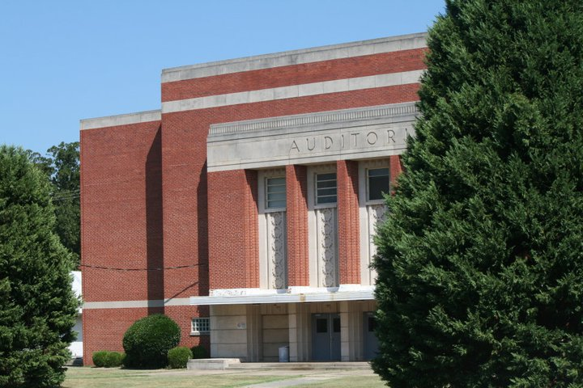
Auditorium at Central State Hospital
Notes:
and I wondered if the family made up these super human stories about Keith when the real challenges in 1970 might have been the lack of support services available to them.

Slide 8
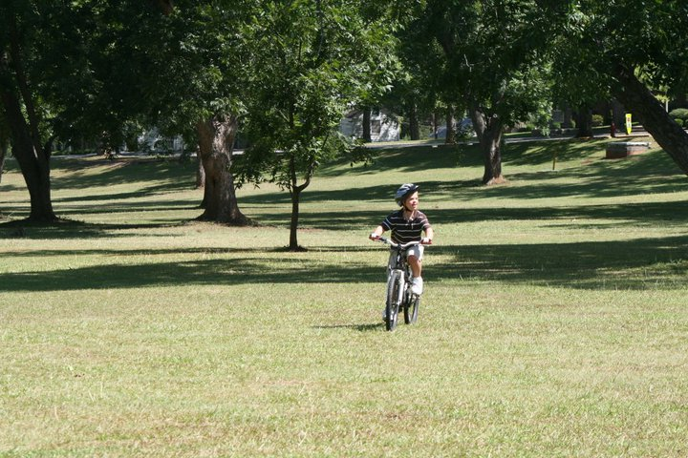
Andy Riding His Bike Across the Lawn at Central State Hospital
Notes:
He would have had no right to healthcare or an education or most of the services Andy has received.

Slide 9
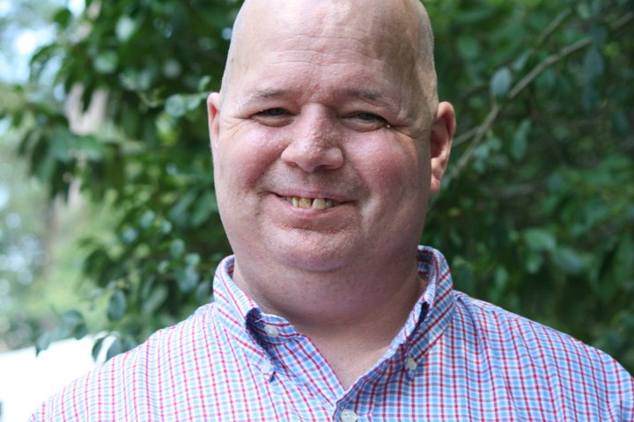
Reunion in 2011
Notes:
When I moved back to Georgia, I connected with the Georgia Protection and Advocacy organization and found him in 2011.

Slide 10
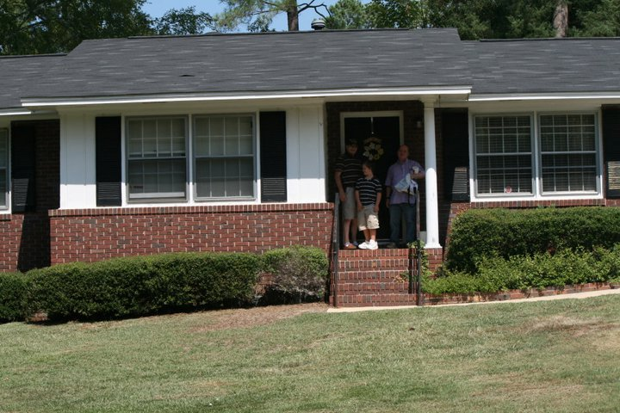
Group Home: Milledgeville, GA
Notes:
I learned that he was born in 1960 and sent to the institution in 1970 where he lived for about 35 years until he moved into a group home in 2004.

Slide 11
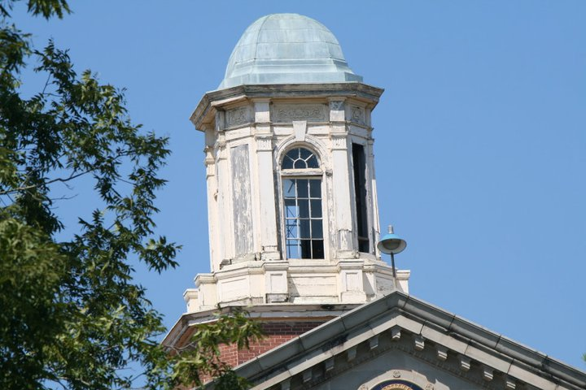
Moving from Institutionalization to Inclusion
Notes:
He moved out of the institution after the Supreme Court Olmstead decision ruled that if people could live outside of an institution, they should be given that opportunity.

Slide 12
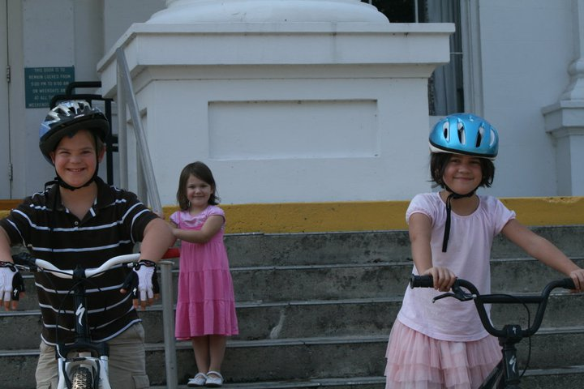
Family visit to Central State Hospital in 2011
Notes:
When I found Keith, my kids, my dad, and I all made arrangements to go visit him, and we also stopped by the institution where Keith lived.

Slide 13
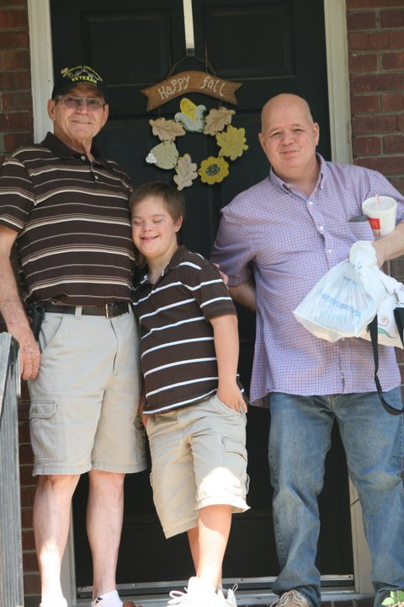
First Family Visit
Notes:
My dad was worried because he thought Keith might be like the stories.

Slide 14
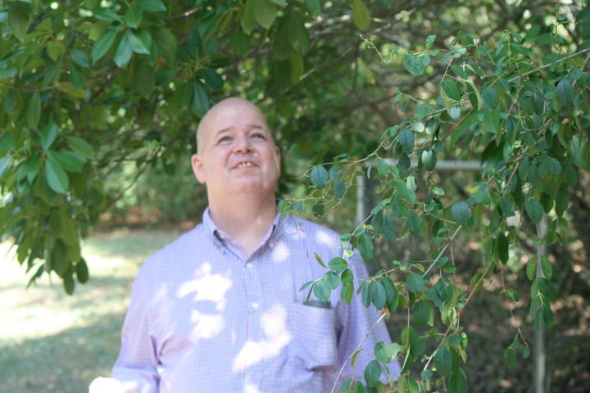
First Family Visit
Notes:
In reality, he really is much like Andy would have turned out without an education and family life. He is helpful and kind, but he did not have meaningful family contact for over 40 years.

Slide 15
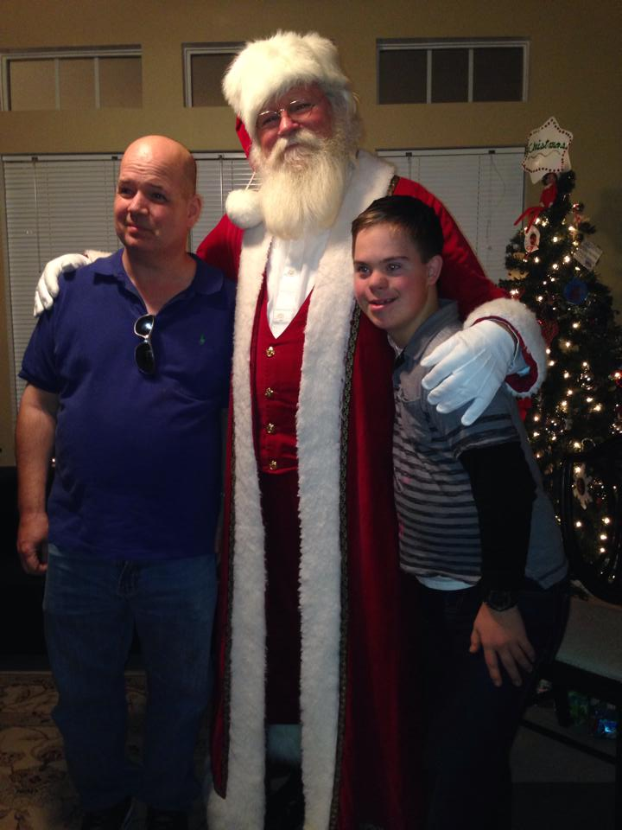
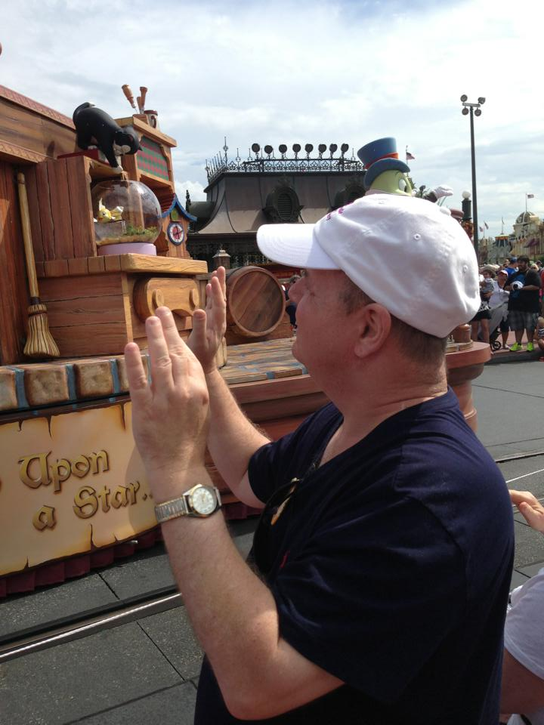
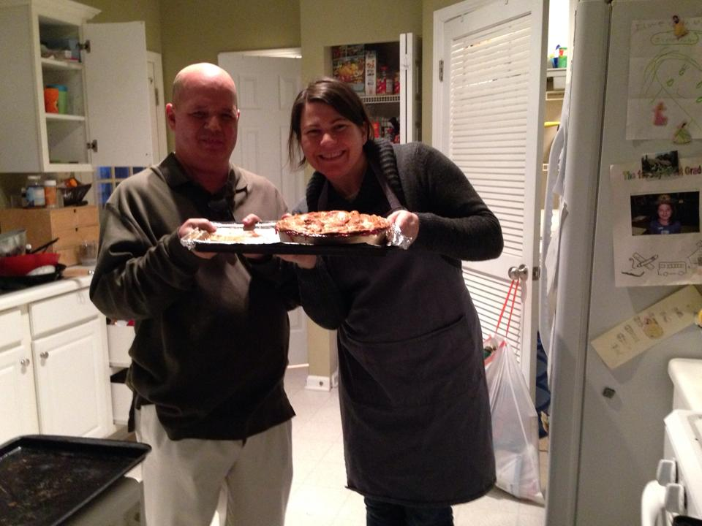
Our Family with Keith
Notes:
In fact, his provider told us we were the first family members to come visit in about 20 years. Now he spends holidays and family vacations with us.

Slide 16
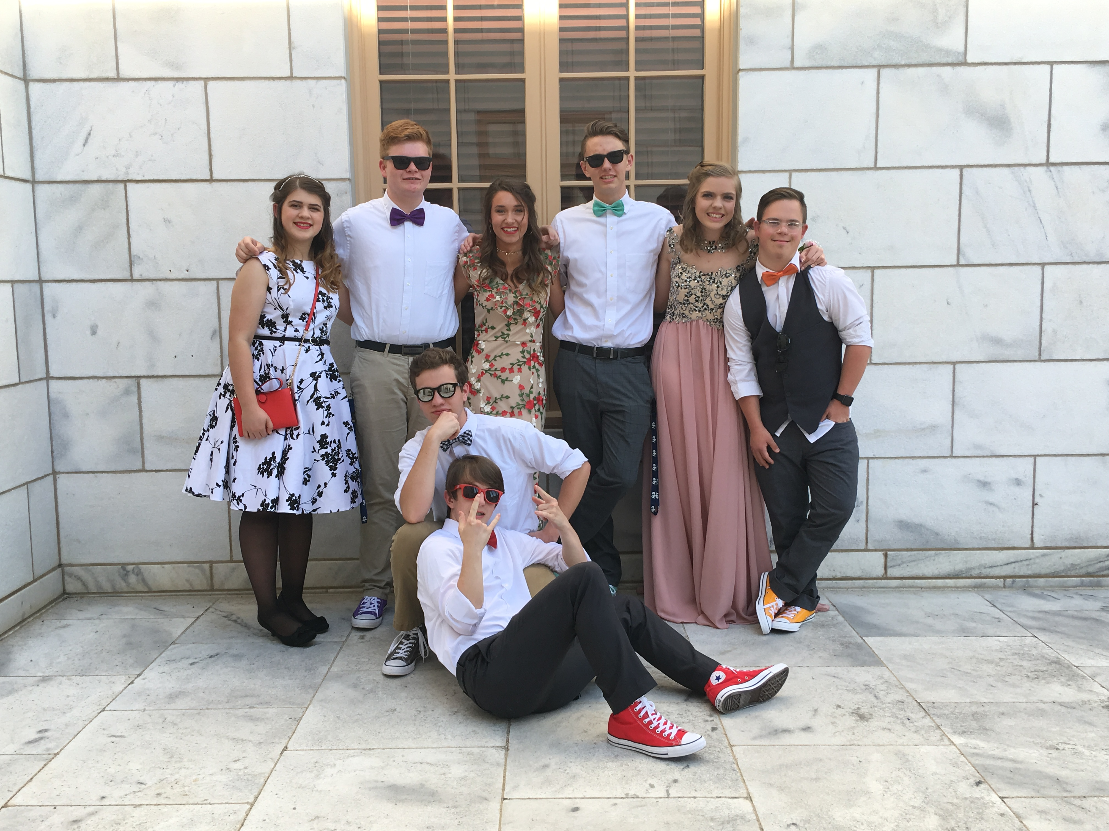
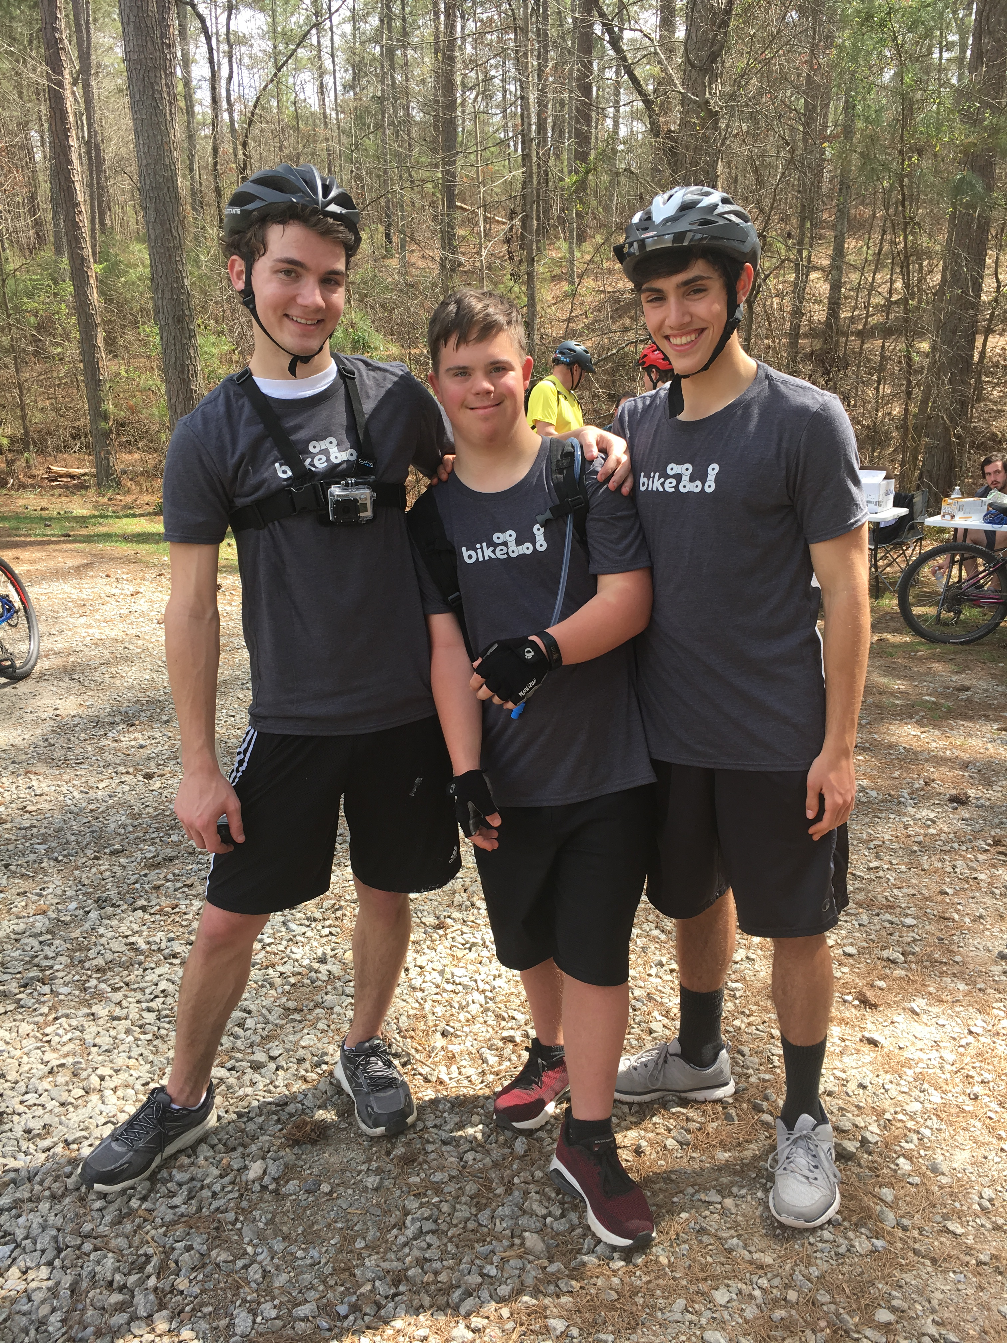
Andy with School Friends
Notes:
In fact, his provider told us we were the first family members to come visit in about 20 years. Now he spends holidays and family vacations with us.

Slide 17
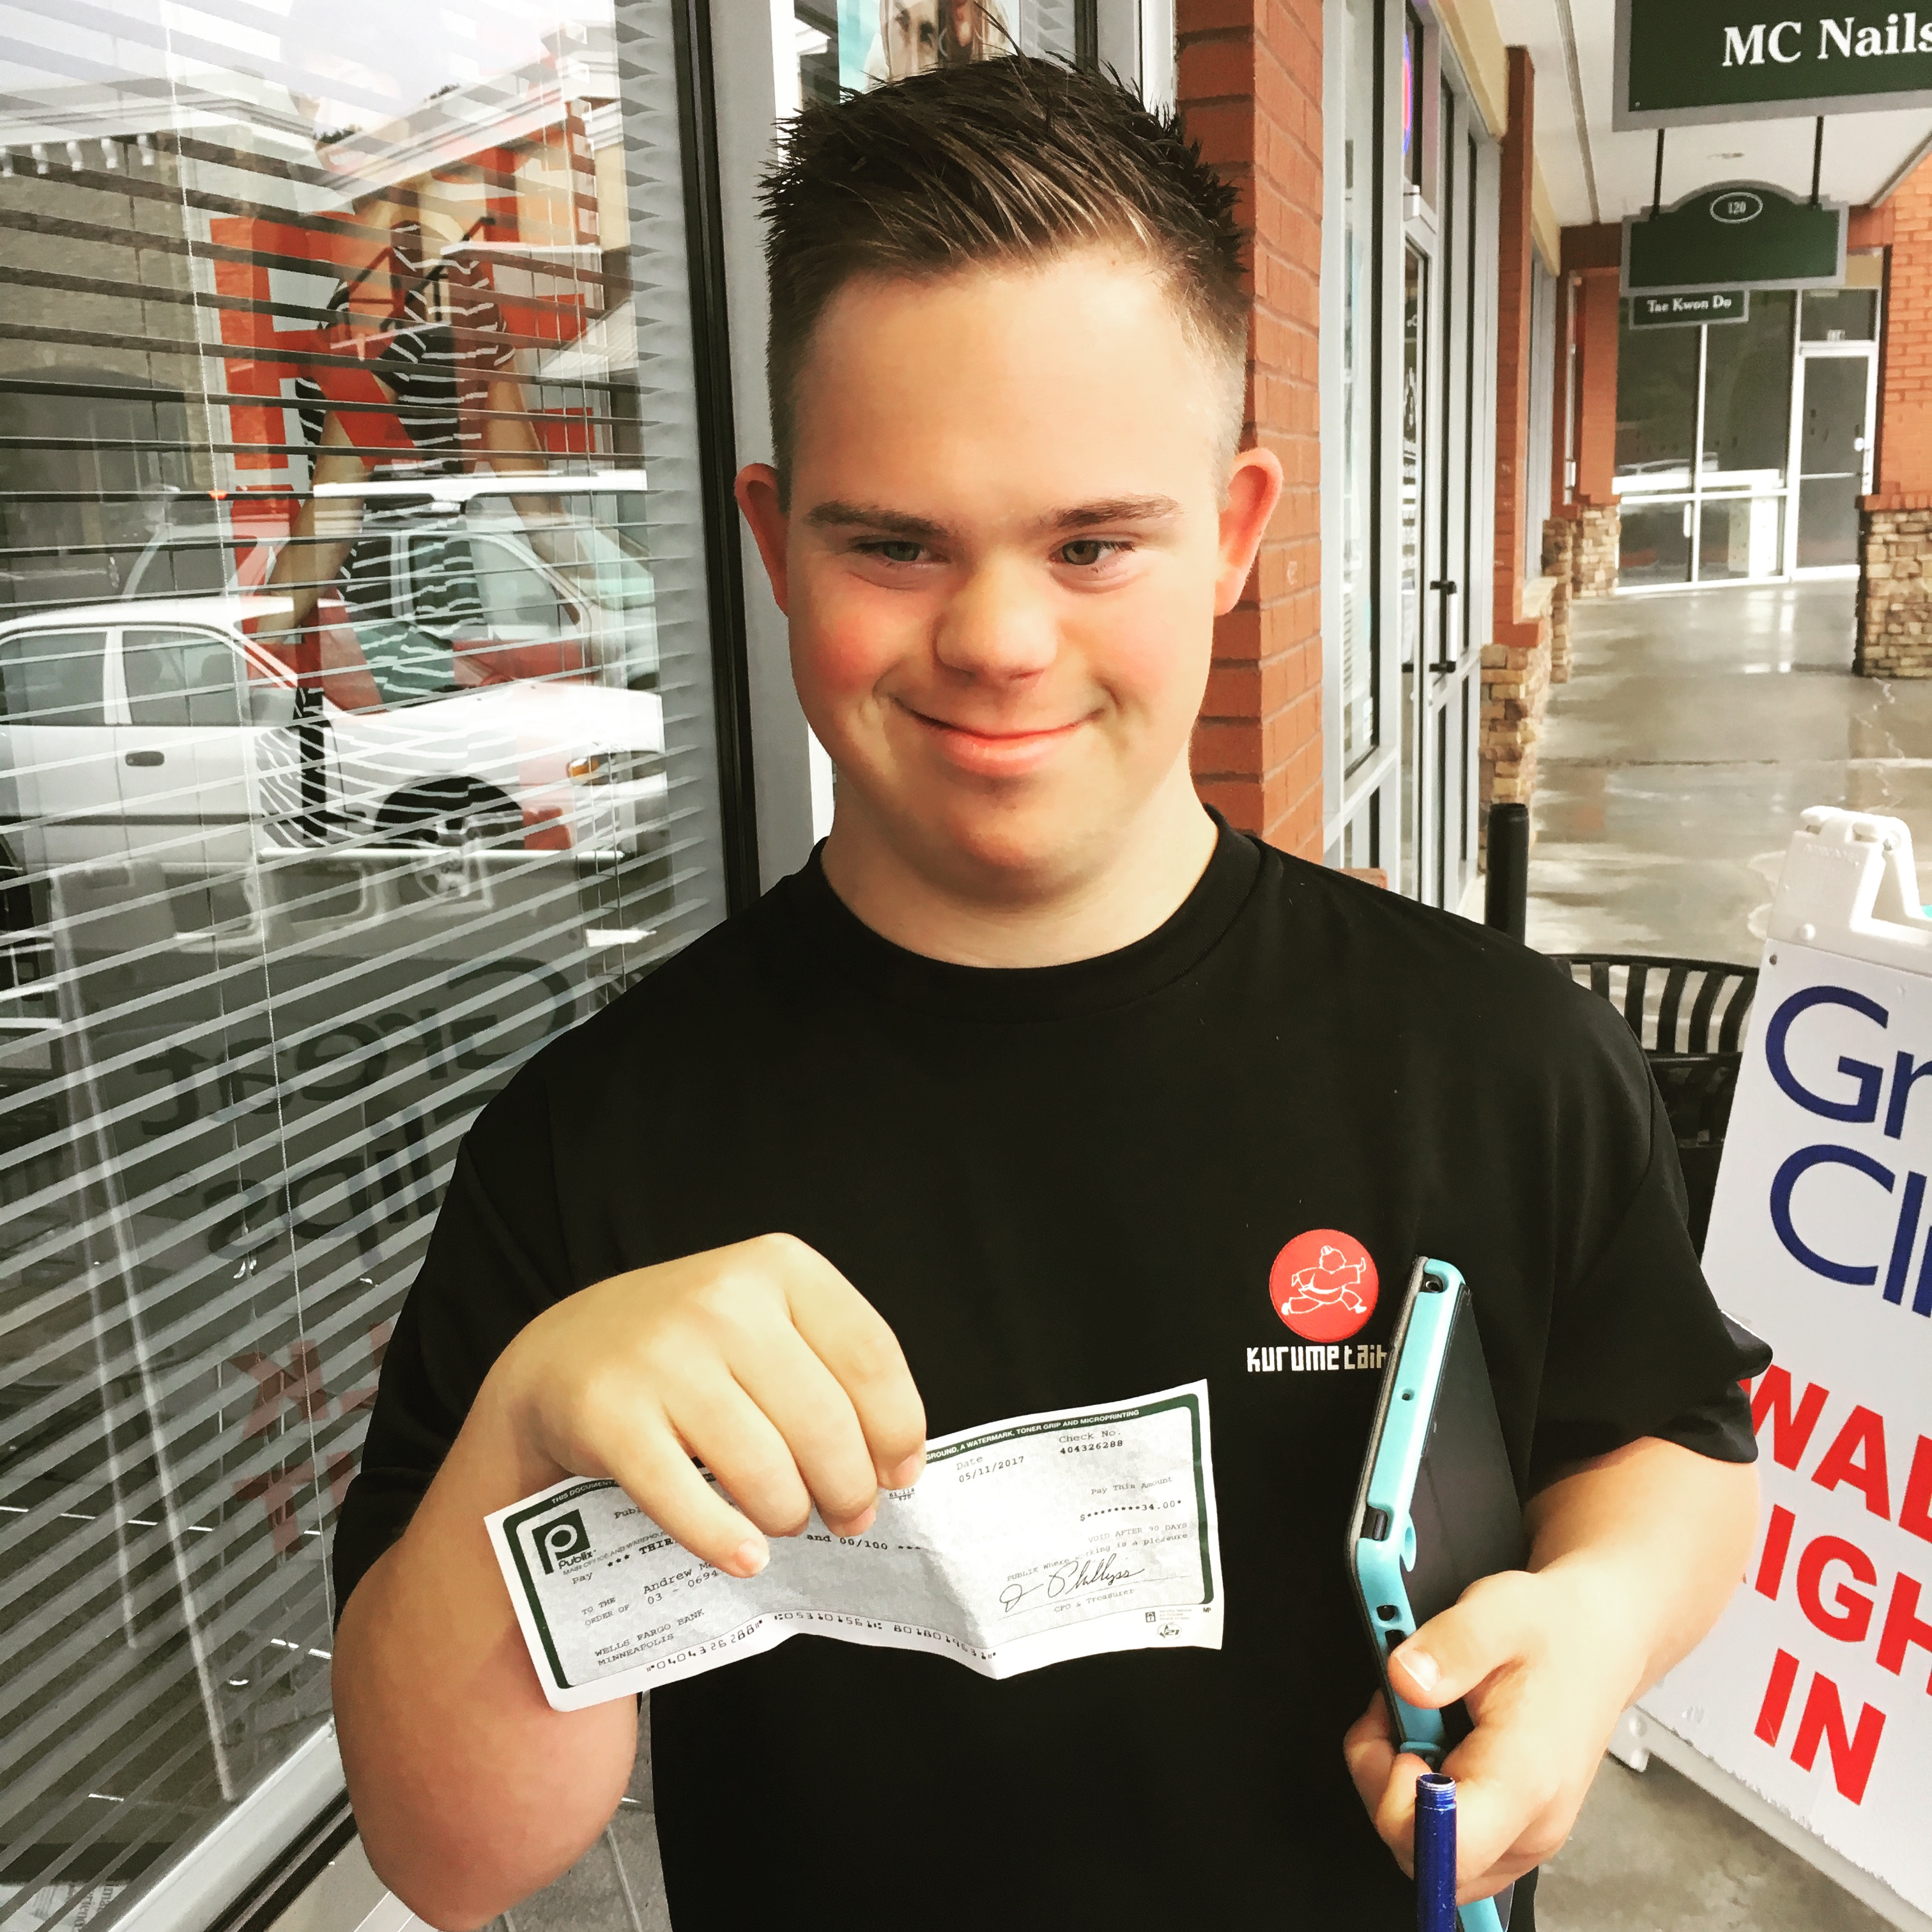
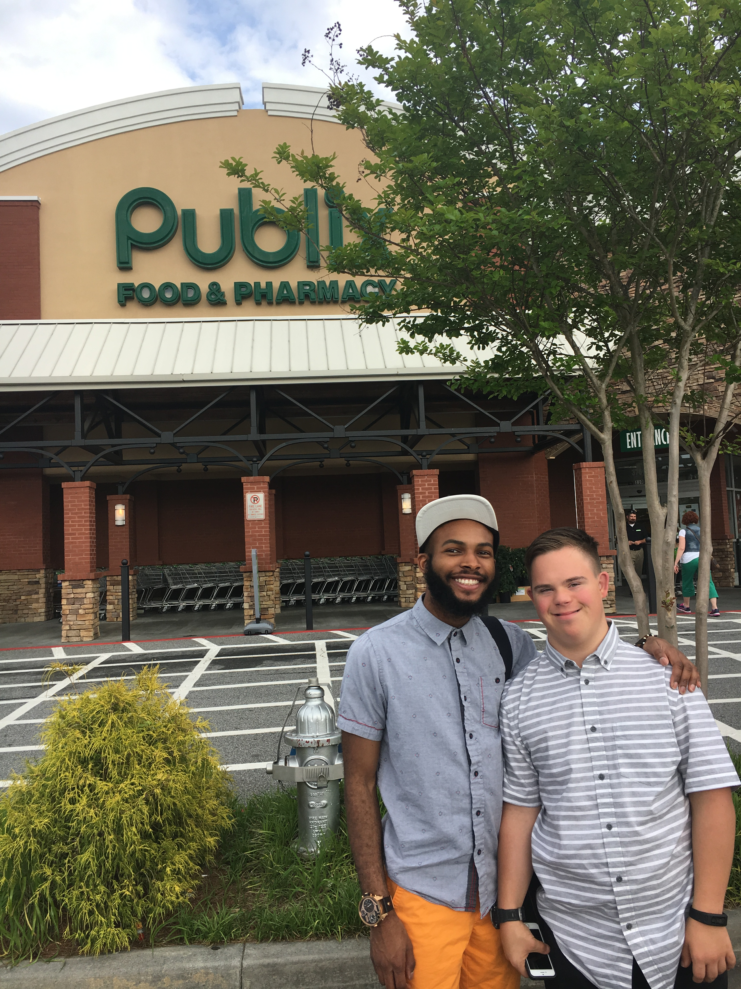
Andy at Work
Notes:
In fact, his provider told us we were the first family members to come visit in about 20 years. Now he spends holidays and family vacations with us.

Slide 18
50 Years of Advocacy: Impact on My Family
Andy | Keith
Access to inclusive education through IDEA | No right to public education.
Access to healthcare through Medicaid | No access to Medicaid.
Parent support groups | No parent support groups
Raised with family | Raised in an institution
Access to therapies with early intervention | No early intervention
College opportunities | No post-secondary programs
Notes:
I learned that he didn’t go to school and can’t read or write, and he goes to a day program instead of a job. In contrast, Andy, who has a similar level of intellectual disability has always lived with his family and has gone to school with his neighborhood peers; he rode his bike to get himself a job at 16 and independently navigates the world, and he plans to go to a post-secondary program for people with disabilities to study photography. The primary difference between these two men born decades apart is access to supports and services.

