Slide 1
Disability History Timeline
Brief Overview and Impact
Notes:
Let’s take some time to talk about some of the improved outcomes for people with disabilities over the years and the milestones in disability rights history that led to some really dramatic changes.

Slide 2
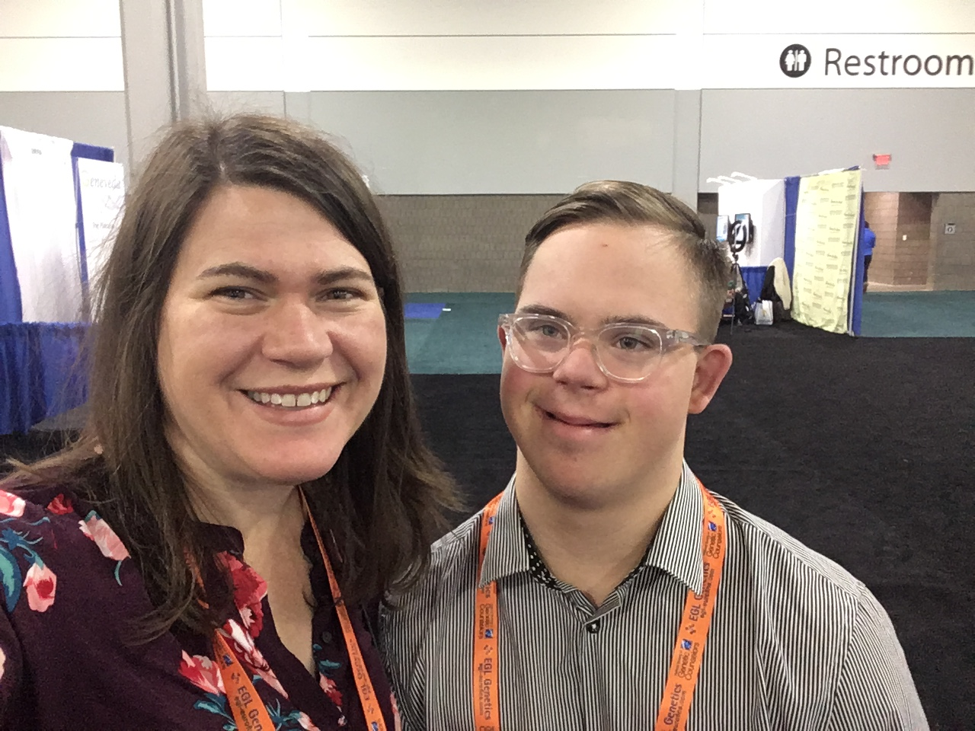
Perspectives as a Family Member and Professional
Andy and Stephanie Meredith.
Notes:
I’ll share with you today my perspective as a professional and also as the mother of a young adult with Down syndrome.

Slide 3
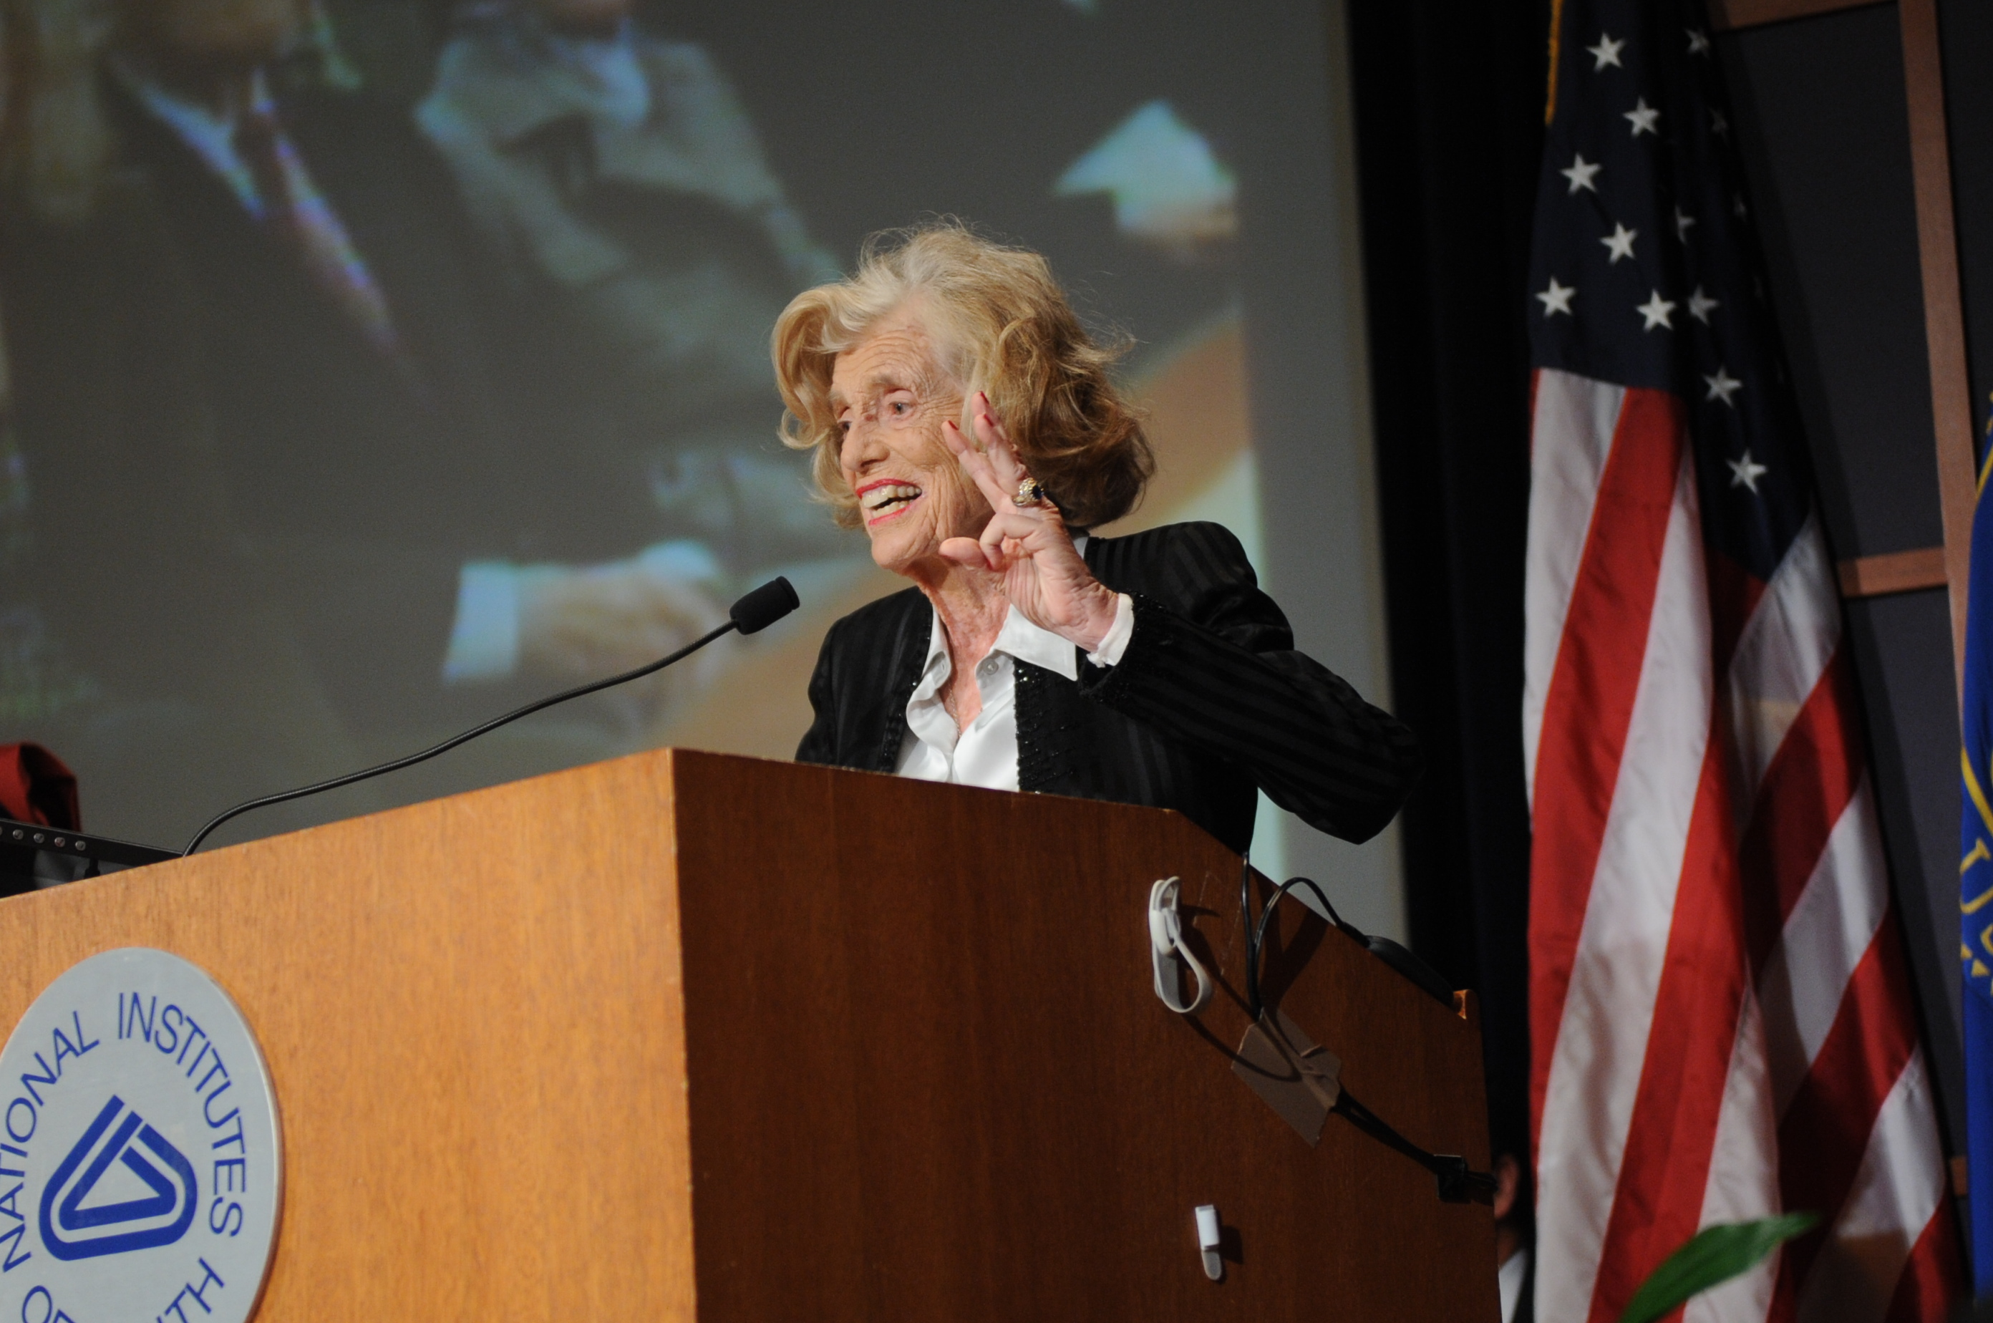
Eunice Kennedy Shriver
National Institutes of Health - https://www.flickr.com/photos/nihgov/26373324495/in/album-72157656516302438/Eunice Kennedy Shriver, a longtime advocate for children's health and disability issues, was the founder of Special Olympics and a key founder of the National Institute of Child Health and Human Development (NICHD).
Notes:
I also want to give special thanks to the Joseph P. Kennedy, Jr. Foundation which oversees and supports our Lettercase program. The director of the Kennedy Foundation was Eunice Kennedy Shriver who was one of the early leaders in the disability rights movement in the US and created Special Olympics.

Slide 4
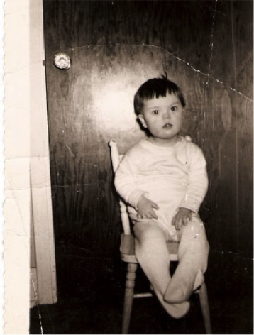
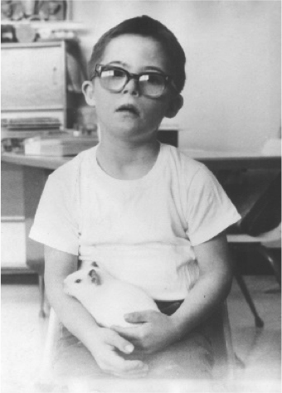
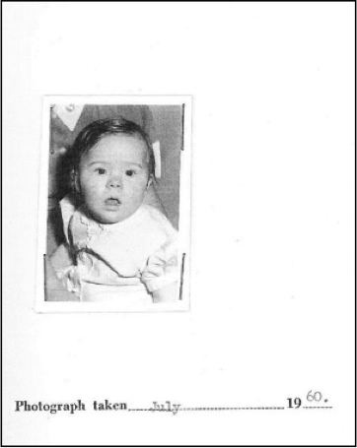
Down Syndrome Diagnosis: 1960
Burghardt, M., Freeman, V., Dolmage, M., & Orrick, C. (n.d.). View of Unheard Voices: Sisters Share about Institutionalization: Canadian Journal of Disability Studies. Retrieved August 12, 2019, from https://cjds.uwaterloo.ca/index.php/cjds/article/view/367/601
Notes:
If you look at the life outcomes for people with genetic conditions over the past 50 years, the change is really dramatic. For example, if a parent in the US found out that their baby was born with Down syndrome in 1960, physicians would often advise them to place their child in an institution. Parents usually told their family and friends that the baby died during childbirth. Back then, families were usually told that the child would only live to about 20. Only 50% of babies with Down syndrome survived past the first year, and parents were also told that children with Down syndrome could not read or write. At that time, this was all true.​

Slide 5
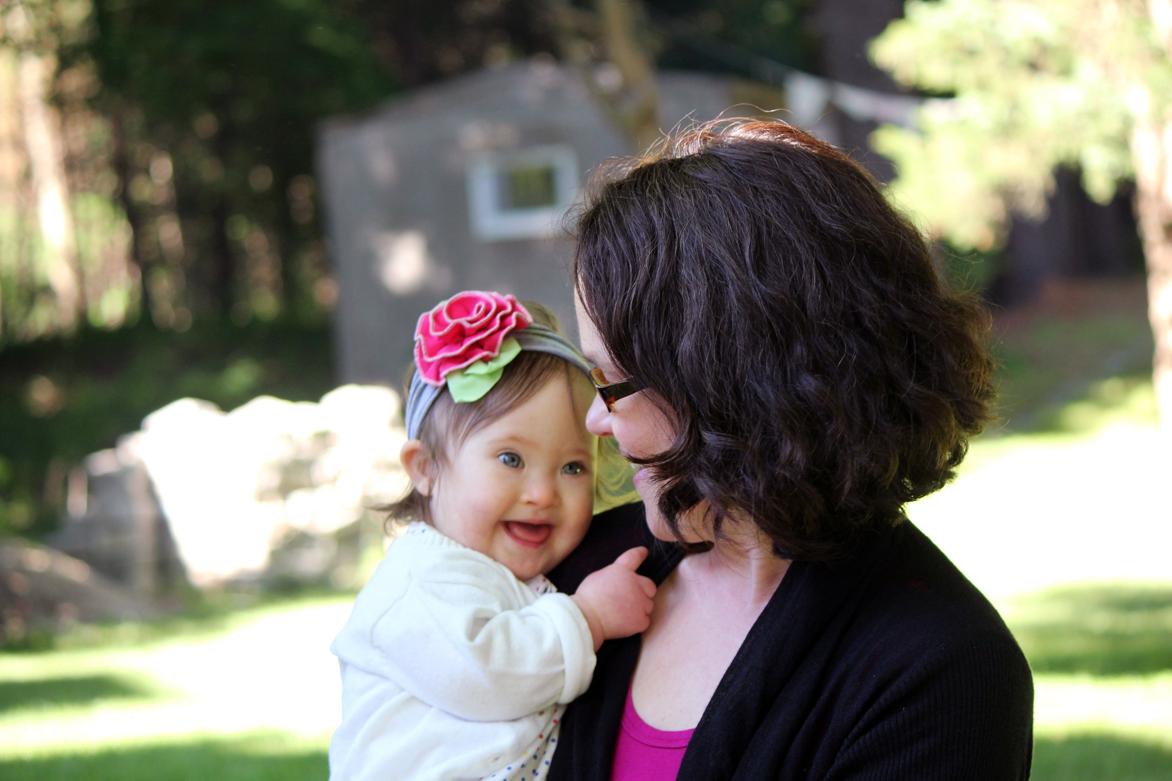
Down Syndrome Diagnosis: Today
Photo by Justin Meredith
Notes:
In contrast, when parents find out their child is born with Down syndrome today, doctors expect that parent will take the baby home.

Slide 6
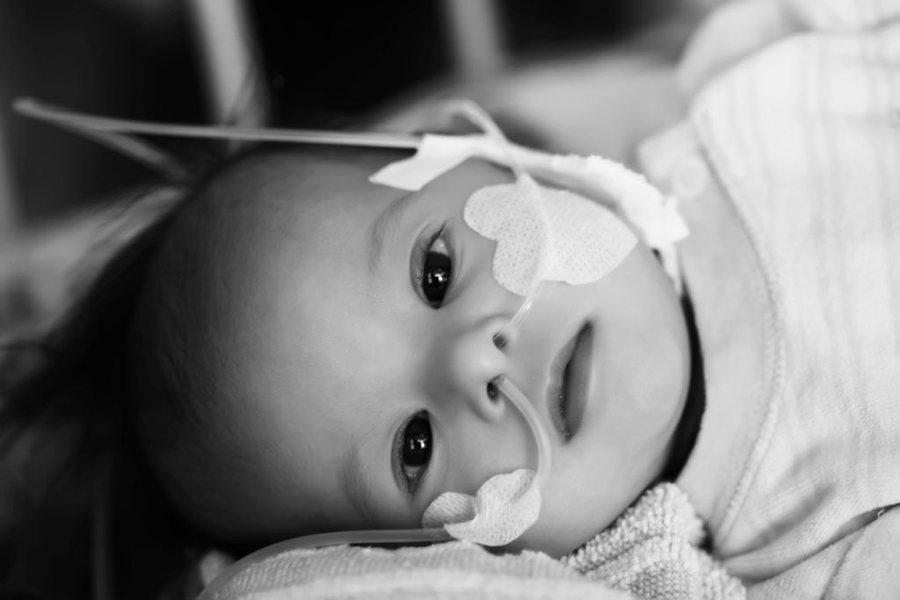
Down Syndrome Today: Healthcare
Photos by Kelle Hampton & Conny Wenk
Notes:
Families are usually told that the child will probably live a long life to about 60 years. The infant survival rate is over 91%.

Slide 7
Down Syndrome Today: Reading
Photos by Conny Wenk
Notes:
Parents are also told that children with Down syndrome have a right to attend school and usually learn to read at some level.

Slide 8
Down Syndrome Today: Work & Play
Photos by Justin Meredith
Notes:
They are valued members of their communities and have the right work and play like everyone else.​

Slide 9
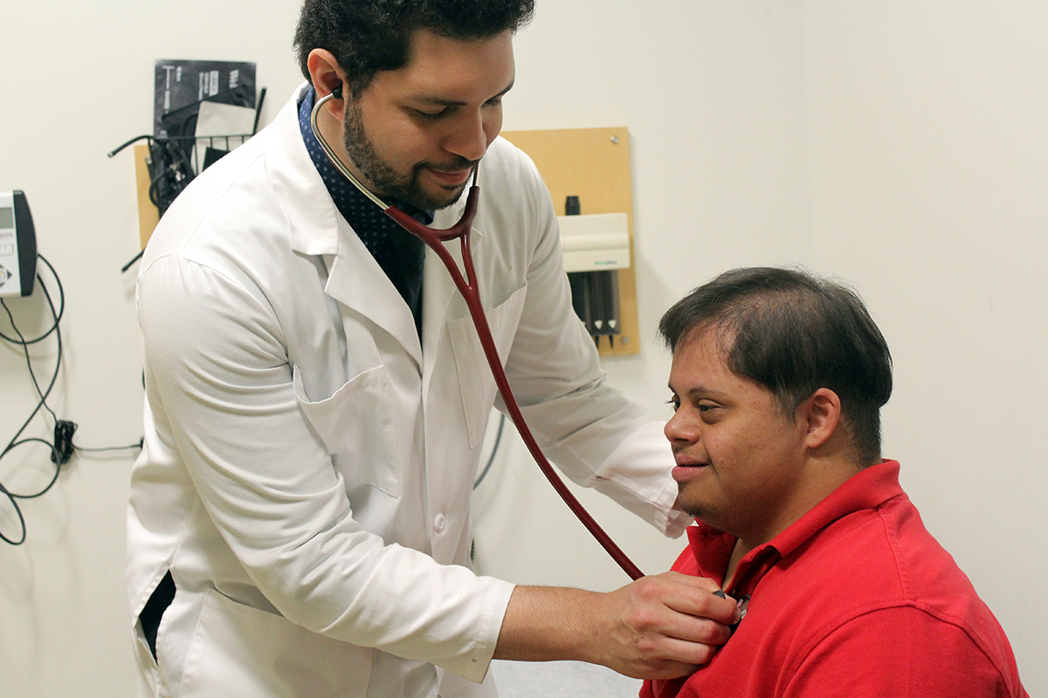
Down Syndrome Today: Supports and Services
Photo by Justin Meredith
Notes:
The thing I often point out to genetic counseling students is: did anything change on that 21st chromosome over the past 50 years? And the answer is of course not. These incredible changes were caused by improvements to healthcare and social supports. That is why up-to-date information for expectant parents is so important.​

Slide 10
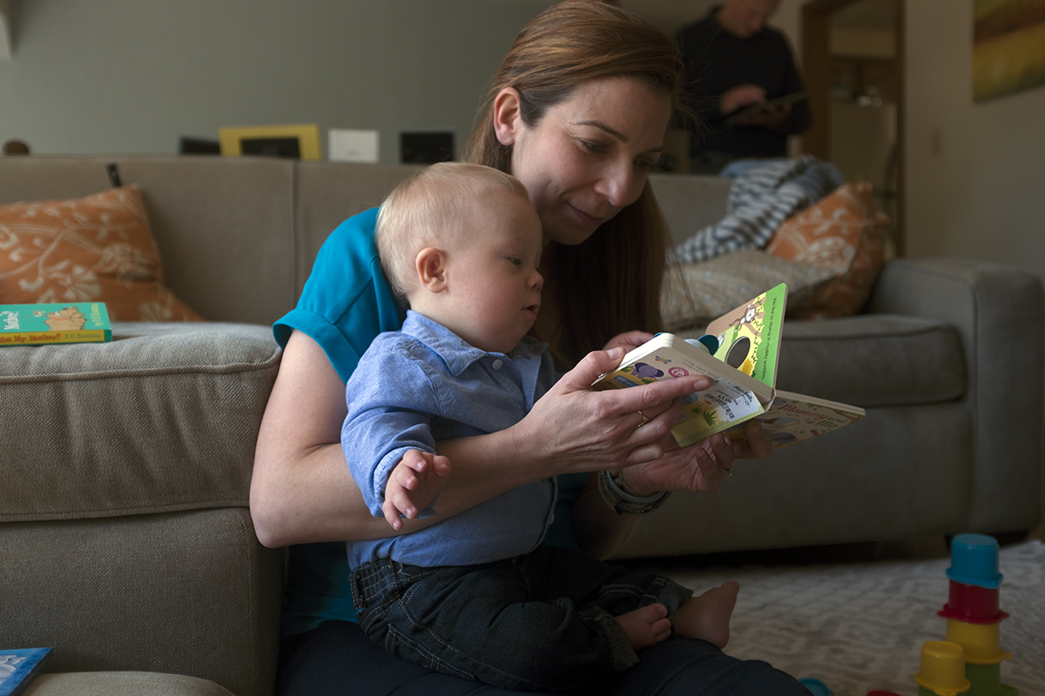
Current Life Outcomes
Photo by Justin Meredith
Notes:
Now when expectant parents have these questions about life outcomes like healthcare, employment, education, and other questions about living with a disability, we really need to understand the laws and supports over the years that have set up the framework for what those outcomes can be. So I’m going to briefly review the disability history timeline, so you can see where these laws have had an impact on those outcomes.

Slide 11
1800’s: Institutionalization
Historic American Buildings Survey L. D. Andrew, Photograph Jan. 3, 1937 VIEW OF FRONT - Milledgeville State Hospital, Central Building, Milledgeville, Baldwin County, GA HABS GA,5-MILG,9-1
https://www.loc.gov/pictures/item/ga0310.photos.056396p
Notes:
Starting in the 1800’s, Institutionalization was common practice for people with disabilities in the US for over 100 years. ​When institutions were first introduced, they were seen as the more compassionate alternative to poverty and abandonment, but what happened over time is that these institutions became overcrowded, underfunded, understaffed, and the segregation allowed for abuse and neglect.

Slide 12
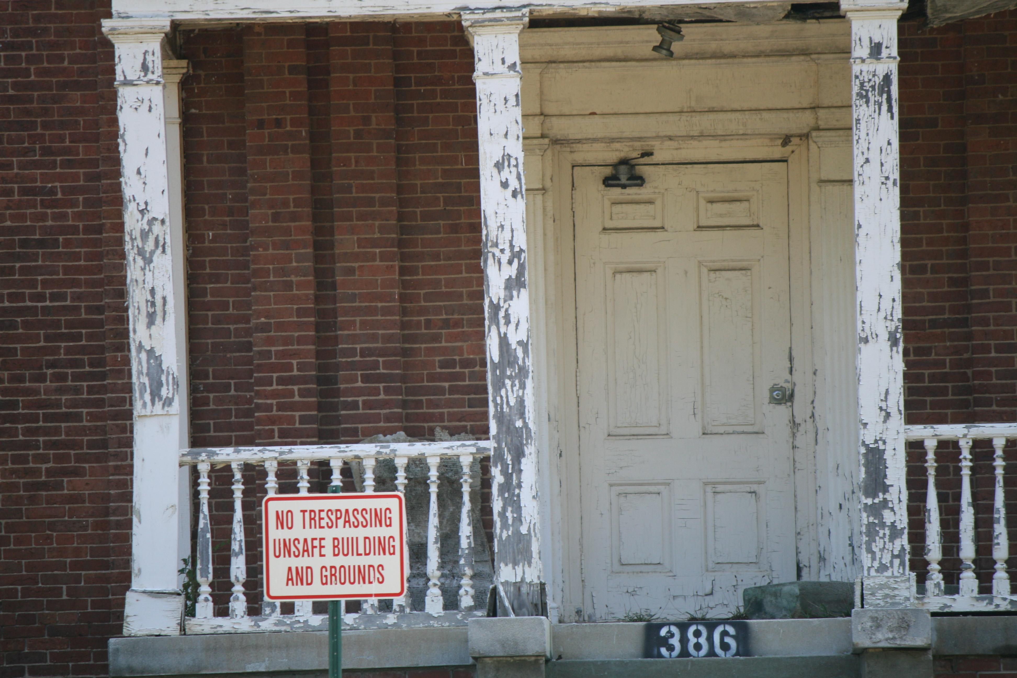
Family Impact of Institutionalization
Central State Hospital in Milledgeville Georgia where Keith lived.
Notes:
My dad’s cousin, Keith, was born with intellectual disabilities in 1960 and lived in one of these institutions in Georgia for over 30 years.

Slide 13
1940’s-1950’s After WW2
https://thearc.org/about-us/history/
Notes:
People with intellectual disabilities were almost never seen in public during that era, but after World War 2, some parents in the 1940’s and 50’s started choosing to raise their children at home even though they had almost no support. They also started parent support organizations like the Arc to support each other.

Slide 14
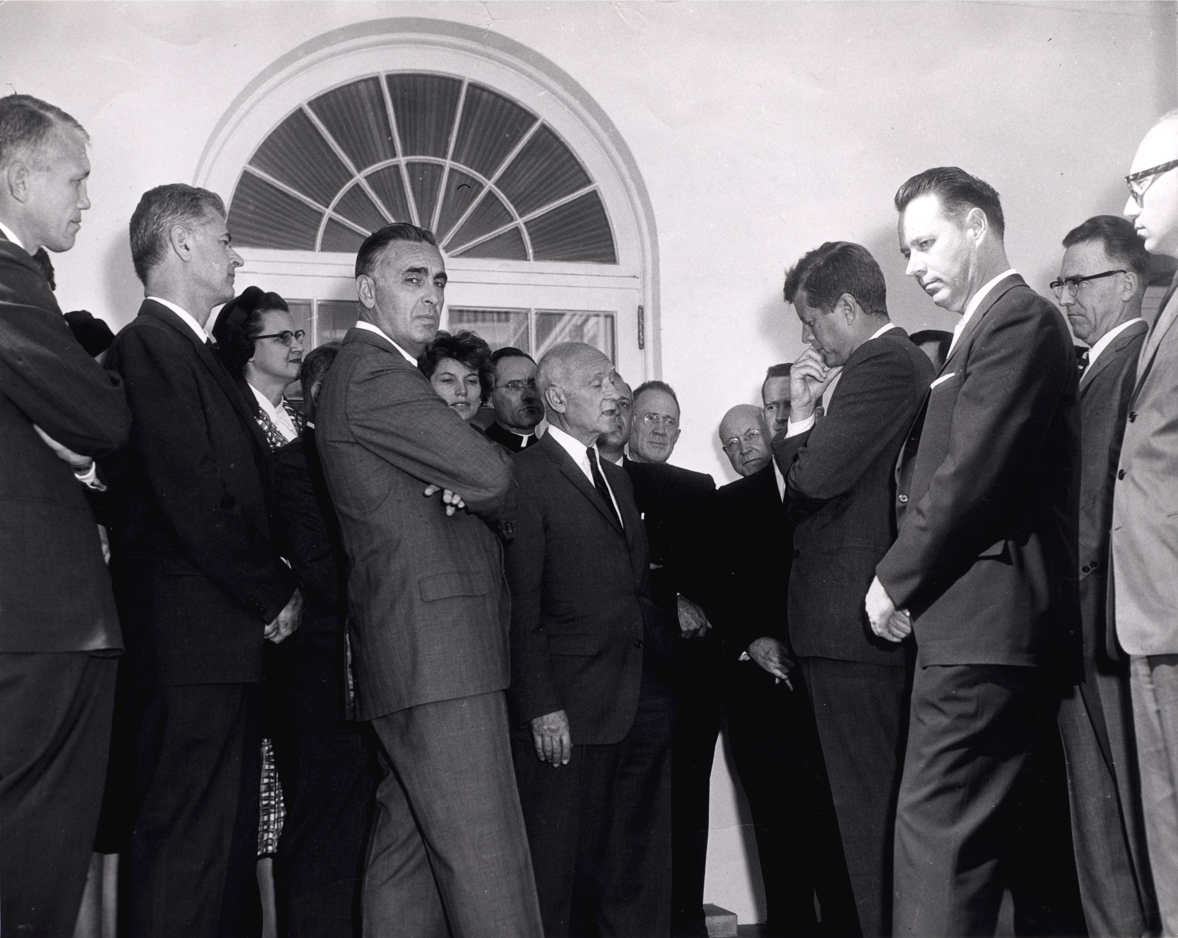
1961: John F. Kennedy President’s Panel on Mental Retardation
White House [Public domain] https://commons.wikimedia.org/wiki/File:Joshua_Lederberg_with_Abe_Ribicoff_and_Wendell_Stanley_at_the_White_House.jpg
Notes:
Another significant milestone was when President John F. Kennedy created the President’s Panel in 1961 to look for solutions to the problems experienced by people with intellectual disabilities.​ This was the first time a President ever started looking into improving the lives of people with these conditions,

Slide 15
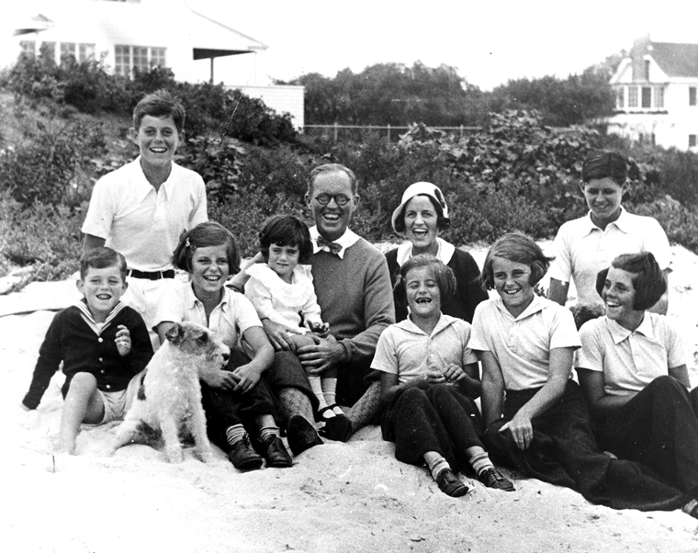
Rosemary Kennedy
By Photograph by Richard Sears in the John F. Kennedy Presidential Library and Museum, Boston. - http://www.jfklibrary.org/Asset-Viewer/Sll9S4XSqUObvY9XJNN1wQ.aspx, Public Domain, https://commons.wikimedia.org/w/index.php?curid=12806756
Notes:
and what most people didn’t know at the time was that this effort was personal. President Kennedy actually had a sister, Rosemary who had intellectual disabilities.

Slide 16
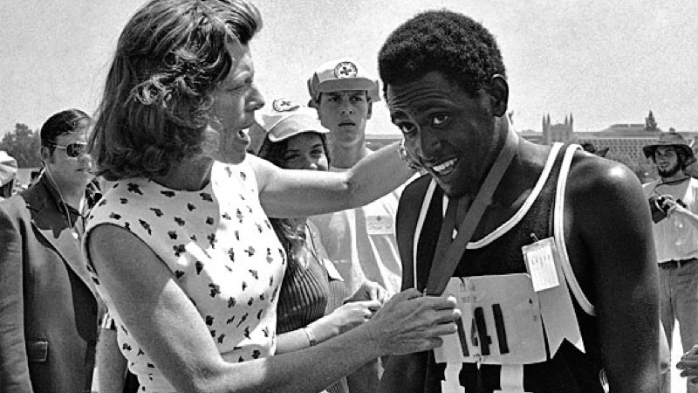
1968: Special Olympics
Eunice Kennedy Shriver and Special Olympics athlete. Retrieved From: https://www.specialolympics.org/our-work/50th/
Notes:
In the early 1960’s, President Kennedy’s sister, Eunice Kennedy Shriver, also created Special Olympics to raise public awareness about their competence on the sports field. But her ultimate purpose was bring people with intellectual disabilities out of the shadows.

Slide 17
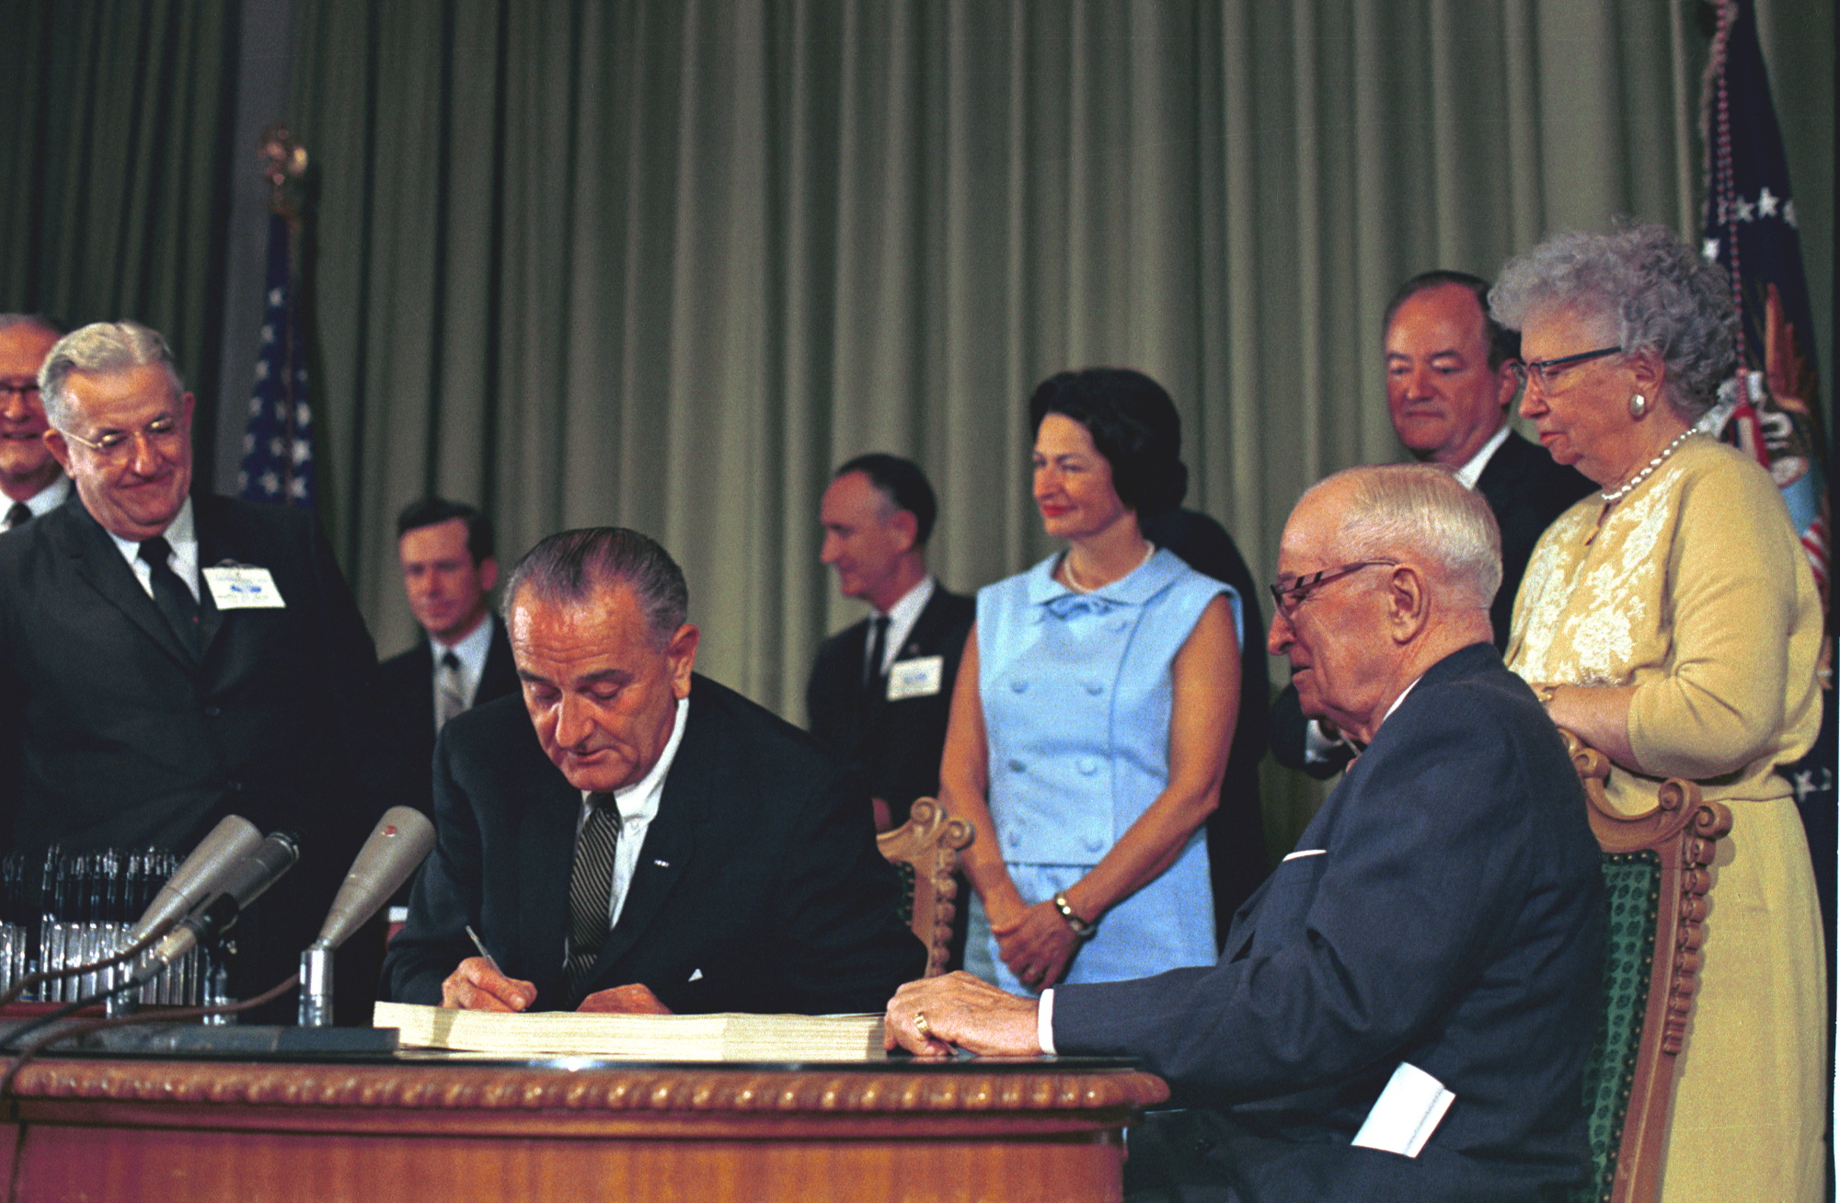
1965 Social Security Amendments: Lyndon Johnson
Lyndon Johnson signing the Social Security Act of 1965. Retrieved from: http://www.lbjlibrary.org/press/media-kit/medicare-and-medicaid
Notes:
Another key ​milestone toward improving healthcare was when President Lyndon Johnson signed the Social Security Amendments of 1965 to provide healthcare to people with disabilities and those who live in poverty through Medicaid.

Slide 18
Family Impact of Medicaid
Stephanie and Andy Meredith at Save Medicaid rally.
Notes:
Even now, my son has access to Medicaid as a secondary health insurance because of this law passed over a half a century ago.

Slide 19
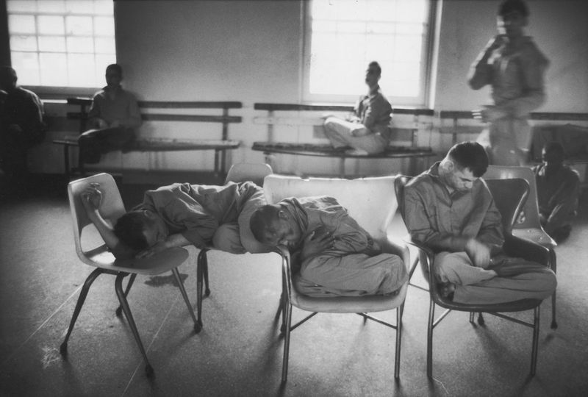
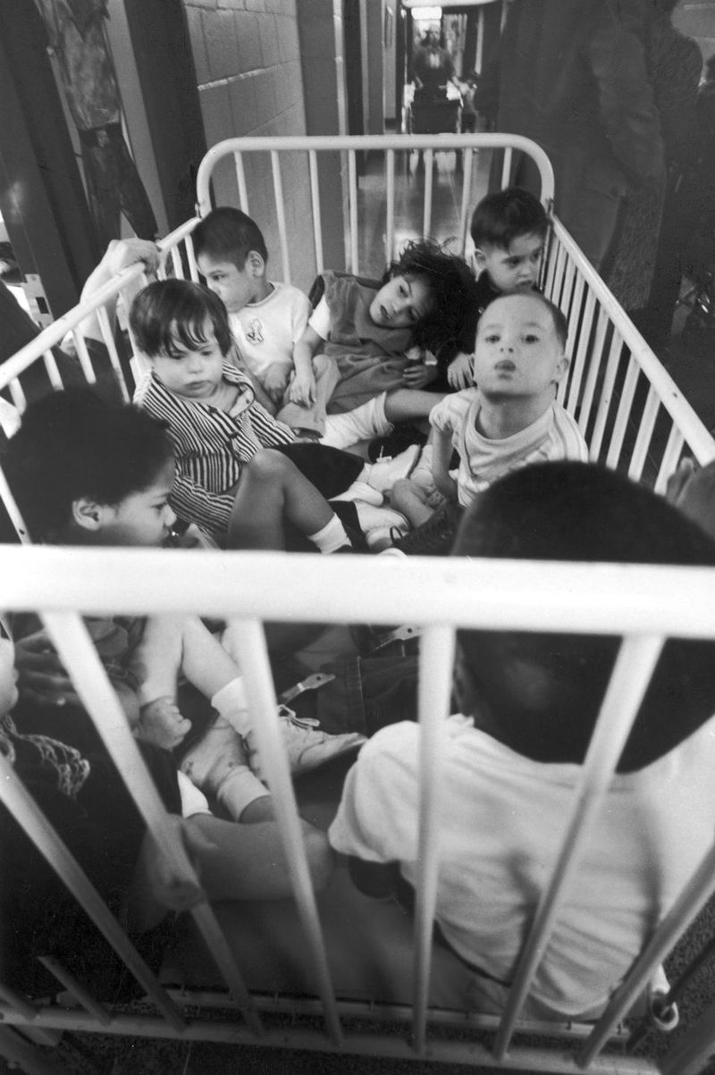
1960’s & 1970’s: Deinstitutionalization (Willowbrook Scandal)
A group of eight young patients sit, crammed into a crib, prior to receiving physical therapy at Willowbrook State School, Staten Island, New York, January 1972. (Bill Pierce/The LIFE Images Collection/Getty) Mentally handicapped patients sleep in chairs at Willowbrook State School, Staten Island, New York, January 1972. After the appalling conditions at the facility were made public, widespread outcry led to its closing. (Bill Pierce/The LIFE Images Collection/Getty)
Retrieved from: https://www.nydailynews.com/news/national/atrocities-consumed-halls-willowbrook-school-article-1.3030716
Notes:
Between 1965-1975, Senator Robert F. Kennedy and journalists exposed the rampant abuse and neglect at the institutions where most people with intellectual disabilities still lived. Kennedy called the institution he visited a “snake pit.” The institutions were found to be filthy, unsanitary, and medical experiments were performed on the residents without their consent.

Slide 20
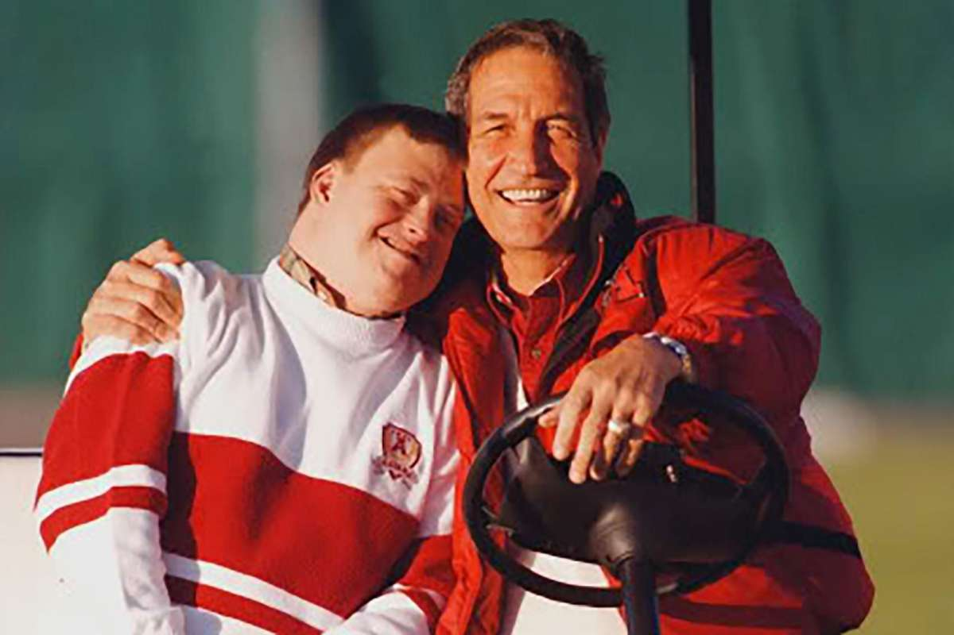
1960’s & 1970’s: Deinstitutionalization
Coach Gene Stallings and his son, Johnny.
https://www.al.com/living/2018/03/coach_gene_stallings_talks_abo.html [left]
https://www.houstonchronicle.com/life/article/Mack-Brown-Gene-Stallings-look-to-win-big-for-12811826.php#photo-15349933 [right]
Notes:
As these horrible conditions became more widely known, more parents started rejecting that model and saying no I’m going to raise this child at home. This was the movement toward deinstitutionalization in the 1960’s and 70’s.

Slide 21
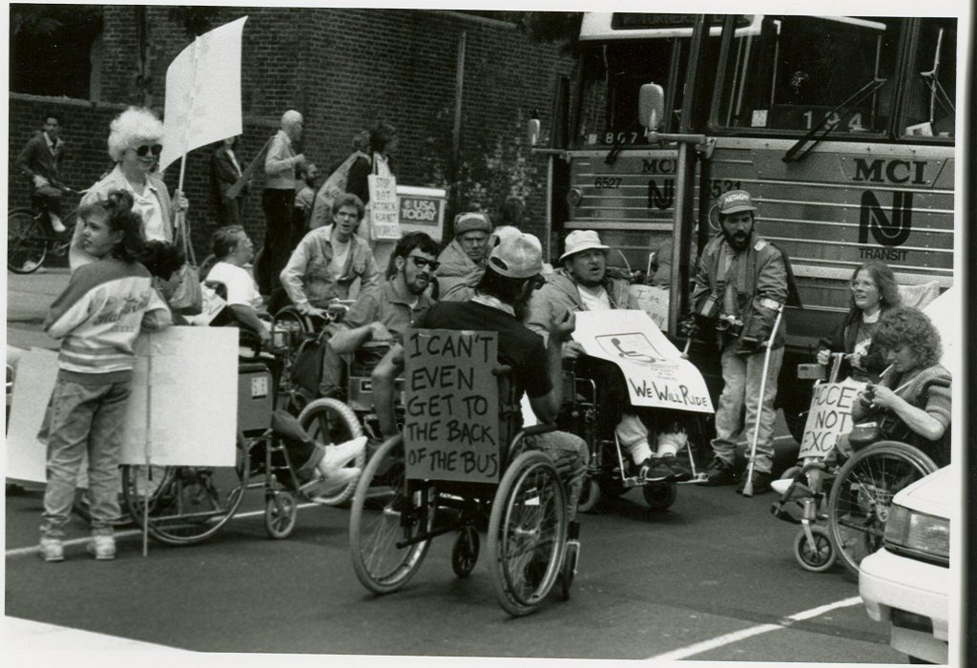
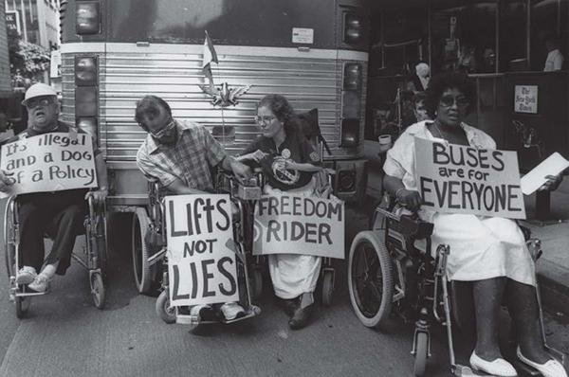
1960’s & 1970’s: Disability Rights Movement
Georgetown Law Library. Retrieved from https://guides.ll.georgetown.edu/c.php?g=592919&p=4186694
Notes:
In the 1960’s and 70’s, adults with disabilities also started using their own voices to advocate for better lives through the disability rights movement.

Slide 22
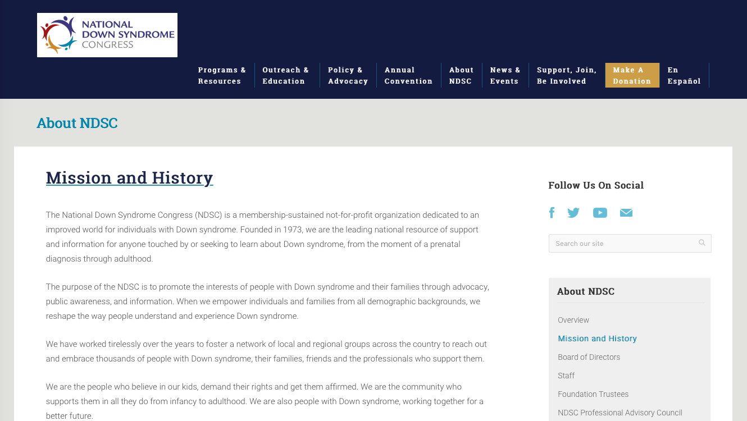
1970’s: National Down Syndrome Organizations
ndsc.org & ndss.org
Notes:
Parents who were raising their children at home also started to form condition-specific parent support groups. The National Down Syndrome Congress was formed in the mid 1970’s, and the National Down Syndrome Society was created shortly after that.

Slide 23
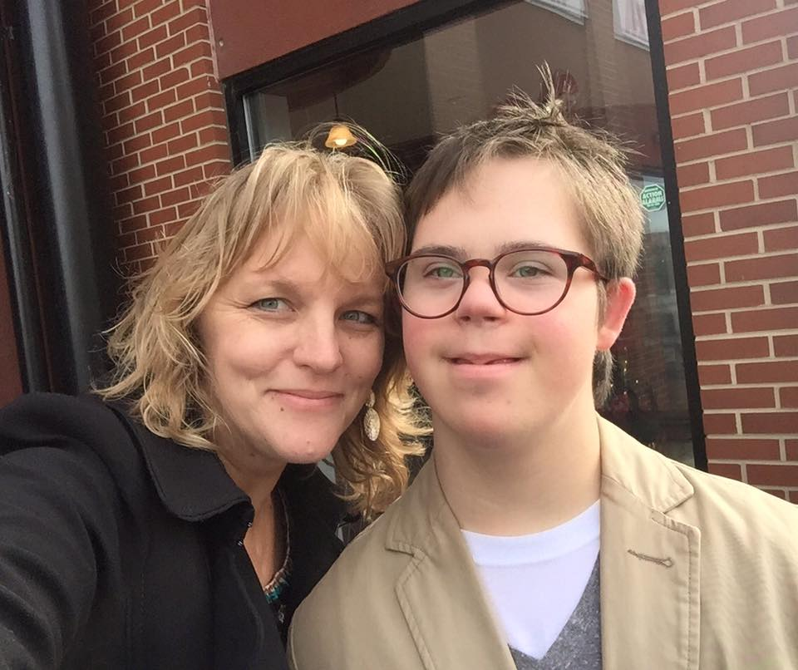
Family Impact of Local and National Down Syndrome Organizations
Andy Meredith and Amy Allison from the Down Syndrome Guild of Greater Kansas City
Notes:
After my son was born with Down syndrome, we were so comforted to be connected right away​ to the national and local Down syndrome organizations and meet parents who could tell us about the resources we needed.

Slide 24
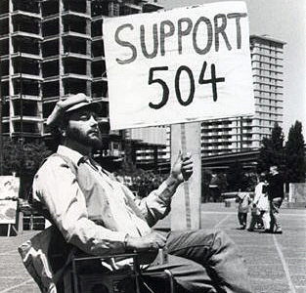
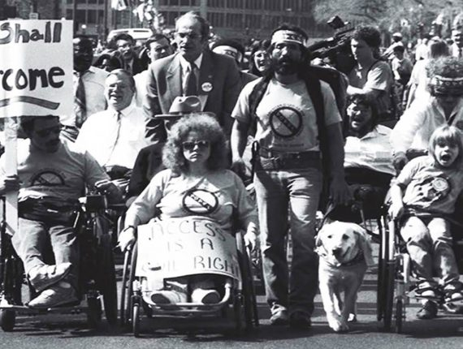
1973: Rehabilitation Act
Disability Rights Education & Defense Fund: https://dredf.org/dale-504/ [left]
Partners for Youth with Disabilities: https://www.pyd.org/history-timeline-1973/ [right]
Notes:
A key milestone driven by self advocates with disabilities in 1973 was the Rehabilitation Act which said that any entity receiving federal funding could not exclude people with disabilities. Makes sense right? This included after school funding, federal building access, schools, higher education, and public housing.

Slide 25
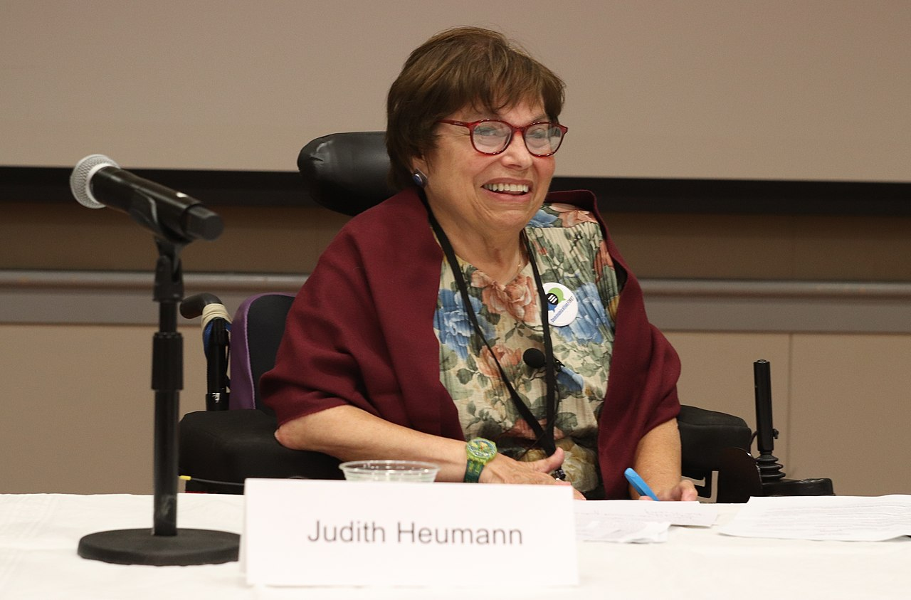
Judy Heumann
Retrieved from: https://commons.wikimedia.org/wiki/File:2019-Jul-25-TASH-OLDL-Judy-Heumann.jpg#filelinks
Notes:
However, people with disabilities like Judy Heumann ended up having to hold a protest in a federal building to finally get the law enacted four years later. If you ever get a chance, the drunk history version of this story is really entertaining and educational.​

Slide 26
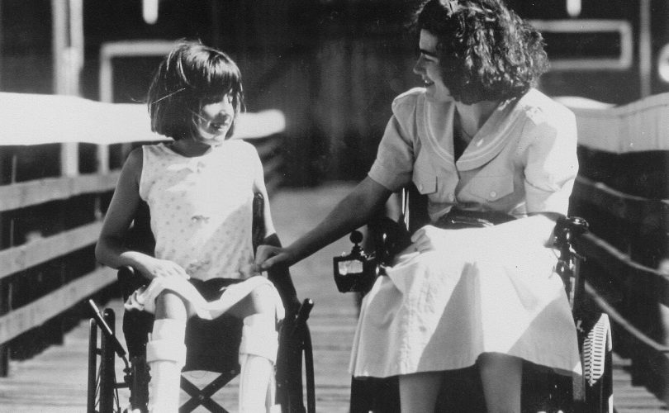
1975: Individuals with Disabilities Education Act
Retrieved from: https://www.pyd.org/announcement/individuals-with-disabilities-education-act/
Notes:
As parents began raising their children at home, they realized that their kids needed to go to school like everyone else and they started advocating for laws to help their kids. The Individuals with Disabilities Education Act gave children with disabilities the right to attend school in 1975. Before that—1 million children had no access to school, and 3.5 million warehoused​.

Slide 27
Family Impact of IDEA
Notes:
It’s hard to believe that just one year before I was born, my son would have had no right to attend a public school.

Slide 28
1981: Katie Beckett Medicaid Waiver Program
President Ronald Reagan meets Katie Beckett, along with her parents, Julia and Mark Beckett as the President exits Air Force One on the tarmac of Cedar Rapids Municipal Airport, Iowa, 20 September 1984. Photograph by official White House photographer Michael Evans, courtesy of the Ronald Reagan Presidential Library. Retrieved from: https://www.reaganlibrary.archives.gov/archives/audiovisual/contactsheets/C24412.jpg,
Notes:
Parents also realized their children needed better access to healthcare and therapies often not covered by regular health insurance. The Medicaid Waiver program was established in 1981 after President Reagan heard the story of Katie Beckett, a little girl with disabilities and medical needs whose parents wanted to care for her at home instead of putting her in an institution, but they couldn’t afford the medical care on their own. President Reagan’s administration created the Medicaid waiver to give kids with disabilities access to Medicaid regardless of parent income in cases where staying at home would cost less than or the same as treatment in an institution. This why our stories matter.

Slide 29
Family Impact of Katie Beckett Medicaid Waiver Program
Andy riding his bike with friends.
Notes:
Because of the Katie Beckett waiver, my son Andy was able to get speech and physical therapy to help him start speaking in sentences and to ride a bike. The life expectancy for people with Down syndrome has also almost doubled since the 80’s​ thanks to improved healthcare.

Slide 30
1980’s: Medicaid home and community based support waivers
Photo by Justin Meredith
Notes:
In the 1980’s, Medicaid also added other waivers to add home and community-based support so that funding started going toward individuals instead of institutions.​

Slide 31
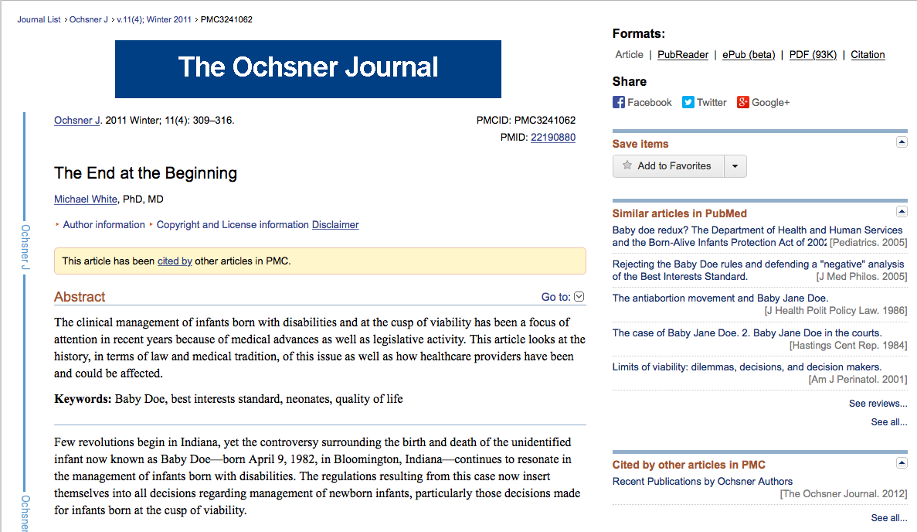
1982: Baby Doe Case
Article about Baby Doe in the Ochsner Journal: https://www.ncbi.nlm.nih.gov/pmc/articles/PMC3241062/
Notes:
The Baby Doe Amendment is the name of an amendment to the Child Abuse Law passed in 1984 in the United States. The law requires medical treatment for seriously ill or newborns with disabilities regardless of the wishes of the parents. This case was so shocking to me when I first read about it because it happened in my lifetime during a year I can remember. In the case of Baby Doe, an Indiana baby boy with Down syndrome was born in 1982 with a repairable trachea-esophogeal atresia​, but his parents were advised by the obstetrician to decline the surgery and let the baby die because the doctor explained that Baby Doe would have a non-existent quality of life because of mental retardation.

Slide 32
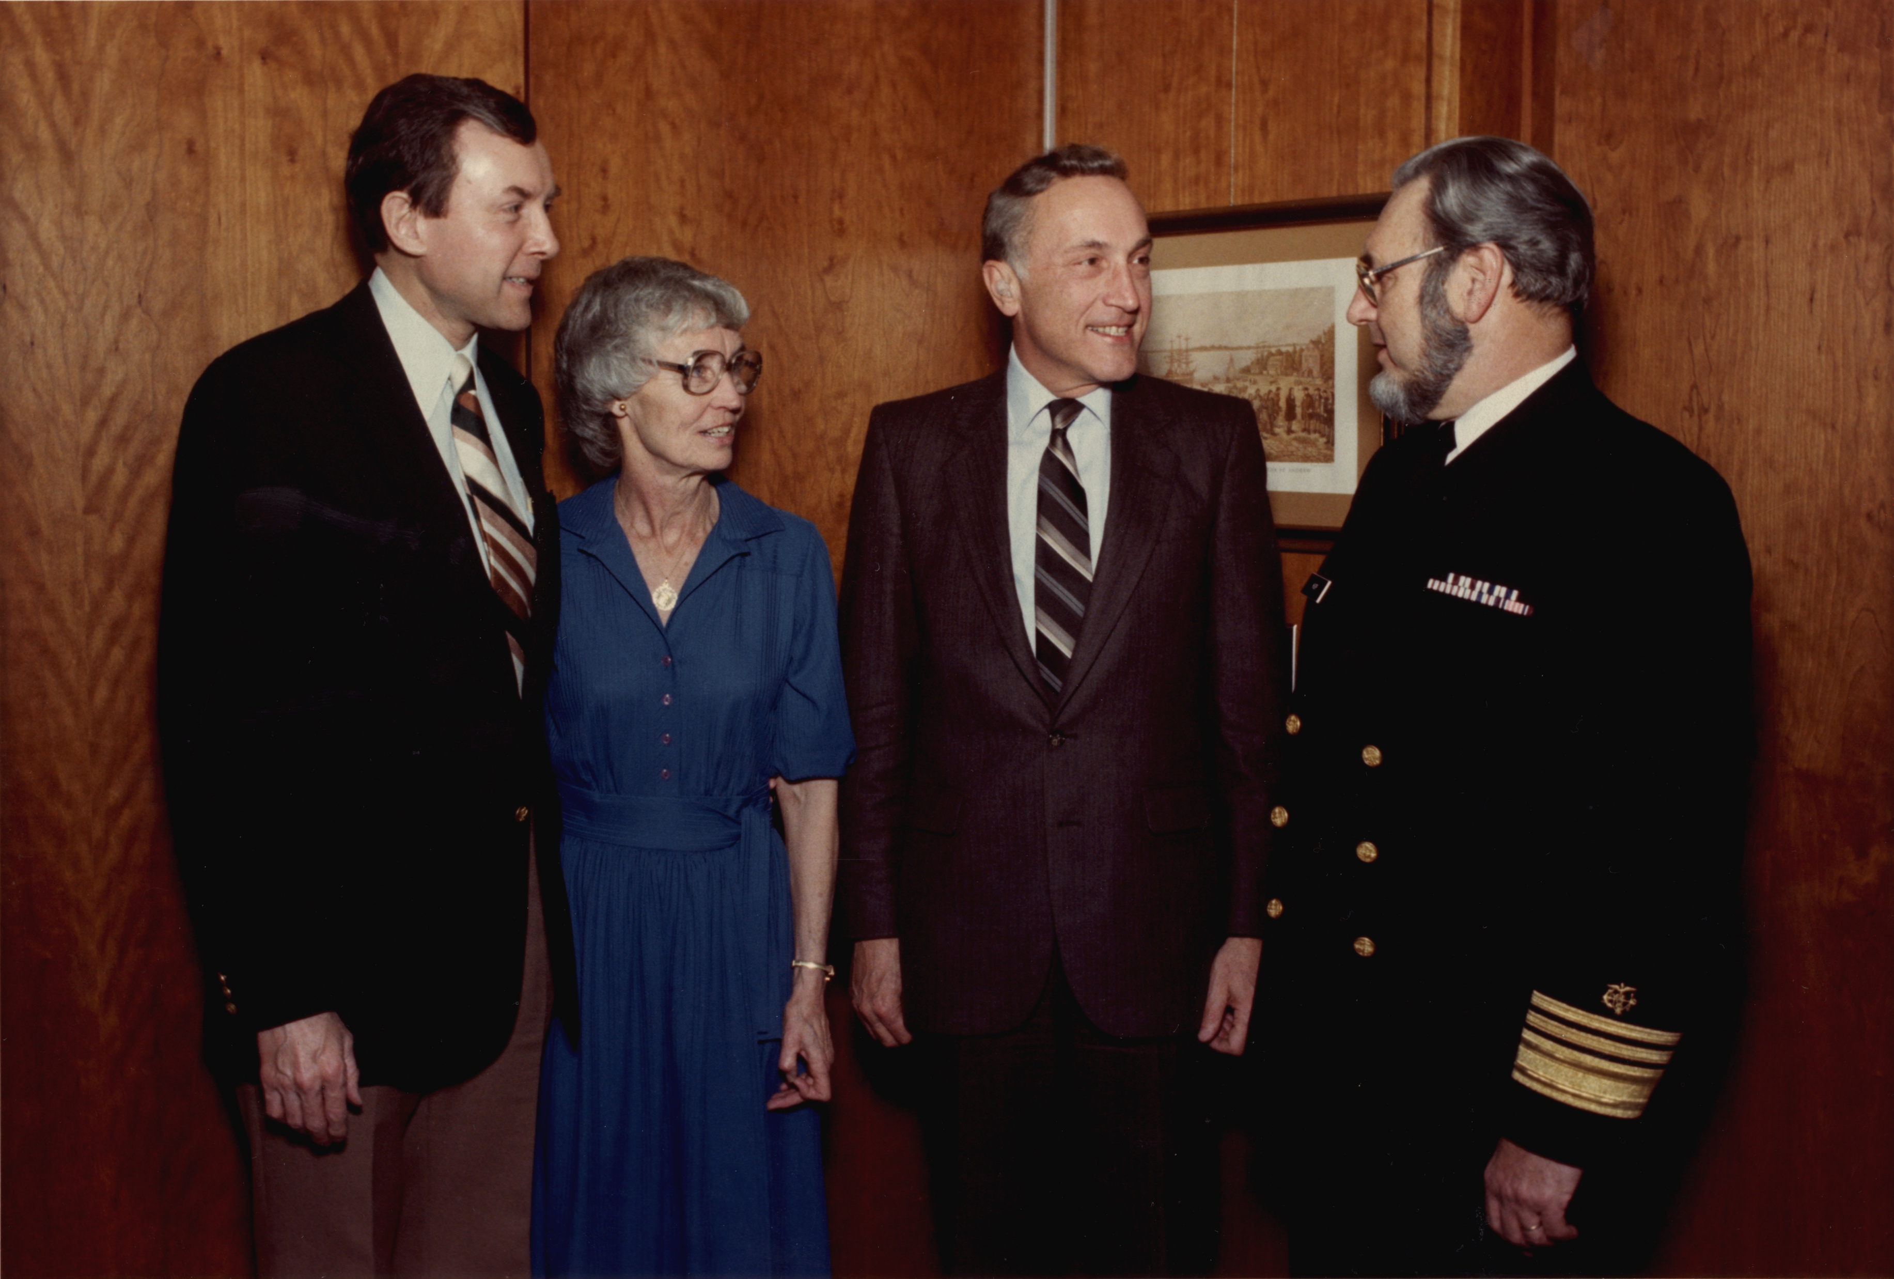
1982: Baby Doe Amendment
Tavan, Norman J.: United States Department of Health and Human Services [Public domain] https://upload.wikimedia.org/wikipedia/commons/5/55/C._Everett_Koop_on_the_day_of_his_confirmation_as_Surgeon_General_%28QQBBQB%29_noframe.jpg
Notes:
The hospital objected to this recommendation, but the parents followed the advice of their obstetrician. When the case was brought to Dr. C. Everett Coop who was the US Surgeon General at the time, he was so disturbed by the story that a child was denied basic medical care because of an intellectual disability that he recommended this change to the law.

Slide 33
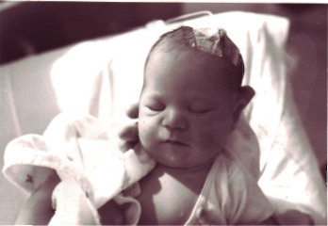
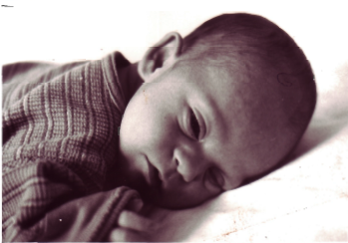
Family Impact of Baby Doe Amendment
Andy treated at the hospital as a newborn for enlarged liver, feeding issues, and low platelet count.
Notes:
By the time Andy was born in 2000 with an enlarged liver and low platelet count, there was never a question about whether he would receive the medical care he needed or not.​

Slide 34
1986: IDEA Part C Early Intervention
Photo by Justin Meredith
Notes:
IDEA Part C passed in 1986, and that’s when early intervention started so that kids birth to 3 with disabilities could have access to therapy to help meet their developmental milestones.

Slide 35
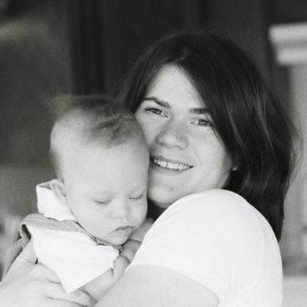
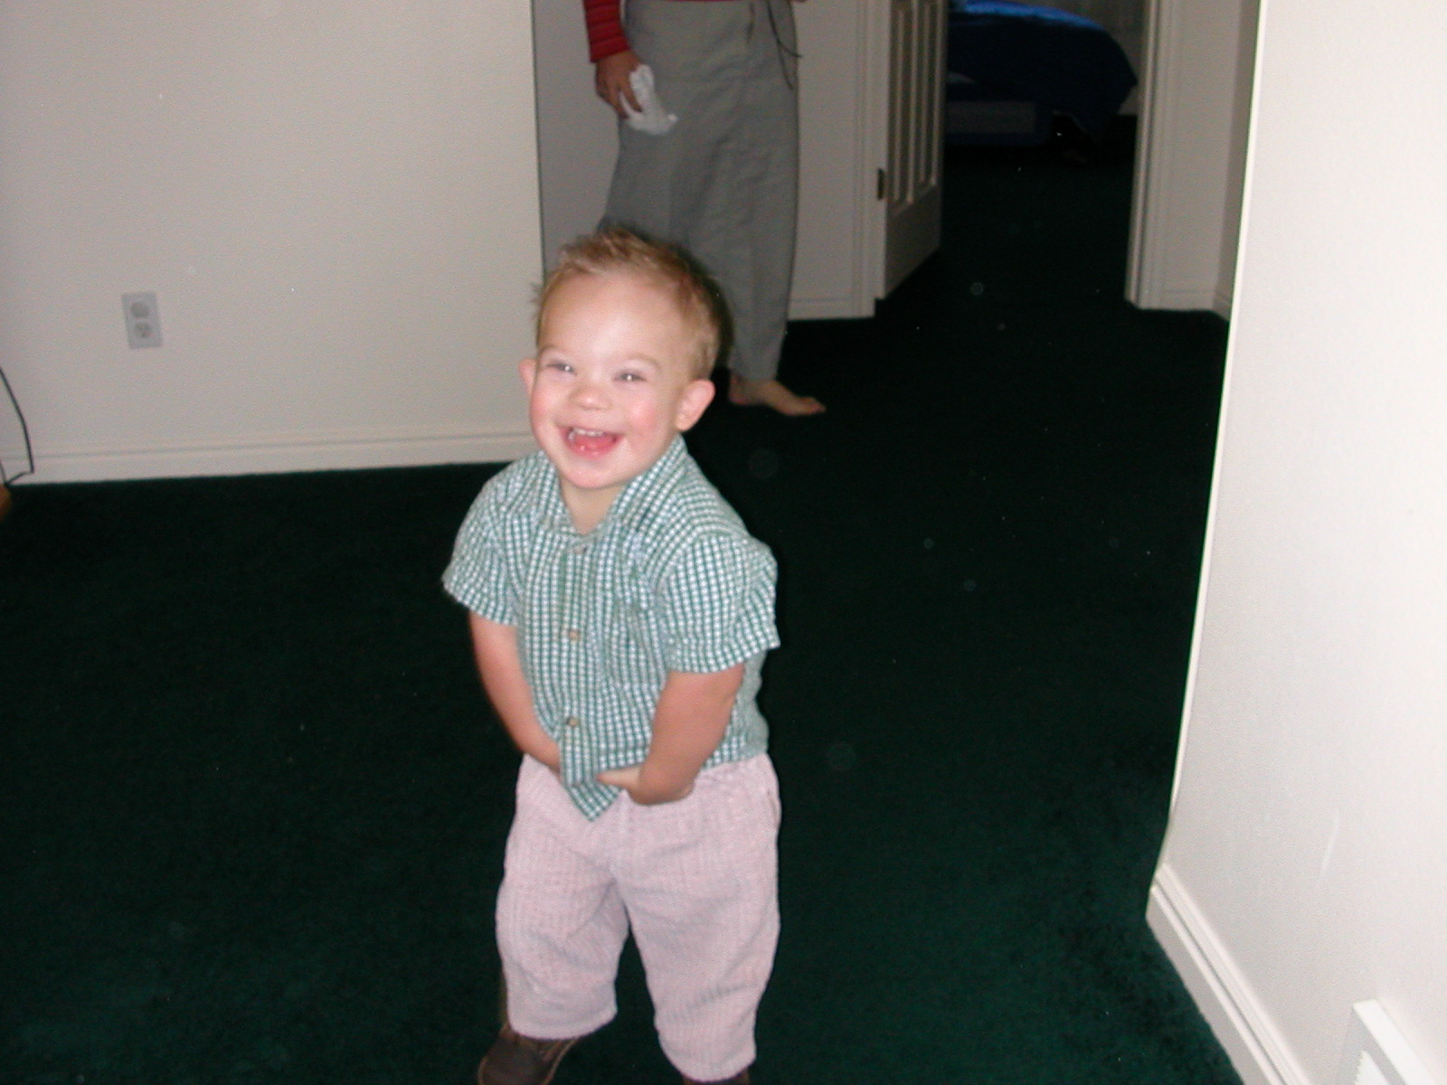
Family Impact of IDEA Part C Early Intervention
Andy learning to stand.
Notes:
I remember when Andy was born thinking that we would never be able to afford what he needed as 23-year-old parents but that we would sacrifice whatever was needed to help him thrive.

Slide 36
Family Impact of IDEA Part C Early Intervention
Andy signing with baby sister.
Notes:
It was such a relief when we found out that Early Intervention would be able to provide speech, fine motor, and physical therapy right away. This is how Andy learned to feed himself, take his first steps, and use sign language.​

Slide 37
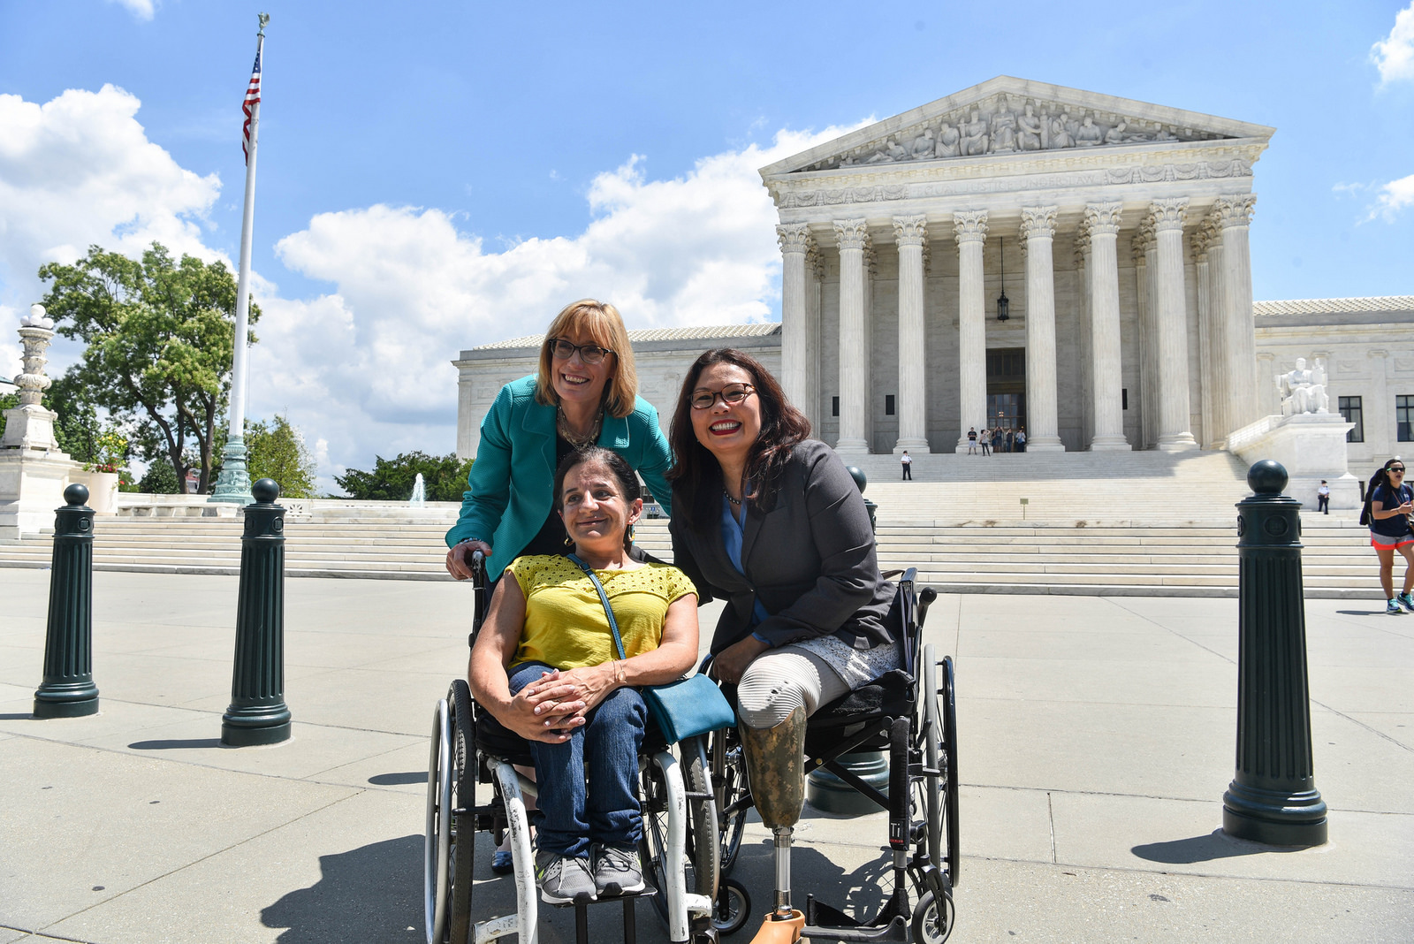
1990: American with Disabilities Act
ADA supporters crawling up the steps of the U.S. Capital building on March 12, 1900. Photo Credit: Tom Olin/Disability History Museum: https://mn.gov/mnddc/ada-legacy/ada-legacy-moment27.html
On the 27th anniversary of the Americans with Disabilities Act (July 26, 2017): https://www.hassan.senate.gov/news/photos/capitol-press-conferences
Notes:
Then, the American with Disabilities Act passed in 1990. The ADA is a civil rights law that prohibits discrimination against individuals with disabilities in all areas of public life—not just publicly funded resources. This includes jobs, schools, transportation, telecommunications, and all public and private places that are open to the general public. To get this law passed, disability rights advocates literally crawled up the stairs of the Capitol to demonstrate their point.

Slide 38
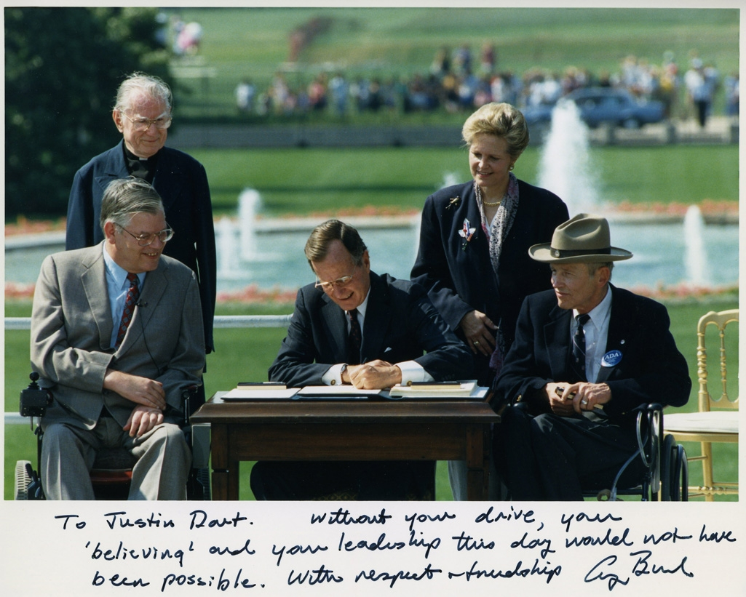
1990: American with Disabilities Act
Photo of President George H. W. Bush signing the Americans with Disabilities Act inscribed to Justin Dart, Jr., 1990. https://www.flickr.com/photos/nationalmuseumofamericanhistory/20825041956/
Notes:
It’s amazing to me that it wasn’t until my freshman year of high school that people with disabilities had a right to get into any public building where they might want to go.

Slide 39
Family Impact of ADA
Andy and friends texting each other
Notes:
Because of the ADA, Andy can make the type bigger on his iPhone and use voice commands to communicate with friends and get adaptive timing accommodations at work.​

Slide 40
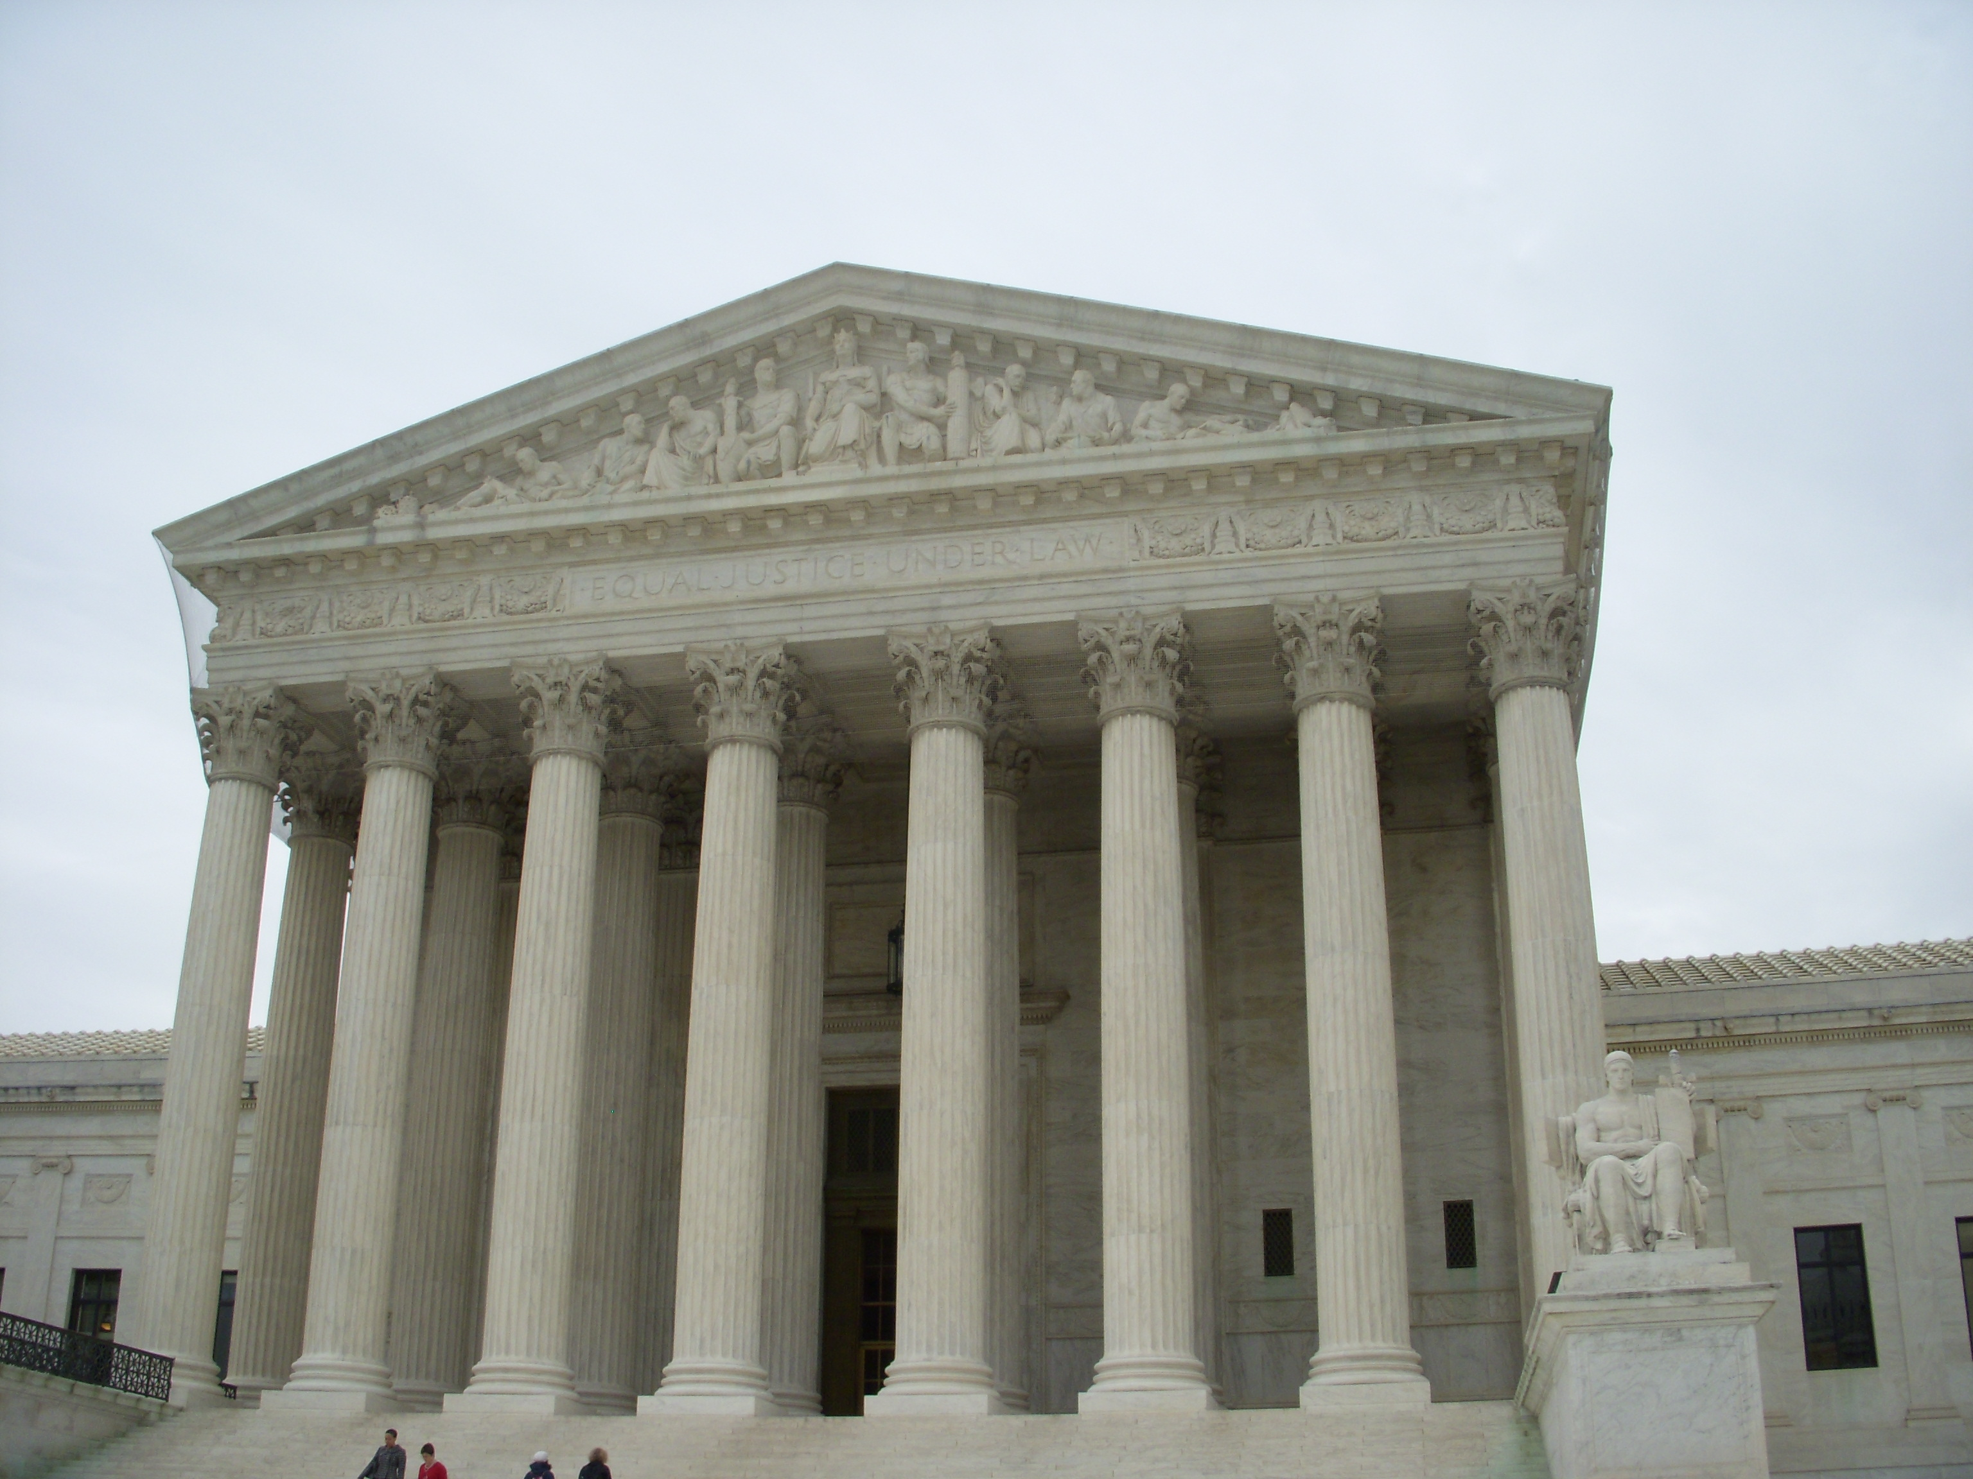
1999: Supreme Court Olmstead Decision
United States Supreme Court” https://upload.wikimedia.org/wikipedia/commons/9/94/Supreme_Court.jpg
Notes:
In 1999, the Supreme Court Olmstead decision ruled that if people with disabilities could live outside of an institution, they should be given that opportunity.

Slide 41
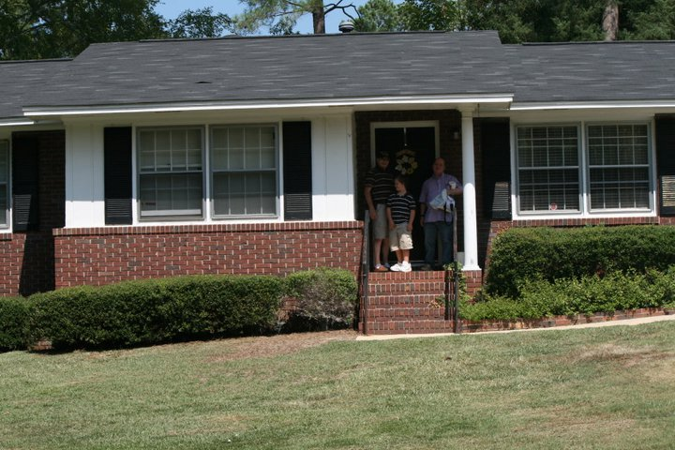
Family Impact of Olmstead Decision
The first day our family reconnected with my cousin, Keith.
Notes:
And because of this decision my dad’s cousin to move out of the institution in Milledgeville, GA. Now he lives in a group home in a community.

Slide 42
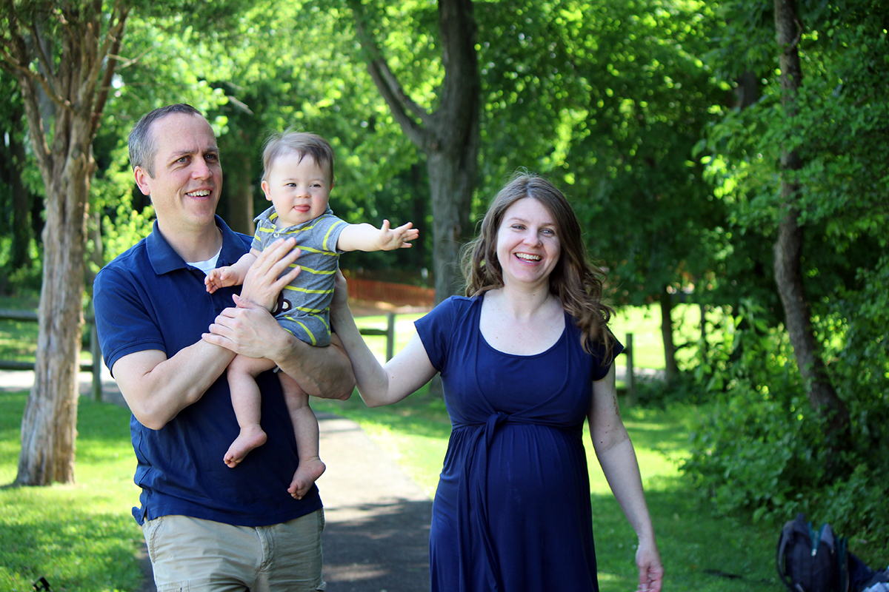
2008: Prenatally and Postnatally Diagnosed Awareness Act
Photo by Justin Meredith
Notes:
The US Congress unanimously passed the Prenatally and Postnatally Diagnosed Awareness Act in 2008 though it was never funded. There was no requirement as part of this law, but it was supposed to fund 5 million per year for 5 years to establish a clearinghouse of balanced and up-to-date information about genetic conditions.

Slide 43
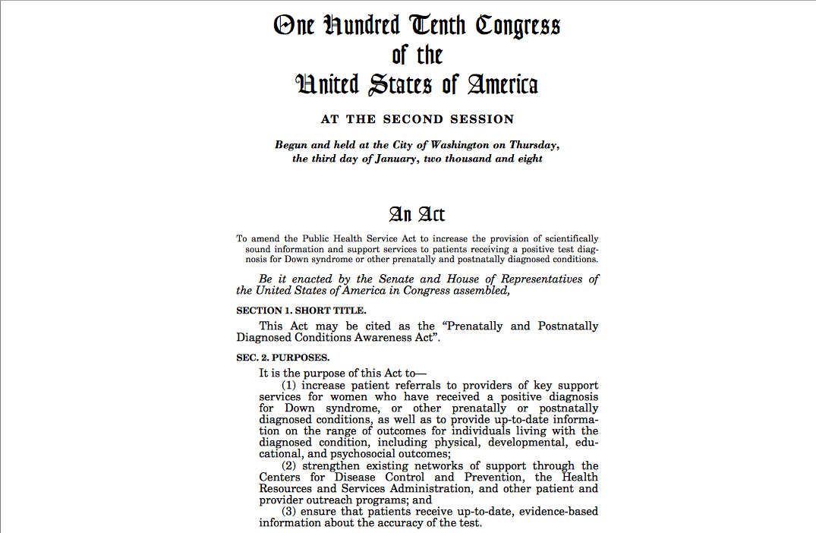
2008: Prenatally and Postnatally Diagnosed Awareness Act
https://www.govinfo.gov/content/pkg/BILLS-110s1810enr/pdf/BILLS-110s1810enr.pdf
Notes:
This is still a huge problem in my work because testing and screening have surged forward without the patient and provider education infrastructure to support it.

Slide 44
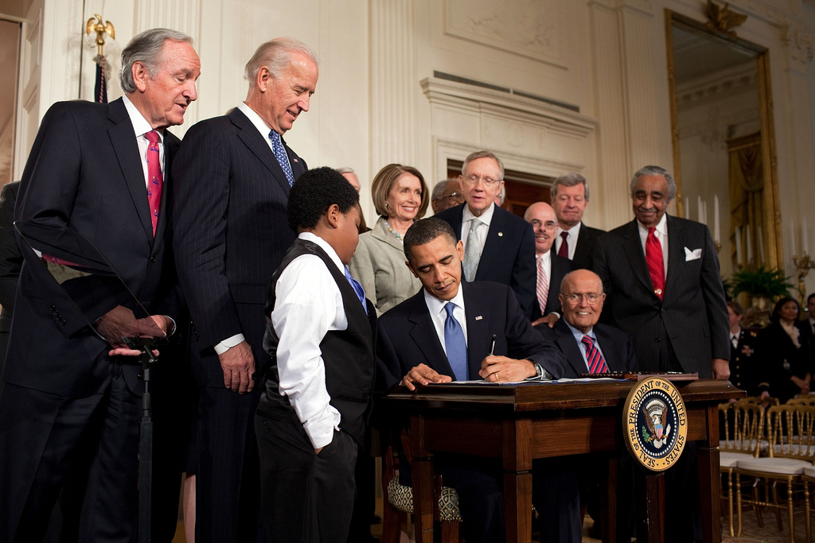
2012-2014: Affordable Care Act
President Barack Obama signing the Patient Protection and Affordable Care Act at the White House: https://commons.wikimedia.org/wiki/File:Obama_signs_health_care-20100323.jpg
Notes:
When the Affordable Care Act became fully functional in 2014, this was also a watershed moment for many people with disabilities because their conditions were by and large considered pre-existing conditions. Before that, we weren’t able to purchase a private health insurance policy at all for our son until 2014 when the Affordable Care Act went into effect. Before that, it was tremendously difficult for us when trying to get insurance as small business owners in a state where the Katie Beckett Medicaid waiver wasn’t funded sufficiently.

Slide 45
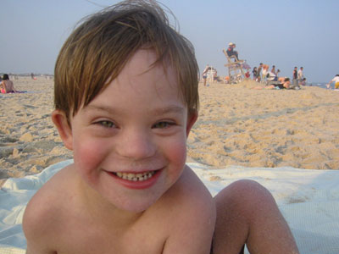
Family Impact Before Affordable Care Act
Before the Affordable Health Care Act, we had to move from Utah to New York in 2004 to get health insurance for Andy as self-employed parents.
Notes:
We actually ended up moving states where Medicaid was better funded when Andy was 4 years old. And one of the challenges with some of these laws is that they’re administered differently in different places.

Slide 46
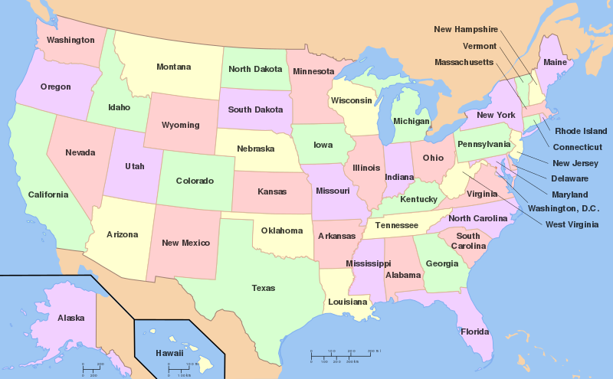
Resources Vary by State
(SVG map of the United States. Created by Wapcaplet. {{GFDL} }) [CC BY-SA 3.0 (http://creativecommons.org/licenses/by-sa/3.0/)]
Notes:
As a medical provider, it’s important for you to be aware that the implementation of these laws can vary significantly between different states, so you’ll want to find out where families can learn about the resources in your state.

Slide 47
2015: ABLE Act
By Kevin McCoy, CC BY-SA 2.0, https://commons.wikimedia.org/w/index.php?curid=106463
Notes:
In 2015, Congress passed the ABLE Act that allows families and individuals with disabilities to save more money without losing their public benefits. ​Before that, people with disabilities and their families couldn’t save more than $2,000 to help them without losing the benefits they need, like Medicaid. This meant that people with disabilities were often stuck in a cycle of poverty, particularly after the death of a parent.

Slide 48
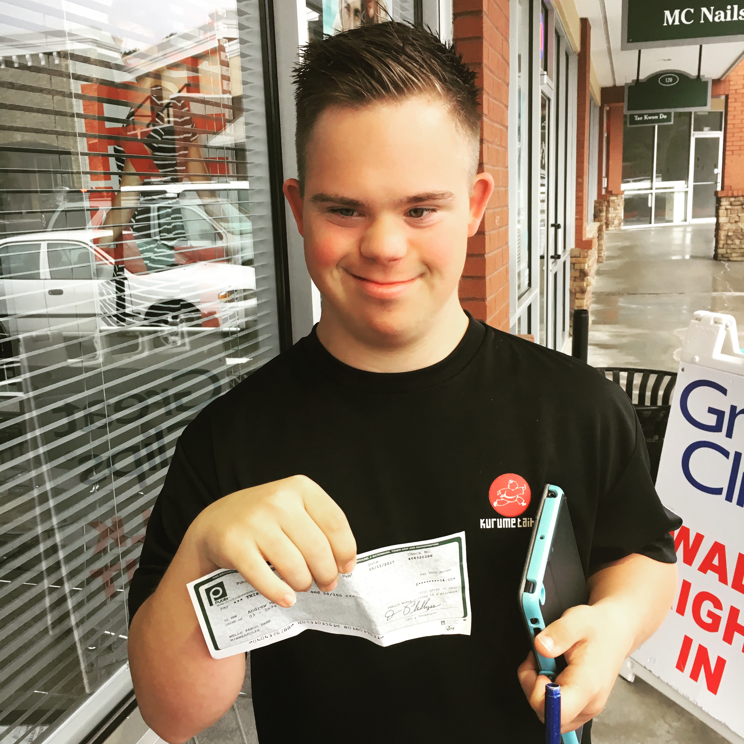
Saving Money
Andy’s first paycheck
Notes:
But now, we’ve been able to save over the past few years for Andy’s future, and he’s been able to save for himself.

Slide 49
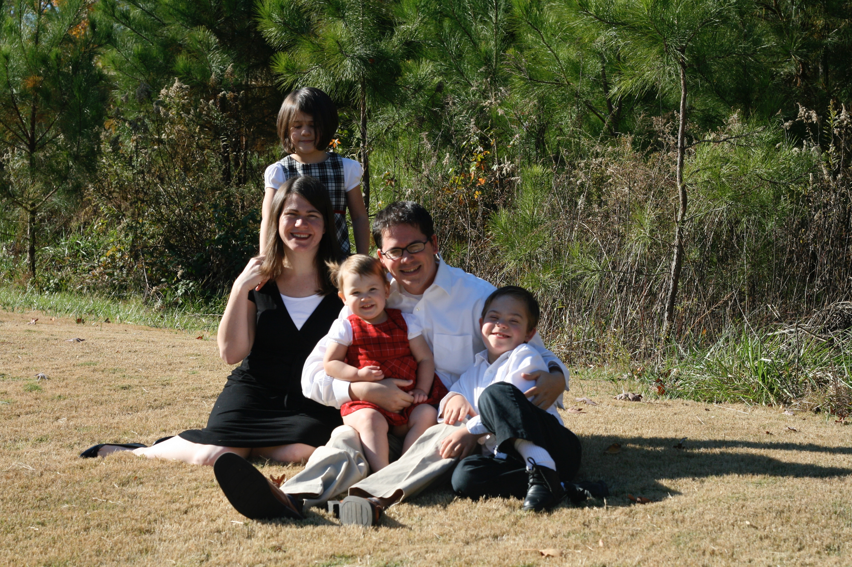
Impact of Disability Rights on Families
Meredith Family
Notes:
All of these historic developments have helped improve the lives of people with disabilities, and they happened because families started raising their children at home, people with disabilities started claiming their own voices, and families and self-advocates started sharing their stories.

Slide 50
Impact of Disability Rights on Outcomes
Andy Graduation
Notes:
This is how the outcomes for people with these conditions ended up improving dramatically.

